Slide 1
Caregiver Support Program Overview
Meghan Booth, LCSW
VISN 8 Caregiver Support Program Manager
Jon Pallone
VISN 8 Caregiver Support Program Specialist
Date: 10/04/2023
Informational Purposes Only
Notes:
~ Good Morning/Afternoon, it's a pleasure to be with you today to provide an overview of the Caregiver Support Program.

Slide 2
Overview
Introduction to VA Caregiver Support Program (CSP)
1 Program - 2 Components
Program of General Caregiver Support Services (PGCSS)
Program of Comprehensive Assistance for Family Caregivers (PCAFC)
Mission: Promoting the health and well-being of Veterans’ caregivers
Informational Purposes Only
Notes:
I will cover an introduction to the VA Caregiver Support Program. There are two unique components under the Caregiver Support Program, or CSP for short. We have the Program of General Caregiver Support Services or PGCSS and the Program of Comprehensive Assistance for Family Caregivers which we refer to as PCAFC.
The two CSP components, programs if you will, are administered under the Veterans Health Administration.
Our Mission: Promoting the health and wellbeing of Veterans’ caregivers

Slide 3
Where we Started, Where we are Headed…..
2008 – Caregiver Support Program established
2010 – Program of Comprehensive Assistance for Family Caregivers (PCAFC) and Program of General Caregiver Support Services (PGCSS) established under P.L. 111-163
2011 – Program officially accepts applications for PCAFC
2018 – MISSION Act of 2018 expands Veteran eligibility for PCAFC
2020 – Implement expansion of PCAFC eligibility (On or before May 7, 1975, on or after September 11, 2001)
2022 – Second Expansion – PCAFC – All Eras
Informational Purposes Only
Notes:
In late 2007, As military operations in Afghanistan and Iraq progressed, the provision of services and supports to family caregivers of Veterans seriously injured in these conflicts moved to the forefront.
With the conflicts in Iraq and Afghanistan, new challenges presented themselves to our service members returning from combat with serious injuries that may have been fatal in previous conflicts. These service members required personal care services, which are often provided by family members and loved ones. In recognition of this significant challenge, in 2010, Congress enacted the Caregivers and Veterans Omnibus Health Services Acts of 2010 or PL 111-163. which required VA to establish specific supports for caregivers of veterans. Two programs were established, the Program of General Caregiver Support Services and the Program of Comprehensive Assistance for Family Caregivers. Collectively we refer to these two programs as the Caregiver Support Program. PCAFC was established/created for Family Caregivers of eligible Veterans who had a serious injury incurred or aggravated in the line of duty.
12 Years ago, the program began officially accepting applications for PCAFC.
2018 – In 2018, the VA MISSION Act required VA to expanded eligibility for the family caregivers' program to caregivers of Veterans of all eras in a phased approach, establish new benefits for designated Primary Family Caregivers and other changes that affected program eligibility and VA’s evaluation of PCAFC applications.
The expansion was implemented in two phases. Veterans who were seriously injured in the line of duty before May 7, 1975, became eligible as of October 1, 2020. As of October 1, 2022, Veterans of all service eras are eligible to apply.

Slide 4
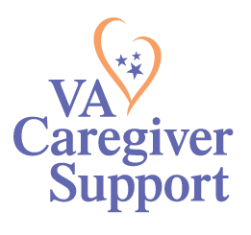
Program of General Caregiver Support Services
Program of General Caregiver Support Services (PGCSS)
Informational Purposes Only
Notes:
Now we’ll talk about the first component, the Program of General Caregiver Support Services, or PGCSS. The mission of PGCSS is to serve caregivers with respect and service excellence through a wide range of support, education and tools that empower them to care for themselves and the Veteran.

Slide 5
General Caregiver Definition
Caregivers who participate in PGCSS are called General Caregivers.
A General Caregiver is a person who provides personal care services to a Veteran enrolled in VA health care who:
Needs assistance with one or more activities of daily living; Or
Needs supervision or protection based on symptoms or residuals of neurological care or other impairment or injury.
General Caregivers do not need to be a relative or live with the Veteran.
Informational Purposes Only
Notes:
Caregivers who participate in PGCSS are called General Caregivers.
This is a person who provides personal care services to a Veteran enrolled in VA healthcare who either:
Needs assistance with one or more activities of daily living; Or
Needs supervision or protection based on symptoms or residuals of neurological care or other impairment or injury.
They do not need to be a relative or live with the Veteran.

Slide 6
PGCSS Four Core Elements
Education and Support
Collaboration and Partnerships
Outreach
Resources and Referrals
Informational Purposes Only
Notes:
Let me give you a bit more detail about PGCSS.
We recognized that it was important that across VA, all caregivers have access to the same resources and services no matter where their Veteran received care and thus, we established 4 core elements as you can see here. Education and Support, Collaboration and Partnerships, Outreach, and Resources and Referrals.

Slide 7
Enrollment into PGCSS
No formal application required to enroll in PGCSS
To enroll, Veterans/caregivers:
Contact local facility Caregiver Support Team
Complete intake with facility Caregiver Support Team
Veteran needs to agree to receive care from their caregiver
As the caregiver will be listed in their healthcare record
Enroll and begin to utilize supports and services offered
Informational Purposes Only
Notes:
Every VA Facility is staffed with a CSP Team. This team can help assist with determining the resources and services available for Veterans and their caregivers, with enrolling in CSP programs. There’s no formal application required to enroll in PGCSS. To enroll, complete the following steps: 1. Veterans and their caregiver(s) can reach out to the facility CSP Team or request a referral from the Veteran’s provider. 2. Then they will complete an intake with the facility CSP Team. The Veteran will need to agree to receive care from their caregiver, as the caregiver will be listed in their healthcare record. 3. They will be enrolled and begin to utilize the supports and services offered.
I will transition to our 2nd component which is our program of comprehensive assistance for family caregivers and will then circle back to share all the resources, education, and support available for all caregivers enrolled in either the general or comprehensive programs.

Slide 8
Program of Comprehensive Assistance For Family Caregivers
Program of Comprehensive Assistance for Family Caregivers (PCAFC)
Informational Purposes Only
Notes:
Our 2nd component is the Program of Comprehensive Assistance for Family Caregivers or PCAFC. It's an honor to care for those who provide care for our nation’s Veterans through both PGCSS and PCAFC.

Slide 9
PCAFC Services
Education and Training
Enhanced Respite Care
Mental Health Counseling
Beneficiary Travel (when travelling with Veteran for appointments)
Monthly Stipend (62.5% or 100% based on the level) – based on OPM General Schedule Grade 4, Step 1
Access to health care through Civilian Health and Medical Program of the Department of Veterans Affairs (CHAMPVA), if eligible
Financial planning and legal resources for Primary Family Caregivers.
Informational Purposes Only
Notes:
PCAFC offers the same education and training services to caregivers of Veterans, as PGCSS does and as I just stated, I will share those resources with a bit more detail soon.
In addition, PCAFC also provides a monthly stipend for the caregiver (if eligible), mental health counseling that does not have to be related to the care of the Veteran, enhanced respite care for not less than 30 days, beneficiary travel, access to CHAMP VA if eligible, and education and training.

Slide 10
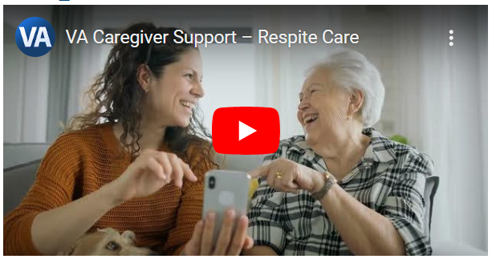
Respite Care
Respite can help to reduce caregiver burden, relieve stress, prevent burnout.
Respite is available to Family Caregivers enrolled in PCAFC.
Respite can be provided in the following venues:
Adult Day Health Care
Traditional Home Care (both skilled and non-skilled)
Nursing Home Care
Community Living Centers (CLC)
Community Nursing Homes (with VA contracts)
Informational Purposes Only
Notes:
Respite also promotes balance allowing caregivers to take a temporary break from their caregiving responsibilities.
Primary Family Caregivers may receive more than 30 days of respite annually if medically and clinically appropriate.
Respite may include 24-hour per day if medically appropriate for the Veteran.
And as you can see, Respite can be provided in a number of venues.

Slide 11
Mental Health Hubs
VA’s CSP is implementing Mental Health Hubs to meet the counseling needs of caregivers approved for PCAFC.
Their focus is on the unique mental health needs of caregivers, like the way VA specializes in the unique mental health needs of Veterans.
The first stage of program implementation began in September 2022
Currently active in VISNs 1, 4, 8, 15, 16, and 23
All VISNs are scheduled to have a Mental Health Hub at a future date.
Informational Purposes Only
Notes:
VA’s Caregiver Support Program (CSP) is implementing Mental Health Hubs (otherwise known as Clinical Resource Hubs (CRH)) to meet the mental health counseling needs of caregivers enrolled in CSP in partnership with VA’s Clinical Resource Hubs.
Their focus is on the unique mental health needs of caregivers, similar to the way VA specializes in the unique mental health needs of Veterans.
The first stage of program implementation began in September 2022 and they are currently active in VISNs 1, 4, 8, 15, 16, and 23
All VISNs are scheduled to have a Mental Health Hub at a future date.

Slide 12
Legal & Financial Services
Live Legal and Financial Planning services became available to Primary Family Caregivers on April 24, 2023. If a Primary Family Caregiver is seeking these services, they can contact their local CSP team for assistance. ​
​
*Web based service, such as live webinars and trainings, are coming soon.
Informational Purposes Only
Notes:
CSP now offers Primary Family Caregivers enrolled in the Program of Comprehensive Assistance for Family Caregivers (PCAFC) access to expert-led legal and financial planning services.
Through this contract, eligible participants (approved PCAFC Primary Family Caregivers in support of the Veterans they serve) are afforded access to licensed attorneys and certified financial counselors which are available to provide expert-led consultative financial planning and legal services relating to the needs of injured Veterans and their caregivers.
To complement the comprehensive support, Primary Family Caregivers can also benefit from the legal and financial web-based educational tools. These resources are designed to enhance the caregiving experience, equipping Primary Family Caregivers with valuable knowledge and skills.

Slide 13
PCAFC ELIGIBILITY CRITERIA
Eligibility Criteria
Caregiver
18 years of age
Son, Spouse, Daughter, etc.
Able to complete training
Able to carry out all requirements
Veteran: There are seven (7) total Veteran eligibility requirements for PCAFC.
Veteran has a serious injury incurred or aggravated in the line of duty. We define serious injury as a 70% service-connected rating. single or combined rating. It can include a presumptive rating.
The Veteran must need in-person personal care services for a minimum of six (6) continuous months based on any one of the following:
An inability to perform an activity of daily living;
A need for supervision or protection based on symptoms or residuals of neurological or other impairment or injury; or
A need for regular or extensive instruction or supervision without which the ability of the Veteran to function in daily life would be seriously impaired.
Informational Purposes Only
Notes:
Sharing the many resources available under the comprehensive assistance component I'm sure you're wondering, who's elgible...
As of October 1, 2022, all eligible Veterans from any era of service may apply for PCAFC.
PCAFC has specific eligibility requirements for Veterans and caregivers.
Caregiver:
Be at least 18 years of age.
Be either:
The eligible Veteran’s spouse, son, daughter, parent, stepfamily member, or extended family member;
Someone who lives with the eligible Veteran full-time or will do so if designated as a Family Caregiver.
Be initially assessed by VA as being able to complete caregiver education and training.
Complete caregiver training and demonstrate the ability to carry out the specific personal care services, core competencies, and additional care requirements.
In addition, there must be no determination by VA of abuse or neglect of the eligible Veteran by the caregiver.
There are seven (7) Veteran eligibility requirements for PCAFC. I highlight a few of those on the slide while directing you to the full list of eligibility criteria on our website that include.
The individual is either:
A Veteran; or
A member of the Armed Forces undergoing a medical discharge from the Armed Forces.
The individual has a serious injury (including serious illness) incurred or aggravated in the line of duty in the active military, naval, or air service.
For purposes of PCAFC, serious injury means any service-connected disability that:
Is rated at 70 percent or more by VA; or
Is combined with any other service-connected disability or disabilities, and a combined rating of 70 percent or more is assigned by VA.
The individual is in need of in-person personal care services for a minimum of six (6) continuous months based on any one of the following:
An inability to perform an activity of daily living;
A need for supervision or protection based on symptoms or residuals of neurological or other impairment or injury; or
A need for regular or extensive instruction or supervision without which the ability of the Veteran to function in daily life would be seriously impaired.
It is in the best interest of the individual to participate in the program.
Personal care services that would be provided by the Family Caregiver will not be simultaneously and regularly provided by or through another individual or entity.
The individual receives care at home or will do so if VA designates a Family Caregiver.
The individual receives ongoing care from a Primary Care Team or will do so if VA designates a Family Caregiver.
For more information about the eligibility requirements, please see the eligibility fact sheet on the caregiver support program’s website. www.caregiver.va.gov

Slide 14
PCAFC APPLICATIONS
PCAFC Application Process
Informational Purposes Only
Notes:
Now, let’s talk about how the application process works for PCAFC.

Slide 15
How To Apply
Veterans and Caregivers may apply for PCAFC in the following ways:
Complete the application online through: http://www.caregiver.va.gov
For most, this is the fastest and easiest route!
Access and download the application (VA Form 10-10CG). Mail to or walk the application into the local CSP Team.
Mail the form and any supporting documents to:
Program of Comprehensive Assistance for Family Caregivers
Health Eligibility Center
2957 Clairmont Road NE, Suite 200
Atlanta, GA 30329-1647
You may also contact your local CSP for assistance, Caregiver Support Team link via CSP Website.
Informational Purposes Only
Notes:
How does a Veteran and their caregiver initiate the PCAFC application process?
There are a few options:
-Complete the application online through: http://www.caregiver.va.gov.
-For most, this is the fastest and easiest route!
-Access and download the application (VA Form 10-10CG). Mail to or walk the application into the local CSP Team.
-Mail the form and any supporting documents to:
Program of Comprehensive Assistance for Family Caregiver
Health Eligibility Center
2957 Clairmont Road NE, Suite 200
Atlanta, GA 30329-1647
-Veterans/caregivers may also contact the local CSP team for assistance, Caregiver Support Team link via CSP Website.

Slide 16
Review and Appeal Options for PCAFC
Veterans and caregivers who disagree, in whole or in part, with a VA decision under the PCAFC, now have additional options available to appeal or request VHA review of the decision.
Informational Purposes Only
Notes:
Sometimes a Veteran and caregiver may disagree with the decision or determination.
If they disagree, in whole or in part, with a Department of VA decision under PCAFC, there are options for them to appeal or to request a Veterans Health Administration (VHA) review of the decision. Options depend on the date VA issued the PCAFC decision.
Previously, Veterans and caregivers could only appeal PCAFC decisions through the VHA Clinical Review Process (formerly known as the VHA Clinical Appeals Process).
Veterans and caregivers now have additional options available to appeal or request a VHA review of the decision.
For information and to initiate the Veterans Health Administration (VHA) Clinical Appeal Review process, the Veteran and caregiver should contact the Patient Advocate at their local VA medical facility.
To find your local VA medical center, you can use the VA Locator for your local VA medical center.
Caregivers receive a letter explaining their options.

Slide 17
Additional Review and Appeal Options for pcafc
Frequently Asked Questions (CSP Website):
Changes to Review and Appeal Options for Program of Comprehensive Assistance for Family Caregivers (PCAFC) Decisions (va.gov)
Review and Appeal Options: VA Form 10-305
Informational Purposes Only
Notes:
There’s a informative Frequently Asked Questions document on the CSP Website:
Changes to Review and Appeal Options for Program of Comprehensive Assistance for Family Caregivers (PCAFC) Decisions (va.gov)
The VA Form 10-305 spells out Review and Appeal options very well and includes links.
INTERNAL TO VA: TMS Modules:
Program of Comprehensive Assistance for Family Caregivers (PCAFC) Decision Review and Appeal Options – TMS ID 131003343

Slide 18
PCAFC Decision Review and Appeal Options
For decisions issued before Feb 19, 2019
Follow the Legacy Appeals Process
For decisions issued on of after Feb. 19, 2019
Follow the Appeals Modernization Act (AMA) Process
Feb 19, 2019
Legacy Appeals Process
Veterans and caregivers must submit a Notice of Disagreement (NOD). Designated individuals will review the NOD and if unable to grant the matter in which the individual disagrees, a Statement of the Case (SOC) will be issued with an explanation.
Appeals Modernization Act (AMA) Process
Veterans and caregivers may only pursue one of the following options at a time. If one of these options is selected, the decision must be received, or the claim withdrawn before another option is pursued. Board decisions are final.
Submit Notice of Disagreement (NOD)
VA Form 10-307 or written notice of disagreement.
Supplemental Claim
File using VA Form 20-0995.
Higher-Level
Review
File using VA Form 20-0996.
Board of Veterans' Appeals
File using VA Form 10182.
Statement of the Case (SOC)
If Veteran and caregiver disagree with the SOC, they can file an appeal to the Board of Veterans' Appeals (Board) using VA Form 9 or elect to enter the AMA process. Individuals cannot enter the AMA process after the Board renders a decision. Board decisions are final.
VHA Clinical Review Process
If Veterans or caregivers have not exhausted the clinical review process for their Legacy or AMA decision, they can file a written request for a clinical review with the Patient Advocate at their local VAMC. However, it is important to note that a request for clinical review can only be done “in tandem” with the review options of Supplemental Claim or Higher-Level Reviews.
Clinical reviews cannot be done in tandem with any type of Board Appeal (Legacy or AMA).

Slide 19
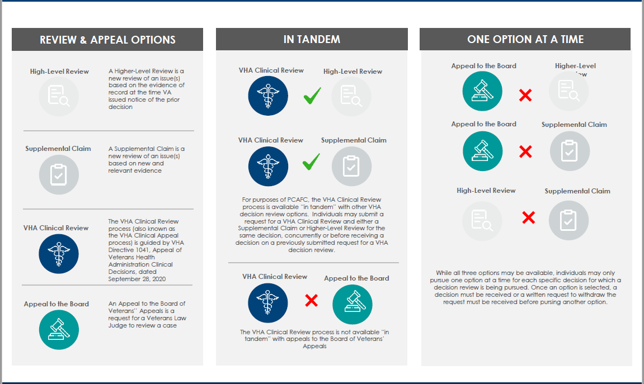
Appeals Visualization Tool

Slide 20
Types of VHA Decision Reviews for PCAFC Decisions
There are several types of VHA Claims and Appeals handled by CSP for PCAFC Decisions:
Supplemental Claims using VA Form 20-0995 (for decisions issued on or after February 19, 2019)
Higher-Level Reviews using VA Form 20-0996 (for decisions issued on or after February 19, 2019)
Legacy NODs using VA Form 10-307 (for decisions issued before February 19, 2019)
This is the start of the Legacy Appeals Process. This form comes to CSP not the Board.
VHA Clinical Reviews (also knowns as VHA Clinical Appeals)

Slide 21
Program of Comprehensive Assistance for Family Caregivers (PCFAC):
Decision Review Options and Contact Information
Board of Veterans Appeals (BVA)
CSP Review and Appeals Team
Centralized Eligibility and Appeals Team (CEAT)
VA Form 10182
VA Form 9
Remands from Board Appeals
VA Form 20-0995 Supplemental Claim
VA Form 20-0996 Higher-Level Review
VA Form 10-307 Form 9
VHA Clinical Review (aka VHA Clinical Appeal)
For questions about the status of a Board Appeal, contact:
The BVA Call Center at
1(800)827-1000
For questions about the status of a review or appeal request or Board remand, contact:
The Caregiver Support Line (CSL) at 1(855)260-3274
For questions about the status of VHA clinical review, contact:
Local CSP Staff or Patient Advocate

Slide 22
Resources and Referrals – For All
Support from CSP Team members for referrals to programs and services:
Other VA (i. e. Whole Health, Mental Health, and many others)
Community organizations and partnerships
Informational Purposes Only
Notes:
As we wrapped up PCAFC specifically over the past few slides, the following resources, education, and services are available for all caregivers enrolled in either component, the General or Comprehensive.
Resources and Referrals - Our teams help caregivers get connected to the right services and support, whether that be at VA or in the community. We want to be sure that caregivers and families have awareness and connection to the resources available that best meet their specific needs.
CSP staff work first-hand with caregivers to connect them with CSP, VA, community and partner resources.
We have strong relationships with our VA and non-VA partners, to help caregivers address any number of issues or needs they may have.

Slide 23
Education and Support – For all
VA S.A.V.E
Skills Training
Veterans Affairs (VA) S.A.V.E. Training
Building Better Caregivers (BBC)
Mobile Support
Annie Caregiver Text Program
One on One Coaching
Resources for Enhancing All Caregivers Health
(REACH) VA
Caregiver Health and Well-Being Coaching
S.A.V.E. Suicide Prevention Skills Training
Signs
Ask
Validate
Encourage & Expedite
Suicide Prevention Toolkit for Caregivers
Informational Purposes Only
Notes:
Training and support is offered through many different opportunities via in person, online, and telehealth sessions. This is based on the needs of the caregiver.
Some caregivers may wish to have weekly check-ins over 6 weeks whereas others may want a monthly support call ongoing. We also provide support groups – Many sites offer topic specific support groups, targeted at bringing together caregivers facing similar circumstances or caring for someone with a specific diagnosis. These can be offered in several modalities, via video telehealth or phone as well as in person, when feasible.
A few of our education and support options examples include:
-VA S.A.V.E is a suicide prevention training that equips caregivers to demonstrate care, support and compassion when talking with their Veteran who could be at risk for suicide. It offers important information as well as simple steps and actions caregivers can take.
-Building Better Caregivers is an online workshop with 6 weekly self-paced lessons, facilitator guidance, and group support for caregivers of Veterans with dementia, memory problems, post-traumatic stress disorder, or a serious brain injury.
-Annie Caregiver Text Program, which promotes self-care for both Veterans and their caregivers. Annie can help manage stress and support self-care by sending three text messages a week, with a focus on education, motivation, and activities to manage stress.
-REACH VA Caregiver Program, which provides caregivers with problem-solving skills, stress management techniques, and specific information on disease-related concerns that are customized for each caregiver.

Slide 24
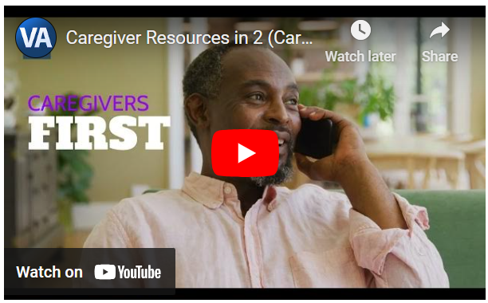
Education and Support – for all – continued
Group Support and Coaching Services Provided Through PGCSS
Caregiver Self-Resilience Courses
Caregivers FIRST
Resources for Enhancing All Caregivers Health (REACH VA)
Peer Support Mentoring Program
Informational Purposes Only
Notes:
Yes, there's more...
Caregiver Self- Resilience : is part of a wellness series for CG.. Resilience covers 3 topics ( 1 hour each ) on self-discovery, self-compassion, and on the job – self care for the caregiver. Self care, Qigong and Mindfulness are also part of the Wellness series.
Caregivers FIRST is a caregiver skills group training program with the goal of connecting caregivers with each other and to resources to help them feel more confident, capable, and supported in their caregiving role.
Resources for enhancing All Caregivers Health- REACH VA
provides caregivers with problem-solving skills, stress management techniques, and specific information on disease-related concerns that are customized for each caregiver either individually or in a group/telephone setting.
Peer Support Mentoring Program links caregivers to a peer who has experienced similar challenges and situations in order to provide additional support and guidance along the caregiving journey.

Slide 25
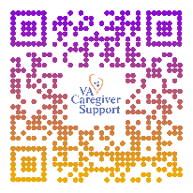
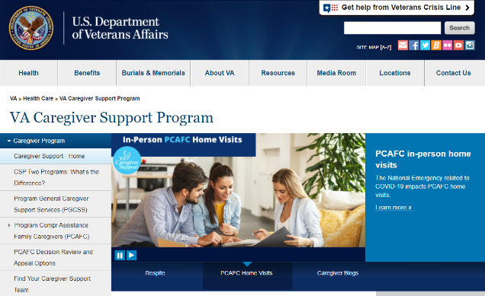
Information at your fingertips
CSP Website: www.caregiver.va.gov
Program information
Zip code based interactive CSP Team/Coordinator locator
Contact info for Caregiver Support Line (CSL)
Resources for Caregiver
Tips and Tools, Resources by Topics, Self-Care
PCAFC online application link
CSP QR Code
CSP Listserv: GovDelivery
Program information/updates
New initiatives, resources, services
370,000 (+) subscribers and counting
Informational Purposes Only
Notes:
We've covered a lot but, you didn't need to memorize all of it. Nearly everything we've talked about today is available to you and the rest of the nation through our website.
So, as we wrap up today, I want to share how to find us and learn more about our many amazing resources. This information is available at the fingertips of anyone interested in learning about CSP.
The national CSP website provides information including:
Program information
Zip code based interactive CSP Team locator
Contact info for CSL
Resources for Caregiver (Tips and Tools, Resources by Topics, Self Care)
PCAFC online application link
Diagnosis and tip sheets
Caregiver stories
As well as information about national calls, important updates and alerts and much more.
Gov Delivery, also know that our listserv has one of the largest number of subscribers of any VA program office.

Slide 26
Caregiver Support Line (CSL) - for All
The VA CSL responds to calls from caregivers, Veterans and community agencies seeking information about VA caregiver services.
Monday - Friday 8:00AM - 10:00PM (ET) and Saturday 8:00AM - 5:00PM (ET)
Staffed by VA professionals
Links callers to their local Caregiver Support Team
Provides information about assistance through the VA
Offers supportive counseling when needed
1-855-260-3274
Informational Purposes Only
Notes:
And finally, but certainly most important:
The Caregiver Support Line is a toll-free number for caregivers, family members, friends, Veterans, and community partners to contact for information related to caregiving and available supports and services.
The CSL is available Monday-Friday 8:00 am-10:00 pm ET and on Saturday from 8:00 am – 5:00 pm.
The CSL is staffed by VA professional staff.
Information on caregiver support services, counseling, and educational services can be provided as well as referrals to
local Caregiver Support Program (CSP).

Slide 27
Thank you!
National Caregiver Support Line: 1-855-260-3274
To find your local Caregiver Support Program Team,
or for more information, please visit: www.caregiver.va.gov
Informational Purposes Only
Notes:
And that brings me to the end of my presentation. I hope this has been helpful for you. Please visit our website often as we update it and share new information regularly. Thank you.

