Slide 1
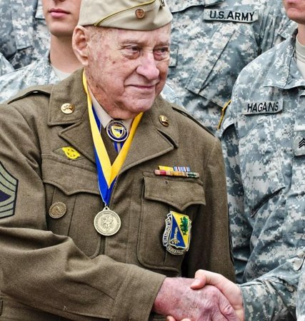

Slide 2
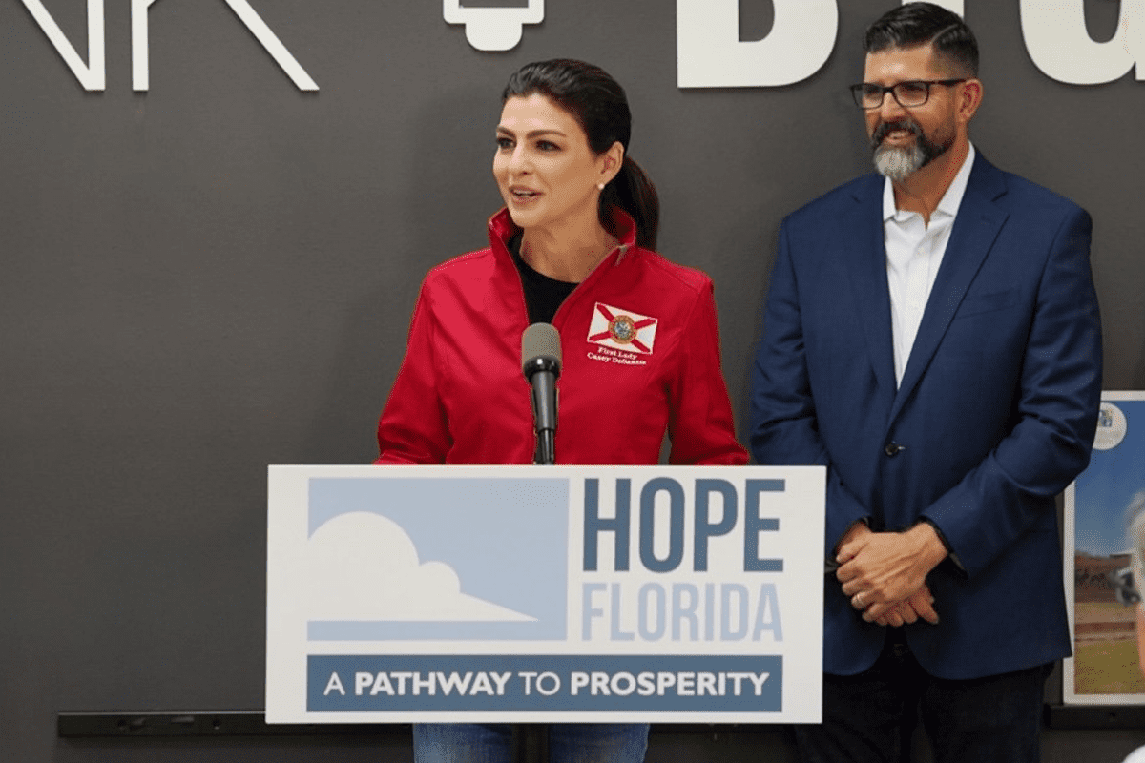
What is the hope Florida initiative?
Spearheaded by First Lady Casey DeSantis, Hope Florida uses ‘Hope Navigators’ to guide Floridians on a path to prosperity, economic self-sufficiency and hope by focusing on community collaboration between the private sector, faith-based community, nonprofits and government entities to break down traditional community silos, maximize resources and uncover opportunities.
Hope Florida initially began as a program offered through the Department of Children & Families (DCF) but has now expanded into several other agencies including Florida Department of Veterans’ Affairs, Florida Department of Juvenile Justice, and Florida Department of Elder Affairs.

Slide 3
What is a hope Navigator?
Hope Navigators are essential in helping individuals identify their unique and immediate barriers to prosperity, develop long term-goals, map out a strategic plan, and work to ensure all sectors of the community have a ‘seat at the table’ and are part of the solution.
A Hope Navigator:
Identifies goals and barriers
Provide client with referrals to local, community-based partners
Offer one-on-one support to develop a plan to achieve economic-self sufficiency

Slide 4
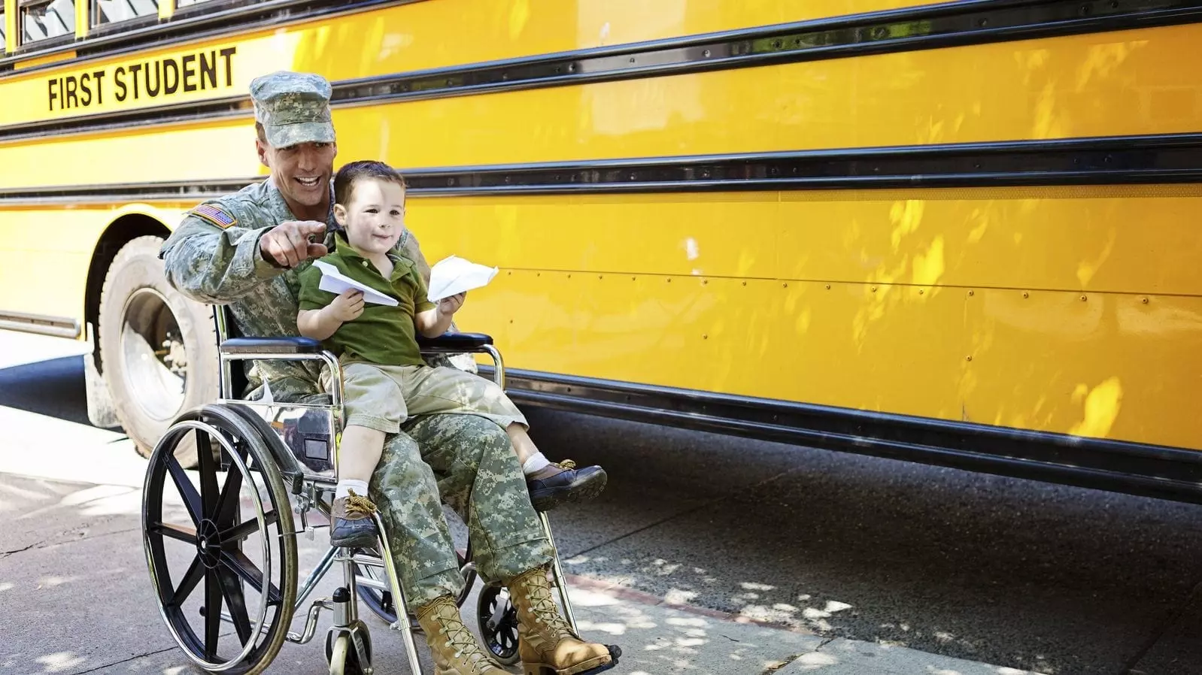
Florida veteran statistics
Florida has the third largest veteran population in the nation, behind California and Texas.
There are 1,492,000 veterans in the State of Florida.
1,328,000 male veterans
164,000 female veterans
753,000 veterans in Florida are 65 years of age and over.
A 2019 report found that there are about 2,472 homeless veterans in the state of Florida.
A 2020 report found that nearly 2 Florida veterans lose their lives to suicide daily.

Slide 5
Who is eligible for assistance?
Any Florida veteran, regardless of:
Age
Gender
Discharge status
Gold Star families
Spouses
Veteran widows
Veteran children

Slide 6
Common barriers
Employment
Housing
Education
Job Skills Training
Access to VA benefits
Bill Payment
Substance Abuse Treatment
PTSD
Military to Civilian Transition
Finance and Budgeting
Basic Needs
Childcare
Medical Treatment
Legal Assistance
Transportation
Mental Health Treatment
MST

Slide 7
DCF will triage and require community resources
Yes
Immediate (non-crisis) & Long-Term Needs referred to primary agency Hope Navigator
FDVA Hope Florida Flow
Hope Line
Hope Line Screening
Immediate Crisis Need
Hope Line staffed with Hope Navigators from all participating agencies
Identifies Floridian’s need
Rolodex to meet need
FDVA Hope Navigator calls veteran prioritizing queue by urgency
Yes
Enters info into closed loop referral case management system
Need Met?
Need Met
Hope Navigator utilizes rolodex of community partners and inputs outstanding needs into CarePortal to activate faith-based community and private sector to remove barriers to personal success
No
Hope Navigator utilizes resources from other agencies
Care plan established to meet long-term goals
Input outstanding need to CarePortal
YES
Primary Hope Navigator works behind the scenes with Hope Navigators from other agencies
NO
Hope Navigator and Veteran continue to work together to implement long-term solutions until goals and achieved and Floridian graduates

Slide 8
Questions
Contact Information
Hope Florida Line: (850) 300- HOPE (4673)
Email: hopenavigators@fdva.fl.gov
Address: 4750 Esplanade Way Tallahassee, FL 32311

