Slide 1
Lee Ann Sferrazza-Rios Public Affairs Manager
Communications & Legislative Update

Slide 2
Why We Serve
Nation’s 3rd largest Veteran population
728,000 Veterans over 65 years of age
401,000 service-connected disabled Veterans
15,000 World War II
87,000 Korean War
476,000 Vietnam War
582,000 Gulf War Era to include Post-9/11
More than 1.45 Million Veterans, including
165,000 Women Veterans!
Notes:
Florida has the third largest population of veterans in the nation with more than 1.5 million veterans. Only California and Texas have more veterans. One in three veterans you see if from the Vietnam era. Women veterans are the fastest growing demographic.

Slide 3
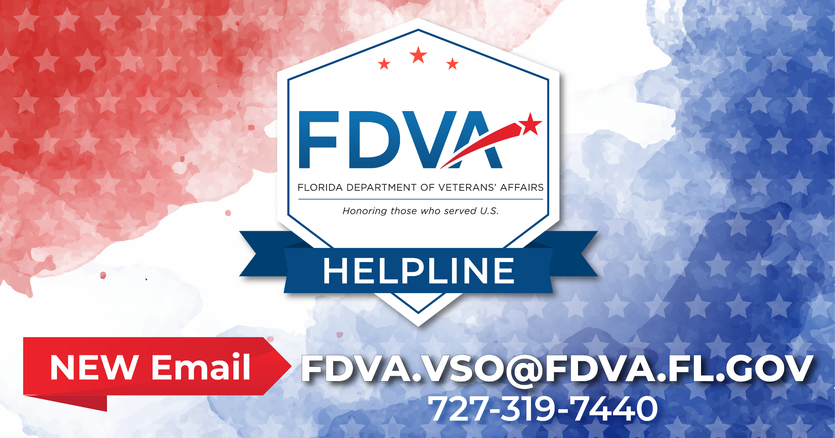
Veterans’ Outreach
Notes:
Veterans’ Claims Examiners from the Florida Department of Veterans’ Affairs are ‎connecting veterans and their families with earned services, benefits and support. To ‎contact a FDVA Veterans’ Claims Examiner, call (727) 319-7440 and they’ll return your ‎call within 24 hours. All services are free to the veteran. You may also contact them via ‎e-mail at VSO@fdva.state.fl.us. Many FDVA Veterans’ Claims Examiners have returned to serving veterans at VA ‎Medical Centers and VA Outpatient Clinics via appointments. For a list of phone ‎numbers, visit the Florida Veterans’ Benefits Guide at ‎https://floridavets.org/resources/va-benefits-guide/‎ Video Teleconferencing now available for Florida Veterans: FDVA has launched a new ‎‎“virtual” video conference option, providing Veterans with the flexibility and ‎convenience of meeting with a claims examiner from a personal computer or mobile ‎device. For more information or to schedule an appointment, call (727) 319-7408.

Slide 4
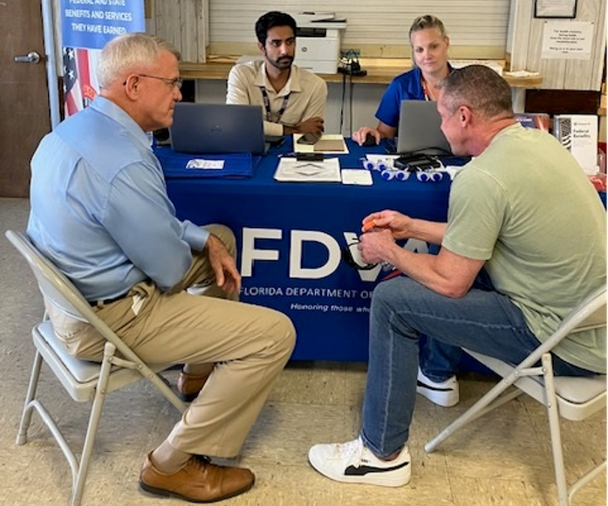
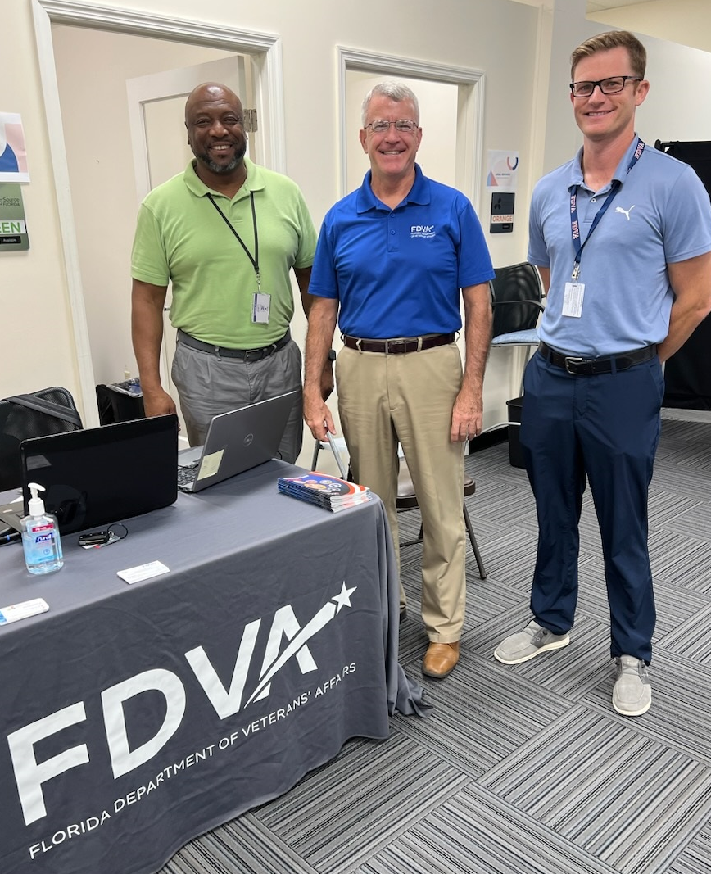
Disaster Recovery Centers
Notes:
Veterans’ Claims Examiners from the Florida Department of Veterans’ Affairs are ‎connecting veterans and their families with earned services, benefits and support. To ‎contact a FDVA Veterans’ Claims Examiner, call (727) 319-7440 and they’ll return your ‎call within 24 hours. All services are free to the veteran. You may also contact them via ‎e-mail at FDVA.VSO@FDVA.FL.GOV. Many FDVA Veterans’ Claims Examiners have returned to serving veterans at VA ‎Medical Centers and VA Outpatient Clinics via appointments. For a list of phone ‎numbers, visit the Florida Veterans’ Benefits Guide at ‎https://floridavets.org/resources/va-benefits-guide/‎ Video Teleconferencing now available for Florida Veterans: FDVA has launched a new ‎‎“virtual” video conference option, providing Veterans with the flexibility and ‎convenience of meeting with a claims examiner from a personal computer or mobile ‎device. For more information or to schedule an appointment, call (727) 319-7408.

Slide 5
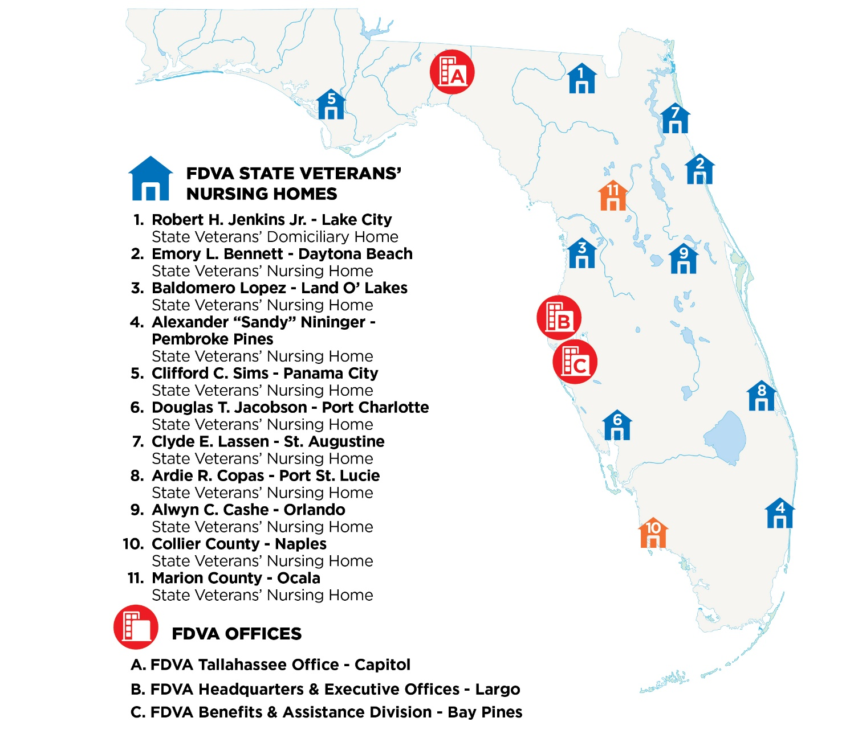
State Veterans’ Homes
Notes:
The Florida Department of Veterans’ Affairs operates eight skilled nursing facilities and one assisted living facility. All facilities are licensed by Florida’s Agency for Health Care Administration and inspected annually by AHCA and the U.S. Department of Veterans Affairs. The homes are supervised round the clock by registered and licensed nurses. Basic admission requirements for all state veterans’ homes include an honorable discharge, Florida residency, and certification of need of assisted living or skilled nursing care as determined by a VA physician. The map also shows our primary offices in Tallahassee, Bay Pines and our administrative headquarters in Largo. Two new homes are planned in the next decade in Collier County and Marion County.

Slide 6
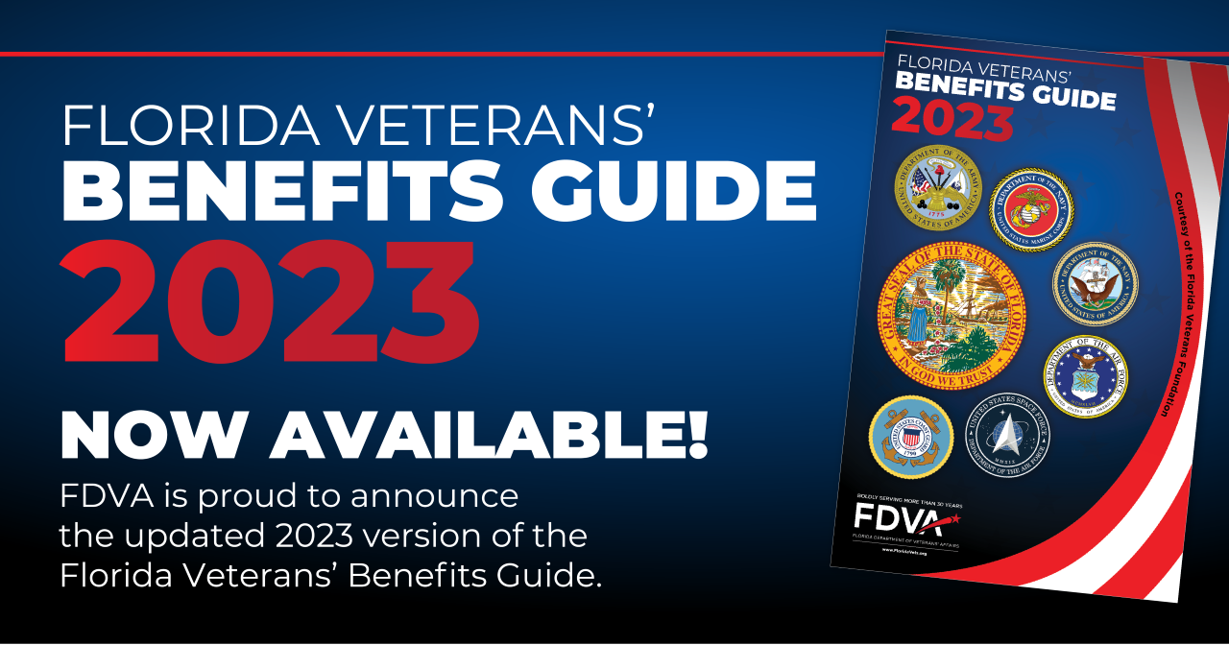
Florida Veterans’ Benefits Guide
Notes:
The Florida Veterans’ Benefits Guide is published annually for Florida veterans and their families. Single copies are available through an e-mail request on the FDVA website at www.FloridaVets.org. An interactive web version is also available online at www.FloridaVets.org. 150,000 copies are printed annually.

Slide 7
Forward March Veterans’ Newsletter
52,000+ Subscribers
Notes:
In Florida, we are changing the narrative of mental health – especially when it comes to preventing suicide among service members, Veterans, and their families. From Florida’s 21 military bases to our 1.5 million Veterans, the Governor’s Challenge supports efforts to use evidence-based practices to prevent suicide among our service members, Veterans, and their families. In order to succeed, we need individuals, organizations, and entire communities to join us in accepting this challenge to reduce the Veteran suicide rate because we know Veterans are the strength of our nation.

Slide 8
2023 Florida Legislative Session March 7 – May 5, 2023
Veterans’ Services and Recognition
HB 485 (Rep. Salzman) & SB 824 (Sen. Collins)
Creates FDVA Division of Long-Term Care
Revises Qualifications of County & City Veteran Service Officers (CVSOs)
Creates “Veterans’ Adult Day Health Care of Florida Act”
Creates Veterans Week in Florida
Notes:
CS/HB 485: FDVA Department Bill. Creates a Long-Term Health Care Division with the Department. It creates The Veterans’ Adult Day care of Florida Act. This Act will allow FDVA to provide Adult Day Health Care services in our homes or off site as needed. This bill revises qualifications for city and county veteran service officers. It authorizes the Governor to designate the week of November 11th of each year as “Veterans Week.

Slide 9
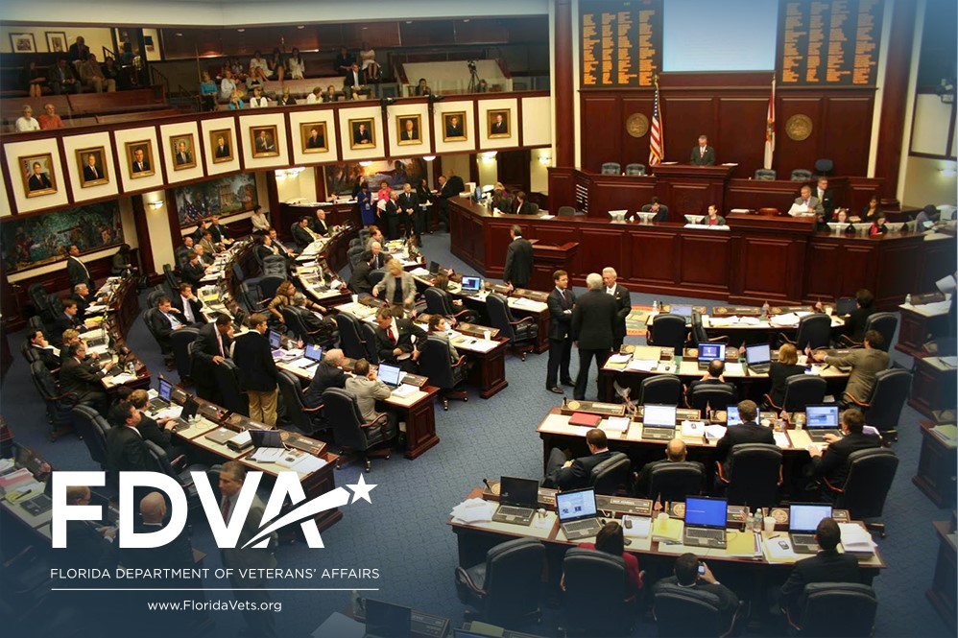
2024 Florida Legislative Session January 9 – March 8, 2024
Follow us on FloridaVets.org

Slide 10
Questions on Legislation
For information on Veteran-related legislation, please contact:
Colonel Roy Clark, U.S. Army (Ret)
Legislative and Cabinet Affairs Director
(850) 414-2312
Roy.Clark@fdva.fl.gov

Slide 11
FloridaVets.org
Notes:
Please follow us on social media. Thank you for the opportunity to speak today. May I answer any questions?

