Slide 1
FDVA RO Operations “Scuttlebutt” October 2023

Slide 2
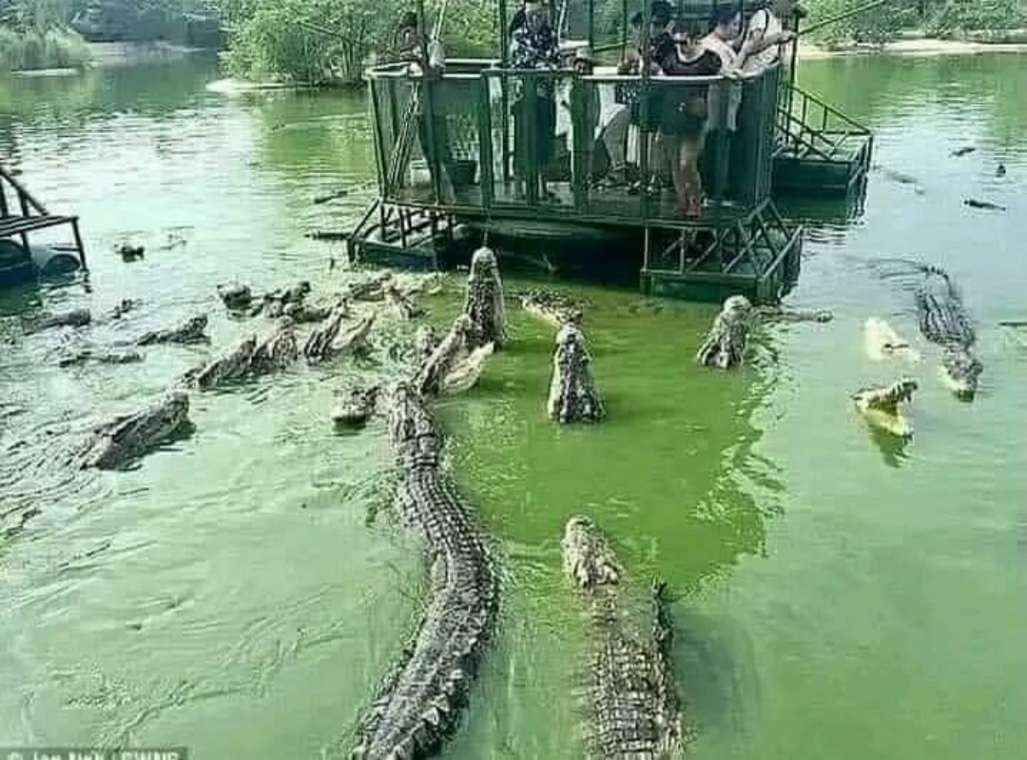
Joke Time

Slide 3
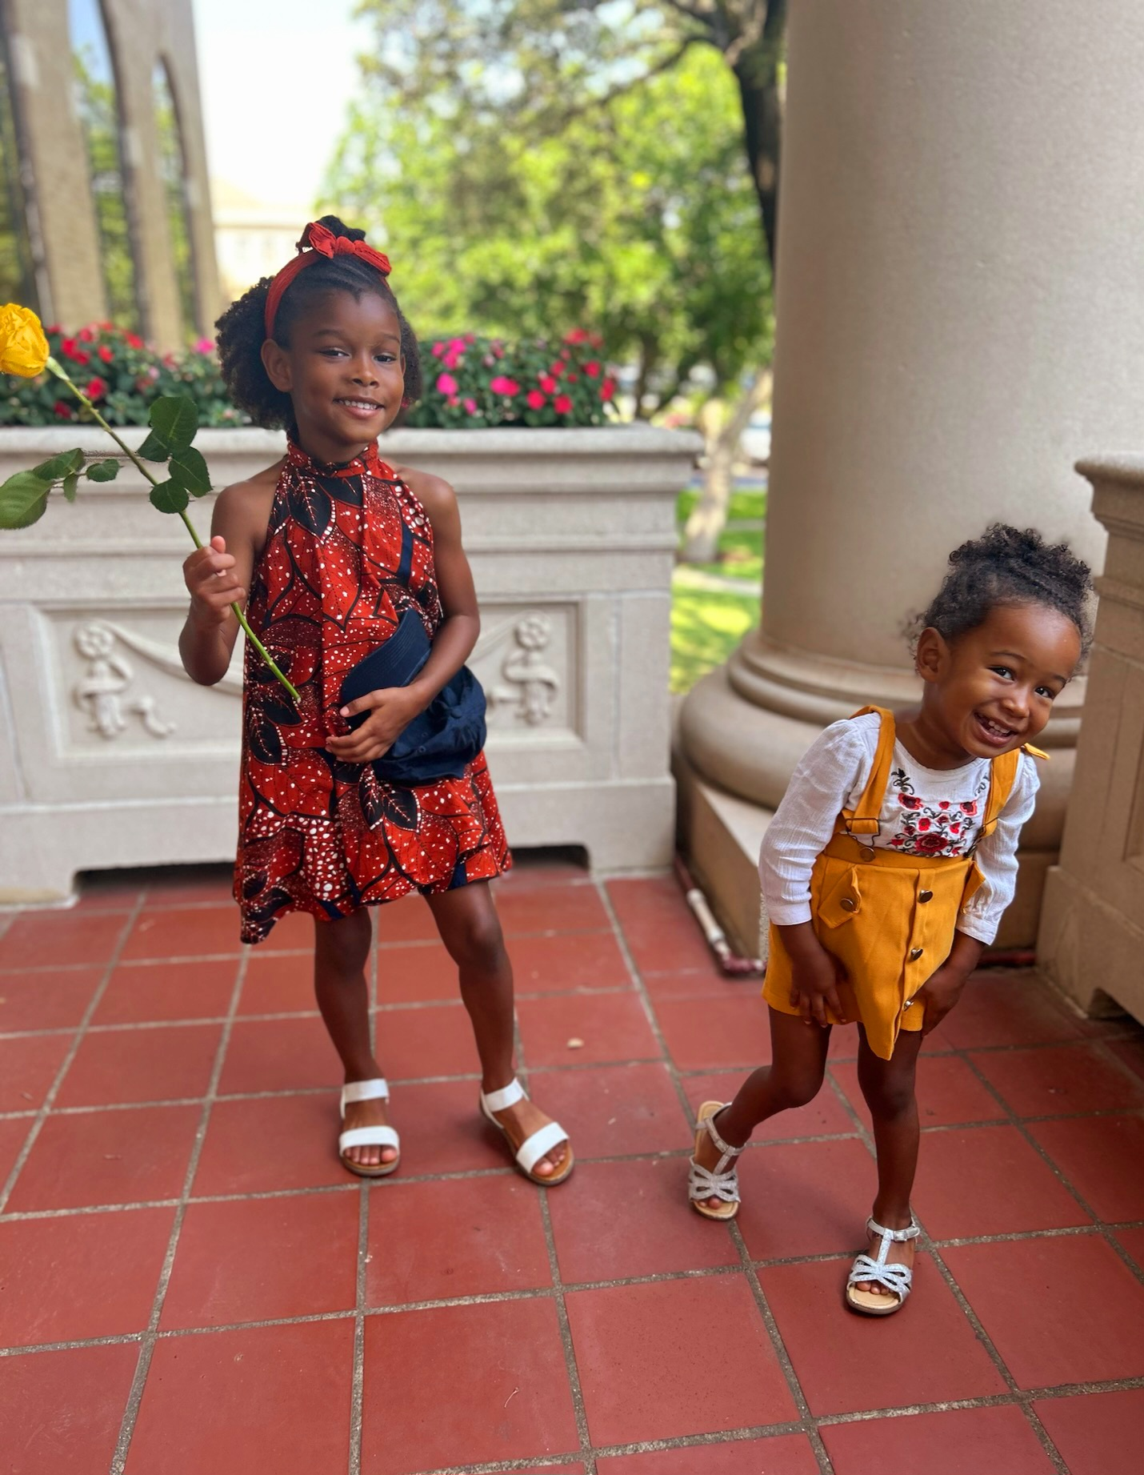
Ms. Leila & Nova

Slide 4
RO Staff
Currently we have 18 VCE’s (Incls WVC) 2 Vacancies 4 in probation
6 Staff positions
9 State Approving Agency (OJT Program)

Slide 5
Bureau Chief of Veterans Claims
Sherrel Pinson
Supervisor
Scott Luciano
Women's Veterans Coordinator
Vanessa Thomas
VCE
Timothy "Ringer" Bell
Reggie Wilson
Troy Shoulders
Fred Deraney
Anthony Schwartzrauber
Nancy Synychak
Supervisor
Dave Wethington
VCE
Sal LoPiccolo
Gheric Boyce
John Zucknovich
Eric DeMello
Hector Hernandez
William Curley
Dale Stengele
Richard Hong
Lawrence Ballentine
Roslyn Donald
Jacob Fahrner
Administration
Patricia Clark
Jim Angles
Danielle Bell
Blake Zatarin
Kenneth Sawyer

Slide 6
What Do We Do?
BVA Hearings (BVA, HLR, RVSR)
Review Rating Decisions
Complete and submit claims/appeals
Walk-ins/Office Visits
Phone and mail inquires
Special Inquires
CSDDV Scholarship (Oct – Apr)
P&T ID Card
Combat Tax Letters

Slide 7
Something New
Automated Decision Support (ADS)
ADS helps automate administrative tasks related to claims processing. ADS helps claims processor make fast, accurate and consistent decisions for Veterans by reducing the amount of time spent on administrative tasks. ADS also provides a summary document of key information required for decision-making, making it easier for decision makers to review records.

Slide 8
Topics for Discussion
POA changes w/I 30 days of BVA Hearings.
Using the appropriate Appeal Lane
Pertinent documents need to be upload into Vetra-Spec (be mindful of limits)
Fax limitation 10 pgs or less, please scan if you have the option

Slide 9
Topics Cont.
Complete Intent to file
Incomplete 21-22s
Timely request for personal hearings
PIV’s (Timely response for BI)
Combat Tax Letters
CSDDV Scholarships
Departing Personnel

Slide 10
FDVA Contact Info VSO Hotline
General Inquiries 727-319-7440
Fax- (727) 319-7780
Email- VSO@FDVA.FL.GOV
VSO Hotline 855-225-0709
Address: Florida Department of Veteran Affairs
9500 Bay Pines Blvd Room 214
Bay Pines, FL 33744

Slide 11
PMC Contact Info
PMC VSOs (215) 381-3762
E-mail: PENCTRVSO>VBAPHI@va.gov
PMCVSO.VBAMIW@va.gov
PMC.CVSO.VBASPL@va.gov
PMC Virtual VA Fax Number
St. Paul 215-842-4220
Milwaukee 215-842-4430
Philadelphia 215-842-4410

Slide 12
VA Intake Processing Center
Mail to: DEPARTMENT OF VETERANS AFFAIRS CLAIMS INTAKE CENTER PO BOX 4444 JANESVILLE, WI 53547-4444
or Fax to: TOLL FREE: 844-531-7818 & 248-524-4260 (Utilized for Foreign Claimants)

Slide 13
PIV Badges
You may email all questions concerning your PIV card to:
ROPIV.VBASPT@va.gov
Patricia Clark ( Patricia.Clark@FDVA.FL.GOV)

Slide 14
CITRIX Issues
VA-IT ticket que for CITRIX issues:
1-727-319-7700
VA – National Help Desk IT:
1-855-673-4357
You may email questions concerning computer access /status of your computer access and information security to the mailbox: ISO.VBASPT@va.gov

Slide 15
FDVA RO Operations
Questions
Scott Luciano & David Wethington
Supervisors, Claims
(727) 319-7428/(727) 319-7405

