Slide 1
Florida Governor’s Challenge to Prevent Suicide Among Service Members, Veterans, and their Families
Danielle M. Morabito
Suicide Prevention & Research Specialist
Florida Department of Veterans’ Affairs
Notes:
Hello and thank you for welcoming me here today
I’m here to talk about the Florida Governor’s Challenge to prevent suicide among service members, veterans, and their families
I’ll provide a little background and then describe some of our current/ongoing initiatives including opportunities to get more involved
Feel free to stop me with questions, or follow up with me after the presentation

Slide 2
Background
National initiative through VA/SAMHSA
Started out as Mayor’s Challenge in individual cities (including Jacksonville & Hillsborough County)
Florida was one of the first states to accept the Governor’s Challenge in 2019
Goal: To help local leaders in community and state governments work together to prevent suicide among Veterans
Team is led by FDVA
Collaboration with federal, state, and non-profit entities
Three overlapping priority areas

Slide 3
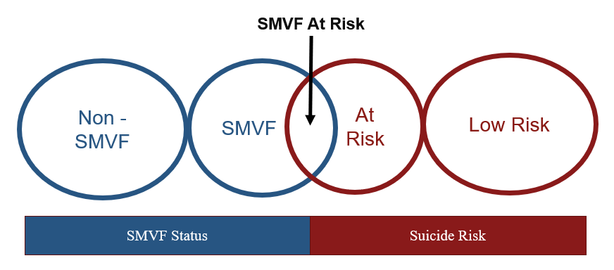
Priority Area #1. Identify SMVF and Screen for Suicide Risk
Notes:
The first Priority Area is about determining who needs support, and where to find those individuals.
The first piece is to identify Service Members, Veterans, and their Families (SMVF)
The second is to screen for suicide risk – which involves teaching individuals in the community to recognize the warning signs/risk level as well as clinical assessments

Slide 4
Priority Area #1 Initiatives
Surveying SMVF needs
“Ask the Question” Campaign
Promoting awareness and resource use through media campaign

Slide 5
Example PSA

Slide 6
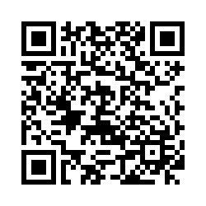
Survey https://fsu.qualtrics.com/jfe/form/SV_25GhOsosZsj74Ds

Slide 7
Priority Area #2. Promote Connectedness & Improve Care Transitions
Improve awareness of resources, services and benefits available to SMVF
Improve access to resources, services, and benefits available to SMVF
Improve coverage and usage of resources, services and benefits available to SMVF
Notes:
The second priority area is to promote connectedness & improve care transitions. This includes:

Slide 8
Priority Area #2 Initiatives
Promoting The Fire Watch Training (https://www.thefirewatch.org/)
OverWatch Training
Crisis Intercept Mapping
Annual FDVA Florida Veterans’ Benefits Guide
Collaborating with VA Community Engagement Partnership Coordinators (CEPCs)
Tracking engagement through The Fire Watch and Crisis Center of Tampa Bay
Notes:
Crisis intercept mapping: Baker, Clay, Hillsborough, Escambia/Santa Rosa, St. Johns, Palm Beach – all at various stages

Slide 9
Priority Area #3. Lethal Means Safety and Safety Planning
Notes:
The third priority area addresses lethal means safety and safety planning
Team 3 is home to the FDVA “Five Star Business Program”

Slide 10
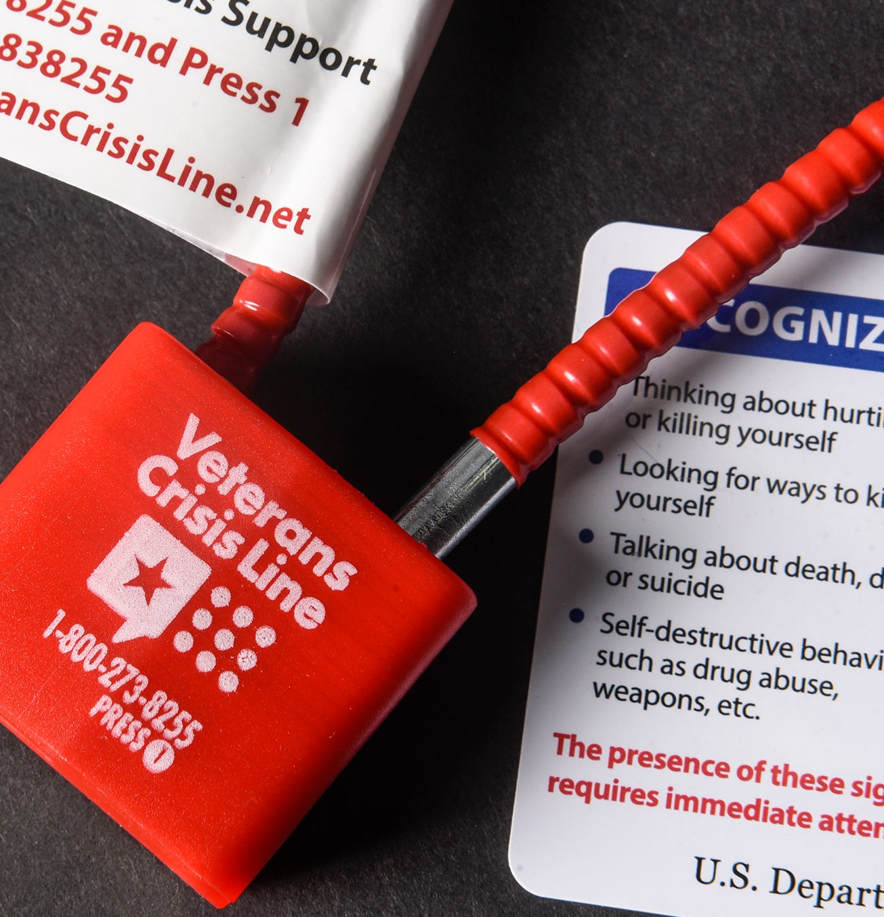
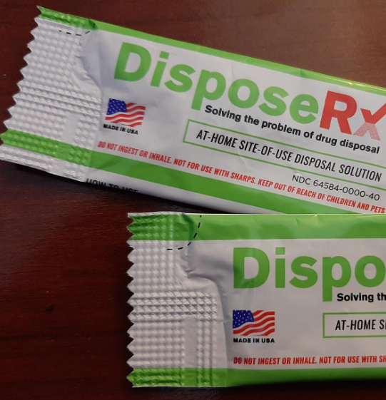
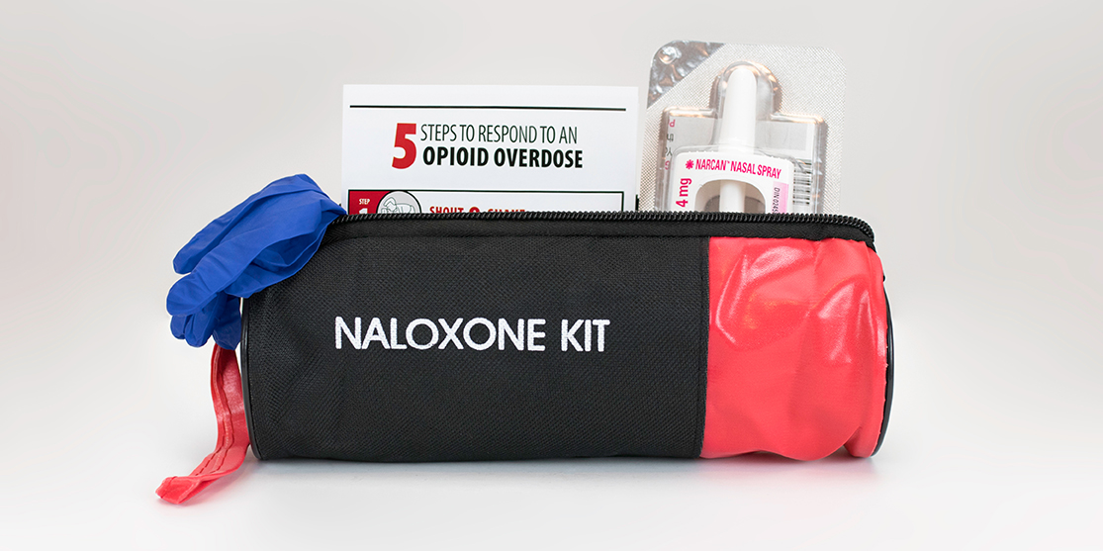
Lethal Means Safety
Gun locks
Medication disposal
Naloxone (https://www.isavefl.com/)

Slide 11
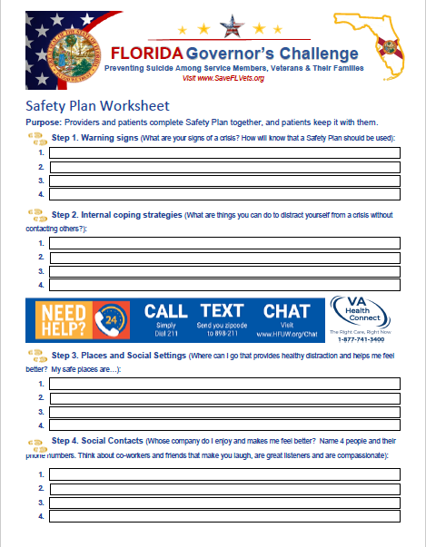
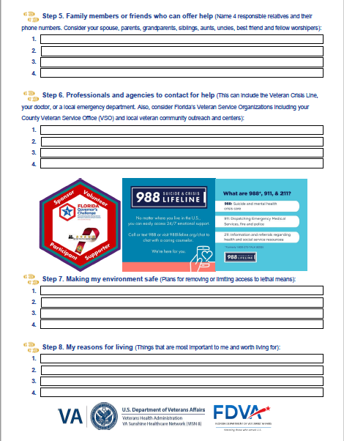
Safety Planning
Worksheets
VA Safety Planning App

Slide 12
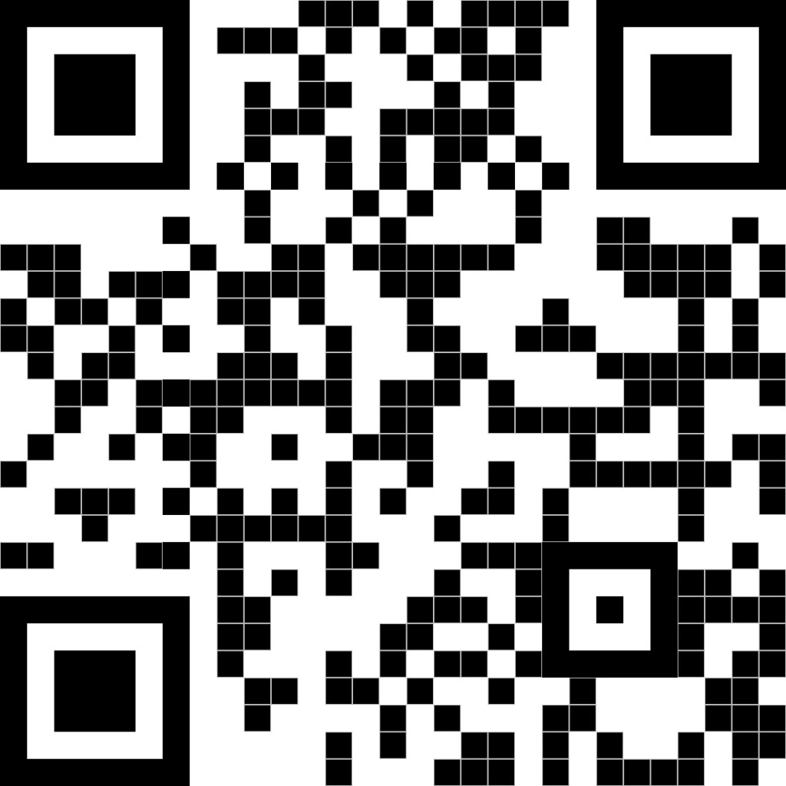
Website SaveFLVets.org
Social Media Facebook.com/SaveFLVets

Slide 13
Contact Information: Danielle Morabito Danielle.Morabito@FDVA.FL.GOV

