Slide 1
Filing VA Claims Eric DeMello, VCE, FDVA

Slide 2
Filing VA claims
What is the compensation for VA disabilities for?
Must be somehow related the military service.
In the eyes of the Federal Government, the VA claim in the Veteran’s responsibility.
If the Veteran is not ready to file the claim, file the Intent to File (ITF) to protect the date of claim.
Notes:
To learn how to assist a claimant request a change or upgrade in the character of his or her discharge from service, and how to request other corrections of the military record when necessary.

Slide 3
Filing VA claims
Theories of entitlement
Direct Service connection
Aggravation of a preexisting condition
Secondary service connection
Allen Aggravation
1151
Presumptive

Slide 4
Filing VA claims
Required components of service connected disabilities:
In service component
Current diagnosis of a disability
Nexus (medical opinion) linking the diagnosis to the in service event.

Slide 5
Filing VA claims
Nexus
In Service Component
Current diagnosis

Slide 6
Filing VA claims
In Service component
STRs
Military personnel file
Post service treatment records (continuity of care)
Lay statements
News articles/Internet

Slide 7
Filing VA claims
Current diagnosis
VA physicians
Private physicians
VA Examiners

Slide 8
Filing VA claims
Nexus
Private physicians
VA Examiners
VA health physicians
Registered Nurse up to physician

Slide 9
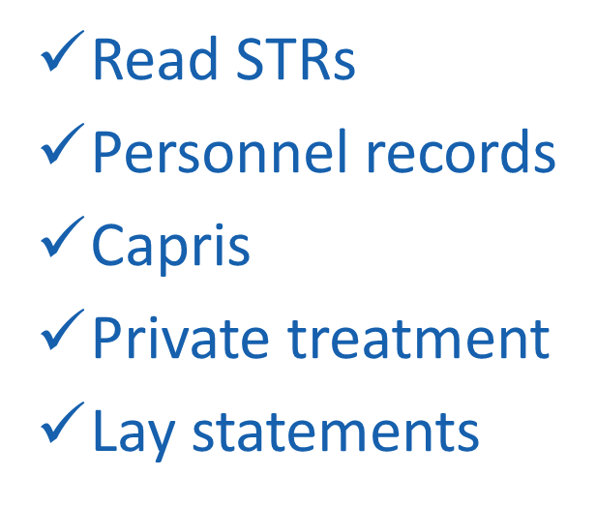
Filing VA claims
Evaluating nexus
VA physician must:
Private physician must:
Read STRs
Personnel records
Capris
Private treatment
Lay statements

Slide 10
Filing VA claims
Veteran statement
Theory of entitlement
When to write it.
What to do in preparation. - ITF

Slide 11
Filing VA claims
Writing disability statements (theory of entitlement)
Prior to service health. (Presumptive of Soundness)
During service event and treatment
Post service symptoms and treatment
Address other etiologies (discount)
State your theory of entitlement

Slide 12
Questions

