Slide 1
Diabetes Mellitus II
Reggie Fujimoto
Director
Pinellas County Veterans Services Division
Notes:
Diabetes Mellitus II (Final)
October 2023 CVSOA Conference

Slide 2
Complications/Residuals of Adult-onset (Type-II) Diabetes
The complications of adult-onset diabetes mellitus (DC 7913) are the same regardless of the cause of the illnesses. Over time high sugar levels in the blood may cause damage:
  Eyes - is the leading cause of adult blindness
  Kidneys - end-stage renal disease
  Nervous System - non-traumatic lower-extremity amputation as a result of nerve disease
  Heart - More than likely to have coronary heart disease and stroke than people without diabetes.
  Type II diabetes is associated with long-term complications that threatened life and the quality of life.
Notes:
The complications of adult-onset diabetes mellitus (DC 7913) are the same regardless of the cause of the illnesses. Over time high sugar levels in the blood may cause damage to the eyes, kidneys, nervous system or heart. Diabetes is the leading cause of adult blindness, end-stage renal disease, and non-traumatic lower-extremity amputation as a result of nerve disease. Type II diabetics are more than likely to have coronary heart disease and stroke than people without diabetes. Type II diabetes is associated with long-term complications that threatened life and the quality of life.

Slide 3
Rating Chronic Complications of Diabetes Mellitus
Microvascular Complications
Notes:
The “Mini and the Mighty” wickedness of Diabetes.

Slide 4
Objective
To provide background on medical information and rating guidelines associated with chronic microvascular complications of Diabetes Mellitus and clarify existing policy in Rating Decisions by the VA.

Slide 5
References
38 CFR Part 4, Schedule for Rating Disabilities
  §4.26 – bilateral factor
  §4.79 – eyes
  §4.115a – urinary
  §4.115b – renal
  §4.119 – diabetes mellitus
  §4.124a – peripheral nerves
M21-1MR, Part III. Subpart iv.6.B.3
M21-1 MR, Part IV. Subpart ii.2.H.36
VBA Training Letters 00-06, 09-03
VBA Fast Letters 06-21, 08-12, 09-10

Slide 6
Internet Resources
http://diabetes.niddk.nih.gov/populations/index.htm
http://www.diabetes.org/living-with-diabetes/complications/
http://www.wrongdiagnosis.com/s/sexual_neuropathy
http://www.diabetes.niddk.nih.gov/dm/pubs/statistics/
http://www.cdc.gov/diabetes/statistics/complications_national.htm
http://www.diabetesnet.com/diabetes_complications/
http://www.healthinsite.gov.au/topics/Complications_of_Diabetes/
http://www.diabetes.usyd.edu.au/foot/
http://www.merck.com/mmhe/sec13/ch165/ch165a.html

Slide 7
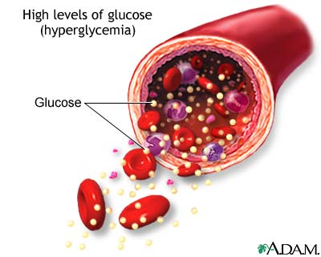
Chronic Complications of Diabetes Mellitus
Microvascular – pertaining to small blood vessels, including capillaries
Known microvascular complications of diabetes mellitus:
  Retinopathy – eye
  Neuropathy – nerves
  Nephropathy – kidney

Slide 8
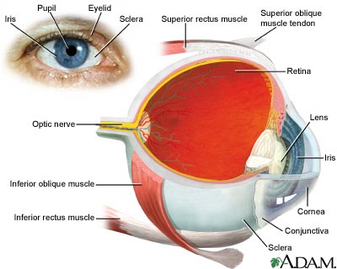
Eye Problems
Retinopathy - damage or growth problems in the small blood vessels of the retina
Cataracts – thickening and clouding of lens of eye
Glaucoma – pressure build-up inside the eye

Slide 9
Retinopathy Symptoms
Blurry or double vision
Rings, flashing lights or blank spots
Dark or floating spots
Pain or pressure in one or both eyes
Trouble seeing things out of the corners of the eyes
Fact: Diabetic retinopathy causes 12,000-24,000 new cases of blindness each year in the US

Slide 10


Normal Vision/Retinopathy

Slide 11
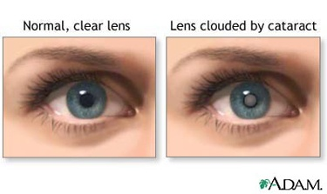
Cataract Symptoms
Clouded, blurred or dim vision
Increasing difficulty with vision at night
Sensitivity to light and glare
Double vision of a single eye
Fading or yellowing of colors
Halos around lights
Fact: Diabetics are twice as likely to get cataracts as non-diabetics

Slide 12

Normal Vision/Cataracts
Cataracts

Slide 13
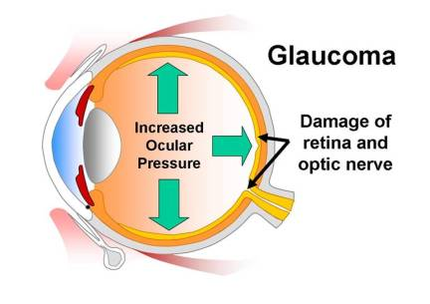
Glaucoma Symptoms
Primary open-angle
Gradual loss of peripheral vision, usually in both eyes
Tunnel vision in advanced stages
Acute angle-closure
Severe eye pain (nausea and vomiting)
Sudden onset of visual disturbance
Halos around lights
Blurred vision
Reddening of the eye

Slide 14

Normal Vision/Glaucoma
Glaucoma

Slide 15
Tests for Eye Problems
Refraction Test – measures ability to see objects at specific distances
Fluorescein Angiogram – evaluates blood circulation in the retina
Tonometry – measures intraocular pressure
Pupillary Dilation Test – expands pupil to examine retina for signs of disease
Slit-Lamp Exam – looks at the front of the eye by shining a beam of light shaped like a small slit on the eye

Slide 16
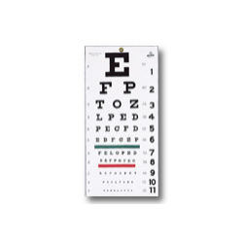

Refraction Test
The Snellen Eye Chart measures how well you see at various distances

Slide 17
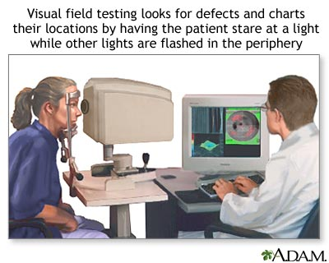
Visual Field Exam
* See FL 06-21, TL 09-03
Goldmann kinetic perimetry and automated perimetry* evaluate central and peripheral visual fields. Test results must be recorded and interpreted based on a Goldmann chart (above)

Slide 18
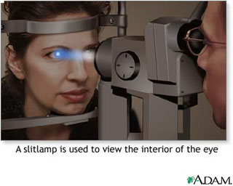
Slit-Lamp Exam
A slit-lamp allows the examiner to evaluate the structures of the eye including the cornea, iris, vitreous and retina

Slide 19
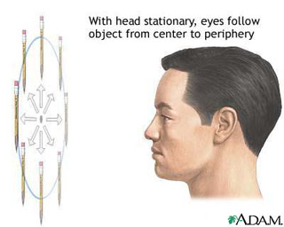
Extraocular Muscle Function Test
An extraocular muscle function test evaluates muscle weakness or other defects that result in uncontrolled eye movement

Slide 20
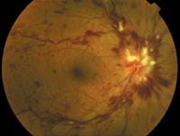
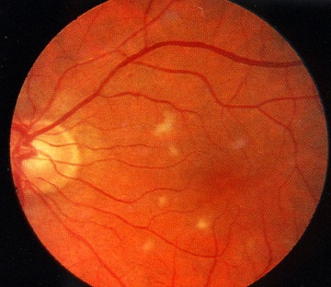
Types of Diabetic Retinopathy
Non-proliferative (background, or simple retinopathy)
  Microaneurysms
  Hemorrhages
  Hard exudates
Proliferative
  Scarring
  Hemorrhaging
  Formation of new
  blood vessels in retina
Retinal vein occlusion (below left) occurs when the central retinal vein, the blood vessel that drains the retina, or one of its branches becomes blocked
Cotton wool spots (above right) are white areas in the retina where blood vessels are blocked and nerves are damaged

Slide 21
Reviewing C&P Eye Exams
Only licensed optometrists and ophthalmologists may conduct C&P eye examinations
A diagnosis is required when there are abnormal findings
A fundoscopic examination after dilation of the pupils is routine, unless medically contraindicated
Examinations of visual fields or muscle function are needed only when medically indicated (or when specially requested, such as on a BVA remand)

Slide 22
Rating Considerations
Diabetic eye diseases are rated as glaucoma, cataract, retinopathy or other manifestation (such as intra-ocular hemorrhage) based on impairment of:
  visual acuity
  visual field
  muscle function
Some eye disabilities result in more than one type of impairment (See TL 09-03).

Slide 23
Rating Considerations
Take the issue of service connection for diabetic retinopathy as an inferred issue when:
  the veteran is already service connected for diabetes
  medical evidence of record provides a diagnosis
Further examination may be needed to ascertain the extent of involvement, but VA may assign 0% evaluation pending that exam

Slide 24
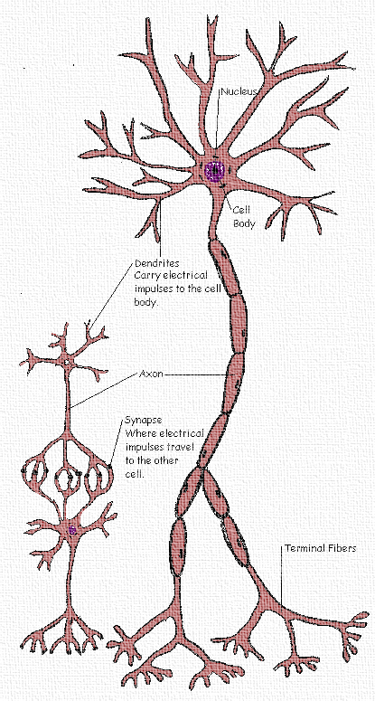
Nerve Damage
Peripheral neuropathy
  Affects nerves in upper and lower extremities
  Progressive, develops slowly
Focal neuropathies
  Affects specific nerves in head, torso, or legs
  Appears suddenly, but usually gets better over time
Autonomic neuropathy
  Affects many body systems (digestive, cardiovascular, genitourinary)

Slide 25
Symptoms of Nerve Damage
Distal symmetric/diffuse polyneuropathy (peripheral neuropathy)
  Tingling, numbness, tightness, or burning, shooting, or stabbing pain in the feet, hands, or other parts of the body that often occurs in a “stocking-glove distribution”
    Bone and joint deformities – Charcot’s joints (degenerative changes, instability, fragmentation of bones)
  Reduced sensitivity to light touch or temperature
    Injuries or burns
  Weakness and loss of balance or coordination
    Abnormalities of gait – sensory ataxia

Slide 26
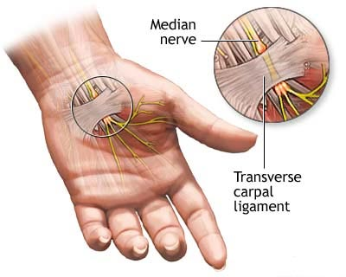
Symptoms of Nerve Damage
Focal (mononeuropathy)
  Localized pain, weakness and motor problems
  Pain in or around one of the eyes, difficulty moving eye
    Facial paralysis - Bell’s palsy
    Sudden wrist or foot drop
Focal (radiculopathy)
  Spinal nerve root
Focal (compression neuropathy)
  entrapment syndromes – Carpal tunnel
Fact: About 60 to 70 percent of people with diabetes have mild to severe forms of nervous system damage

Slide 27
Symptoms of Nerve Damage
Autonomic neuropathy
  Digestive – delayed gastric emptying due to vagus nerve involvement causes frequent bloating, belching, constipation, heartburn, nausea and vomiting, diarrhea, and abdominal pain
    Dumping syndrome
    Gastroparesis
  Cardiovascular – decreased cadiac sensation of angina
    Orthostatic hypotension (low blood pressure) with syncope (fainting)
  Skin (sweat glands) - profuse sweating of the torso, face, or neck; or reduced sweating of feet or legs
  Urinary tract – difficulty sensing when bladder is full
  Sexual dysfunction – loss of erections or vaginal dryness

Slide 28
Tests for Nerve Damage
Deep tendon reflexes/muscle strength – provide information on the integrity of the central and peripheral nervous system
Sensation testing – measures the ability to detect temperature, light touch, sharp and dull pressure, and vibration
Electromyogram (EMG) – measures the electrical activity of muscles at rest and during contraction
Nerve Conduction Velocity (NCV) – measures how quickly electrical impulses move along a nerve

Slide 29
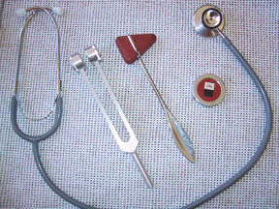
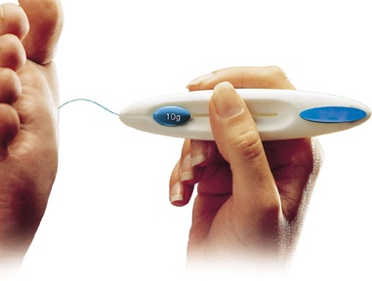
Reflex, Strength and Sensation
Typically, physicians assess neurological function by evaluating deep tendon reflexes, muscle strength, and sensation (temperature, light touch, sharp and dull pressure, and vibration)

Slide 30
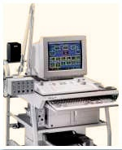
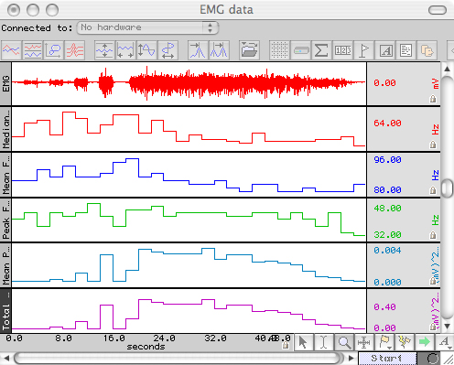
EMG
A needle is inserted through the skin into the muscle. Electrical activity is detected by the needle. Activity is displayed visually on an oscilloscope. The presence, size, and shape of the wave provide information about the ability of the muscle to respond to stimulation.

Slide 31
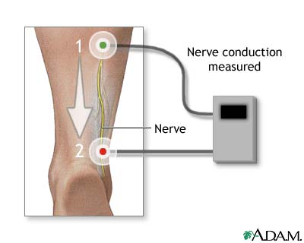
NCV
Surface electrodes are placed on the skin over nerves at various locations
Each patch gives off a very mild electrical impulse stimulating the nerve
Electrical activity is recorded by other electrodes
Distance is measured between electrodes and the time it takes for impulses to travel

Slide 32
Rating Considerations
Diagnostic criteria are based on some combination of symptoms and a focused neurological examination.
Nerve conduction studies and special quantitative sensory tests are not routinely done during a C&P examination but may be ordered in certain circumstances.

Slide 33
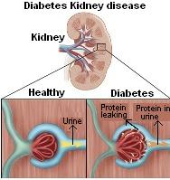
Kidney Disease
Diabetic nephropathy – damage to the blood vessels in the kidneys caused by diabetes
Fact: Diabetes is the leading cause of kidney failure, accounting for 44 percent of new cases in 2005

Slide 34
5 Stages of Nephropathy
Silent stage – gradually damaged nephrons
Microalbuminuria – albumin, a type of protein, in the urine), in the range of 30-300 mg/24 h
Clinical albuminuria or proteinuria – diabetes for 5+ yrs and clinically apparent albuminuria (>300 mg per 24 hrs) w/no other cause of kidney disease
Renal insufficiency – rising blood creatinine 2 mg/dL or greater
End-stage renal disease (ESRD) – may require hemodialysis or kidney transplant
Notes:
If you had a fasting blood glucose test, a level between 70 and100 milligrams per deciliter (mg/dL) is considered normal.

Slide 35
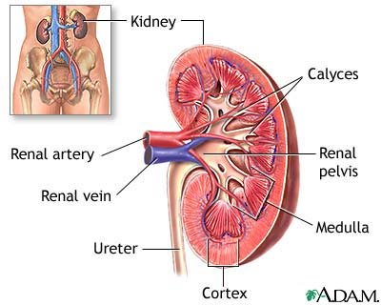
Symptoms of Nephropathy
Early stages have no symptoms (Stage I)
Progressive loss of kidney function (Stages II-IV)
  Swelling in legs (edema)
  Poor appetite/weight loss
  Weakness
  Fatigue/trouble sleeping
End-stage renal disease (Stage V)
  Reduced urine output
  Uremia
  Mental confusion
  Nausea, vomiting

Slide 36
Tests for Kidney Complications
Blood Urea Nitrogen (BUN)
  Reference range for an adult is 7-20 mg/dL,
  Increased levels suggest impaired kidney function
  Levels can increase with the amount of protein in your diet
  Concentrations may be elevated when there is excessive protein breakdown (catabolism)
  If one kidney is fully functional, BUN concentrations may be normal even when significant dysfunction is present in the other kidney

Slide 37
Tests for Kidney Complications
Creatinine
  Measured in blood or urine
  Reference range for blood 0.6 - 1.2 mg/dL
  No reference range for urine (measured by ratio)
  Increased levels in blood suggest damage to/swelling of blood vessels in kidneys due to infection or disease
  Concentrations in blood can increase temporarily as a result of muscle injury
  Concentrations in blood are slightly lower during pregnancy

Slide 38
Tests for Kidney Complications
Creatinine Clearance
  Measures how fast creatinine leaves the blood
  Reference range is 97-137 ml/min for men, 88-128 ml/min for women
Microalbuminuria
  Occurs when kidney leaks small amounts of albumin into urine (albumin is normally retained in the bloodstream by the kidneys)
  Detected by urine dipstick methods
  Diagnosed either from a 24-hour urine collection (20 to 200 µg/min) or from elevated concentrations (30 to 300 mg/L) on at least two occasions

Slide 39
Tests for Kidney Complications
Proteinuria
  Occurs when damaged kidneys fail to separate protein from waste products
Urinary casts
  Tube-shaped particles made up of white blood cells, red blood cells, and kidney cells
  Held together by a protein released by the kidney
  Types of casts:
    granular fatty/waxy
    hyaline renal tubular epithelial
    red blood cell white blood cell

Slide 40
Rating Considerations
Even in the incipient stage, diabetic nephropathy is associated with renal hypertension, which is the most common cause of the hypertension that results from diabetes nephropathy, and is manifested by:
  persistent microalbuminuria, which is characterized by urinary excretion of 150-500 mg of protein/24 hours, and
  overt proteinuria, which is characterized by urinary excretion of greater than 0.5 mg protein/24 hours

Slide 41
General Rating Considerations
  Evaluate compensable complications of diabetes separately unless they are a part of the criteria used to support a 100 percent evaluation
  Noncompensable complications are considered part of the diabetic process under diagnostic code (DC) 7913

Slide 42
General Rating Considerations
If a veteran has noncompensable complications of diabetes mellitus but does not have ketoacidosis or hypoglycemic reactions, do not evaluate the diabetes mellitus at 60 percent simply because noncompensable complications are present.
Assign a 40 percent evaluation if there is a requirement of insulin, restricted diet, and regulation of activities and include the noncompensable complications under DC 7913.

Slide 43
Rating Chronic Complications of Diabetes Mellitus
Macrovascular Complications
Notes:
Macrovascular – pertaining to the large blood vessels

Slide 44
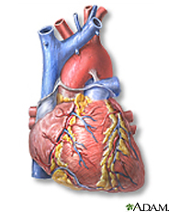
More Chronic Complications of Diabetes Mellitus
Known macrovascular complications of diabetes mellitus:
  Heart problems
  Hypertension
  Peripheral vascular disease
  Stroke

Slide 45
Macrovascular Complications
Acute (sudden) events due to chronic disease:
heart attack is caused by blockage of blood vessels supplying the heart, and
stroke is caused by blockage of blood vessels supplying the brain.
Fact: Heart disease or stroke account for about 65% of deaths in people with diabetes

Slide 46
Arteriosclerotic Heart Disease
also known as coronary artery disease (CAD)
caused by plaque build up on the walls of arteries, making them narrow
as coronary arteries narrow, blood flow to the heart can slow down or stop, causing chest pain (stable angina) or heart attack
Fact: Diabetic adults have heart disease death rates about 2 to 4 times higher than non-diabetics

Slide 47
Heart Attack
also known as myocardial infarction (MI)
blockage of a coronary artery deprives heart muscle of blood and oxygen, injuring it
causes chest pain and chest pressure sensation
if blood flow is not restored within 20 to 40 minutes, irreversible death of the heart muscle will occur
muscle continues to die for six to eight hours at which time the heart attack usually is “complete”
dead heart muscle is replaced by scar tissue

Slide 48
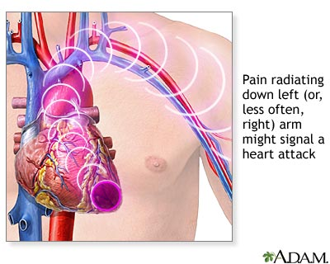
Symptoms of Heart Attack
discomfort, pressure, fullness, squeezing or pain in the center of the chest
pain spreading to the shoulders, neck or arms
lightheadedness, fainting, sweating, nausea or shortness of breath
anxiety, nervousness
increased or irregular heart rate
feeling of impending doom

Slide 49
Tests for Heart Complications
Metabolic Equivalent of Task (METS) – determines if there are abnormalities in the heart’s electrical activity by measuring the metabolic rate on cardiac stress test
Ejection Fraction – measures the fraction of blood pumped out of the left ventricle with each heart beat
Electrocardiogram (ECG) – checks for problems with the electrical activity of the heart

Slide 50
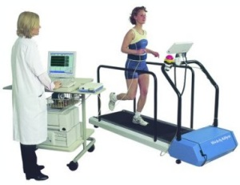
METS
The Bruce protocol stress test is a non-invasive procedure that involves walking on a treadmill while the heart is monitored by an electrocardiograph with various electrodes attached to the body

Slide 51

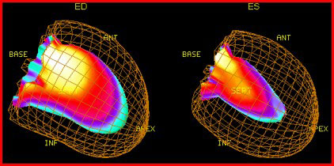
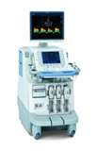
Ejection Fraction
Left ventricular dysfunction is measured by echocardiography in which the volumes of the heart's chambers are measured during the cardiac cycle

Slide 52
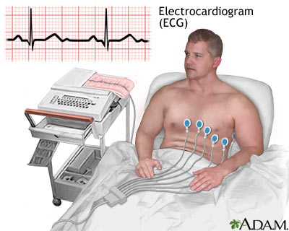
ECG
ECG translates the heart's electrical activity into line tracings on paper; spikes and dips in the line tracings are called waves

Slide 53
Hypertension
More than half of all diabetics have hypertension
Most hypertension that develops in diabetics is essential, primary hypertension that is not due to diabetes
Even in the incipient stage, diabetic nephropathy is associated with renal hypertension, which is the most common cause of the hypertension that results from diabetic nephropathy
Renovascular hypertension, a secondary hypertension, is < 2% of all cases of hypertension

Slide 54
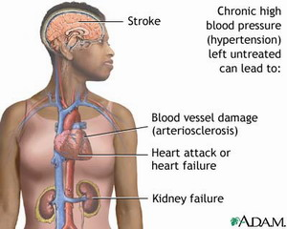
Hypertension
The long-term stress of high blood pressure levels increases the risk of other diabetic complications such as stroke, coronary artery disease (CAD), diabetic retinopathy, and nephropathy (kidney disease)
  Blood pressure is measured in millimeters of mercury (mmHg)
  “Normal” blood pressure for those with diabetes and/or chronic kidney disease is <130/80 mmHg

Slide 55
Symptoms of Hypertension
  In most cases of mild or even moderate hypertension, there are no symptoms
  People with extremely elevated blood pressure may experience:
      headache
      vision problems
      abdominal or chest pain
      shortness of breath
      dizziness or nausea

Slide 56
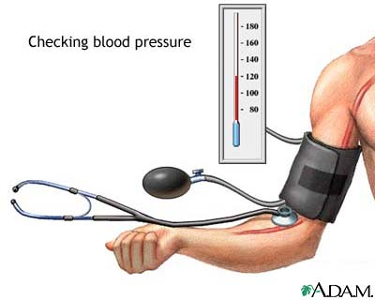
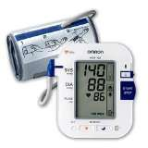
Tests for Hypertension
Blood pressure is measured with a cuff device. The numbers that are given as your blood pressure results (e.g., 130 over 80) are systolic and diastolic pressure readings, respectively. The systolic reading represents your blood pressure as your heart beats, while the diastolic is the pressure between beats.

Slide 57
Test for Hypertension
To obtain an accurate blood pressure reading, a person should avoid caffeine, exercise, or smoking for at least 30 minutes and rest quietly for at least 5 minutes beforehand.
A diagnosis of hypertension requires multiple readings, because blood pressure varies throughout the day.
After a high initial reading, one or more measurements should be done outside the doctor's office to distinguish between sustained and white-coat hypertension.

Slide 58
Rating Considerations
Infer the issue of service connection for hypertension as secondary to diabetes mellitus whenever:
  service connection is established for
    diabetes mellitus, and
    diabetic nephropathy, and
  the veteran has a diagnosis of hypertension.

Slide 59
Rating Considerations
M21-1 MR, III.iv.4.F.22.e
If | Then
hypertension was diagnosed after diabetic nephropathy was diagnosed | grant service connection for hypertension as secondary to diabetes
hypertension was diagnosed before diabetic nephropathy was diagnosed; no change in hypertension or increase in blood pressure | deny service connection for hypertension as not secondary to diabetes
hypertension was diagnosed before diabetic nephropathy was diagnosed; but change in hypertension and/or increased blood pressure readings | obtain a medical opinion to determine if hypertension was aggravated by the s/c diabetic nephropathy
no clear indication when hypertension was diagnosed, or if it worsened since diabetic nephropathy diagnosis | obtain medical opinion to determine if hypertension developed or was aggravated by s/c diabetic nephropathy

Slide 60
Stroke
also known as cerebrovascular accident (CVA)
occurs when blood supply to a part of the brain is interrupted or severely reduced, depriving brain tissue of oxygen and nutrients
within a few minutes, brain cells begin to die
prompt treatment is crucial, as early treatment can minimize damage
Fact: Diabetics risk for stroke is 2 to 4 times higher and risk of death from stroke is 2.8 times higher than non-diabetics

Slide 61
Symptoms of Stroke
sudden numbness, paralysis, or weakness in face, arm or leg
new problems with walking or balance
sudden vision changes
drooling or slurred speech
sudden, severe headache or feeling confused
new problems speaking or understanding simple statements

Slide 62
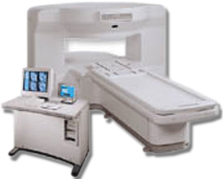
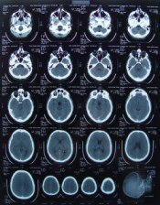
Tests for Stroke
Magnetic resonance imaging (MRI) – visualizes the internal structure and function of the body; provides much greater contrast between the different soft tissues of the body than a CT scan

Slide 63
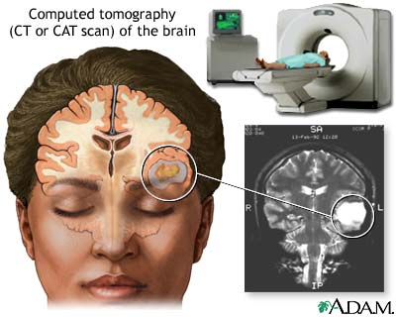
Tests for Stroke
Computed tomography (CT) scan – a series of X-rays of the brain that show whether there is bleeding

Slide 64
Peripheral Vascular Disease
also known as peripheral artery disease (PAD) or peripheral artery occlusive disease (PAOD)
includes all diseases caused by the obstruction of large arteries in the arms and legs
can result from atherosclerosis, inflammatory processes leading to stenosis, an embolism or thrombus formation
causes either acute or chronic ischemia (lack of blood supply), typically of the legs

Slide 65
Symptoms of Peripheral Vascular Disease (PVD)
claudication – pain, weakness, numbness, or cramping in muscles due to decreased blood flow
sores, wounds or ulcers that heal slowly or not at all
noticeable change in color (blueness or paleness) or temperature (coolness) when compared to the other limb
diminished hair and nail growth on affected limb and digits

Slide 66
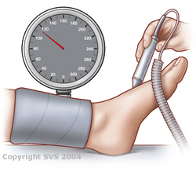
Tests for PVD
Ankle brachial pressure index (ABI)
Doppler ultrasound
  a noise, called a bruit ("brew-ee"), may warn the doctor that there is narrowing in the artery
Fact: Diabetics account for up to 70% of nontraumatic amputations performed

Slide 67
Ankle-Brachial Pressure Index
A normal resting ankle-brachial index is 1 or 1.1 Blood pressure at the ankle is the same or greater than the pressure at the arm; no significant narrowing or blockage of blood flow
A resting ankle-brachial index < 1 is abnormal
If the ABI is:
  Less than 0.95, significant narrowing of one or more blood vessels in the legs is indicated
  Less than 0.8, pain in the foot, leg, or buttock may occur during exercise (intermittent claudication)
  Less than 0.4, symptoms may occur when at rest
  0.25 or below, severe limb-threatening PAD is likely

Slide 68
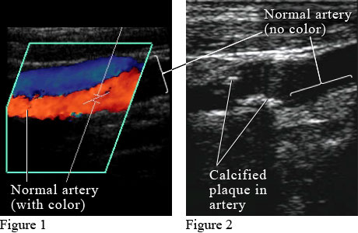
Doppler Ultrasound
A Doppler ultrasound test uses reflected sound waves to evaluate blood as it flows through a blood vessel

Slide 69
Rating Considerations
  Evaluations of PVD, under diagnostic code (DC) 7114, Arteriosclerosis obliterans, are for involvement of a single extremity.
  If more than one extremity is affected, evaluate each separately and combine (§ 4.25), using the bilateral factor (§4.26), when applicable

Slide 70
General Rating Considerations
  Evaluate compensable complications of diabetes separately unless they are a part of the criteria used to support a 100 percent evaluation
  Noncompensable complications are considered part of the diabetic process under diagnostic code (DC) 7913

Slide 71
General Rating Considerations
If a veteran has noncompensable complications of diabetes mellitus but does not have ketoacidosis or hypoglycemic reactions, do not evaluate the diabetes mellitus at 60 percent simply because noncompensable complications are present.
Assign a 40 percent evaluation if there is a requirement of insulin, restricted diet, and regulation of activities and include the noncompensable complications under DC 7913.

Slide 72
What is
Regulation of Activities?
The phrase “Regulation of Activities” has a very specific meaning and interpretation. To qualify for higher evaluation on the basis of regulation of activities competent medical evidence must document that a physician has undertaken to control and regulate the activities of a patient in order to help control and stabilize blood sugar levels. This is seen most often in diabetics who are either prone to hypoglycemia or to overshooting their range of blood sugar. Regulations of activities does not refer to the need for ordinary exercise nor does it refer to a reduced capacity for exercise due to fatigue, numbness in the hands or feet, or other limitations imposed by the natural progression of the diabetes disease itself, or by any other co-existing disabilities which may preclude or limit activities.
Notes:
“Regulation of Activities” requires competent medical evidence which documents that a physician has undertaken to control and regulate the activities of a patient in order to help control and stabilize blood sugar levels. This is seen most often in diabetics who are either prone to hypoglycemia or to overshooting their usual range of blood sugar. Regulation of activities does not refer to the need for ordinary exercise nor does it refer to a reduced capacity for exercise due to fatigue, numbness in the hands or feet, or other limitations imposed by the natural progression of the diabetes disease process itself, or by any other co-existing disabilities which may preclude or limit activities.

Slide 73
7913 Diabetes mellitus
100%
  Requires more than one daily injection of insulin, restricted diet, and regulation of activities (avoidance of strenuous occupational and recreational activities) with episodes of ketoacidosis or hypoglycemic reactions requiring at least three hospitalizations per year or weekly visits to a diabetic care provider, plus either progressive loss of weight and strength or complications that would be compensable if separately evaluated 100
Notes:
M21-1MR, Part III, Subpart iv, Chapter 4, Section F
Endrocrine System
Diabetes Mellitus
Introduction
This topic contains information about diabetes mellitus, including
the symptoms of diabetes mellitus
evaluating the extent of disability caused by diabetes mellitus
the complications of diabetes mellitus
rating complications of diabetes mellitus, and
consideration of hypertension as secondary to diabetes mellitus.
Change Date
December 29, 2007
a. Symptoms of Diabetes Mellitus
The cardinal symptoms of uncontrolled diabetes are
polyuria (excessive urination)
polydipsia (excessive thirst)
polyphagia (excessive hunger)
weakness, and
loss of weight.
The presence of sugar in the urine is characteristic of, but not essential to, a diagnosis of diabetes mellitus.
Notes:
A diagnosis of diabetes mellitus cannot be made from glycosuria alone, as this may result from
a low renal threshold for sugar, or
excessive ingestion of sugar.
Persistent hyperglycemia, a blood sugar of 170 mg per 100 cc blood after 12-hour fast, and glycosuria may be secondary to
hyperthyroidism
dyspituitarism
pregnancy
apoplexy
cerebral trauma, or
severe infections.
b. Evaluating the Extent of Disability Caused by Diabetes Mellitus
Diabetes mellitus is not seriously disabling if, on a diet sufficient to maintain the weight and strength of the claimant, the
blood sugar can be kept within normal limits, and
urine is sugar free.
As diabetes mellitus progresses
it become more difficult to control, even with insulin
complications develop which increase the degree of disability, and
increasing limitation of activity due to unstable blood sugar levels limits employability.
c. Complications of Diabetes Mellitus
The complications of diabetes mellitus may include, but are not limited to
arteriosclerosis, including peripheral or cardiac complications
cataracts, and
secondary hypertension.
Notes:
Most hypertension that develops in diabetics is essential, primary hypertension and not due to diabetes.
Even in the incipient stage, diabetic nephropathy is associated with renal hypertension, which is the most common cause of the hypertension that results from diabetes nephropathy, and is manifested by
persistent microalbuminuria, which is characterized by urinary excretion of 150-500 mg of protein/24 hours, and
overt proteinuria, which is characterized by urinary excretion of greater than 0.5 mg protein/24 hours.
Renovascular hypertension, a type of secondary hypertension, is responsible for less than two percent of all cases of hypertension and is sometimes (but not always) due to arteriosclerosis that may be caused by diabetes.
Reference: For more information on considering hypertension as secondary to diabetes mellitus, see M21-1MR, Part III, Subpart iv, 4.F.22.e.
d. Rating Complications of Diabetes Mellitus
Evaluate compensable complications of diabetes separately unless they are a part of the criteria used to support a 100 percent evaluation. Noncompensable complications are considered part of the diabetic process under diagnostic code (DC) 7913.
Reference: For examples of rating decisions for the complications of diabetes mellitus, see M21-1MR, Part III, Subpart iv, 4.F.24.
e. Consideration of Hypertension as Secondary to Diabetes Mellitus
Infer the issue of service connection for hypertension as secondary to diabetes mellitus whenever
service connection is established for
diabetes mellitus, and
diabetic nephropathy, and
the veteran has a diagnosis of hypertension.
Use the table below to determine what action to take on the inferred claim for secondary service connection for hypertension.
If the medical evidence shows …
Then …
hypertension was diagnosed after diabetic nephropathy was diagnosed
- grant service connection for hypertension as secondary to diabetes mellitus.
hypertension was diagnosed before diabetic nephropathy was diagnosed, and
there has been no change in the treatment of hypertension or increase in blood pressure readings since diabetic nephropathy was diagnosed
- deny service connection for hypertension as not secondary to diabetes mellitus.
e. Consideration of Hypertension as Secondary to Diabetes Mellitus (continued)
If the medical evidence shows …
Then …
hypertension was diagnosed before diabetic nephropathy was diagnosed, but
there has been a change in the treatment of hypertension and/or an increase in blood pressure readings since diabetic nephropathy was diagnosed
- obtain a medical opinion to determine if hypertension was aggravated by the service-connected (SC) diabetic nephropathy.
no clear indication as to
when hypertension was diagnosed, or
whether hypertension has worsened since diabetic nephropathy was diagnosed
- obtain a medical opinion to determine if hypertension developed or was aggravated by the SC diabetic nephropathy.

Slide 74
60%
Requiring insulin, restricted diet, and regulation of activities with episodes of ketoacidosis or hypoglycemic reactions requiring one or two hospitalizations per year or twice a month visits to a diabetic care provider, plus complications that would not be compensable if separately evaluated 60
Notes:
If a veteran has noncompensable complications of diabetes mellitus but does not have ketoacidosis or hypoglycemic reactions, do not evaluate the diabetes mellitus at 60 percent simply because noncompensable complications are present.
24. Exhibit 1: Examples of Rating Decisions Involving the Complications of Diabetes Mellitus
Introduction
This exhibit contains three examples of rating decisions involving the complications of diabetes mellitus.
Change Date
December 13, 2005
a. Example 1
Situation: The veteran has noncompensable complications of diabetes mellitus but does not have ketoacidosis or hypoglycemic reactions.
Result: Do not evaluate the diabetes mellitus at 60 percent simply because noncompensable complications are present. Assign a 40 percent evaluation if there is a requirement of insulin, restricted diet, and regulation of activities. Include the noncompensable complications under DC 7913.
b. Example 2
Situation: The veteran’s diabetes mellitus is controlled by insulin, restricted diet and careful regulation of activities. In addition, there is diabetic peripheral neuropathy ratable at 10 percent.
Result: Rate the diabetes mellitus at 40 percent, and separately evaluate the compensable complication in accordance with the note under DC 7913.
Continued on next page
24. Exhibit 1: Examples of Rating Decisions Involving the Complications of Diabetes Mellitus, Continued
c. Example 3
Situation: The veteran underwent a below-the-knee amputation due to complications of diabetes mellitus. In addition
his basic diabetes mellitus requires
more than one daily injection of insulin
restricted diet, and
regulation of activities
his episodes of ketoacidosis require weekly visits to the diabetic care provider, but
there is no progressive loss of weight and strength.
Result: Evaluate the diabetes mellitus at 100 percent and grant Special Monthly Compensation (SMC) (k) for anatomical loss of a foot. Since the below the knee amputation is secondary to diabetes mellitus, and is considered a compensable complication (in lieu of progressive loss of weight and strength) to warrant the 100 percent evaluation, it would be pyramiding to assign a separate 40 percent evaluation for the amputation.
Note: If compensable complications are not considered in reaching the 100 percent evaluation, they may be separately evaluated.

Slide 75
40%, 20%, & 10%
Requiring insulin, restricted diet, and regulation of activities -40 %
Requiring insulin and restricted diet, or; oral hypoglycemic agent and restricted diet -20 %
Manageable by restricted diet
-10 %
Note (2): When diabetes mellitus has been conclusively diagnosed, do not request a glucose tolerance test solely for rating purposes.
Notes:
Note (1): Evaluate compensable complications of diabetes separately unless they are part of the criteria used to support a 100 percent evaluation. Noncompensable complications are considered part of the diabetic process under diagnostic code 7913.

Slide 76
Example 1
Situation: The veteran has noncompensable complications of diabetes mellitus but does not have ketoacidosis or hypoglycemic reactions.
Result: RO will not evaluate the diabetes mellitus at 60 percent simply because noncompensable complications are present. RO will assign a 40 percent evaluation if there is a requirement of insulin, restricted diet, and regulation of activities. And include the noncompensable complications under DC 7913.
Notes:
Note: If compensable complications are not considered in reaching the 100 percent evaluation, they may be separately evaluated.

Slide 77
Example 2
Situation: The veteran’s diabetes mellitus is controlled by insulin, restricted diet and careful regulation of activities. In addition, there is diabetic peripheral neuropathy ratable at 10 percent.
Result: RO will rate the diabetes mellitus at 40 percent, and separately evaluate the compensable complication in accordance with the note under DC 7913.
Notes:
Note: If compensable complications are not considered in reaching the 100 percent evaluation, they may be separately evaluated.

Slide 78
Example 3
Situation
Situation: The veteran underwent a below-the-knee amputation due to complications of diabetes mellitus. In addition, his basic diabetes mellitus requires:
-more than one daily injection of insulin,
-restricted diet, and
-regulation of activities,
-his episodes of ketoacidosis require weekly visits to the diabetic care provider, but
-there is no progressive loss of weight and strength.
Notes:
Note: If compensable complications are not considered in reaching the 100 percent evaluation, they may be separately evaluated.

Slide 79
Example 3
Result
Result: RO should evaluate the diabetes mellitus at 100 percent and grant Special Monthly Compensation (SMC) (k) for anatomical loss of a foot. Since the below the knee amputation is secondary to diabetes mellitus, and is considered a compensable complication (in lieu of progressive loss of weight and strength) to warrant the 100 percent evaluation, it would be pyramiding to assign a separate 40 percent evaluation for the amputation.
Notes:
Note: If compensable complications are not considered in reaching the 100 percent evaluation, they may be separately evaluated.

Slide 80
Vocational Implications
Common Functional Limitations
•Physical stamina/endurance
•Standing
•Walking
•Motor coordination
•Heavy exertion
•Tactile discrimination
•Finger dexterity
•Handling
•Grasping
•Manual dexterity
•Tolerance to extremes in temperature
•Tolerance to long hours without rest/food intake
•Tolerance to occupations that pose unusual injury hazards (cuts, burns, skin injuries)
•Concentration
•Visual acuity
Notes:
What other considerations would you look at if veteran is not rated at 100%?

Slide 81
Vocational Impediments
Do the specific functional limitations prevent the person from performing the jobs performed in the past?
Do the specific functional limitations restrict the type of jobs the person might qualify for in the future?
Will a need for rest during the workday, level amounts of physical exertion, and regular meal times affect the person's chances for employment?
Consider the client's degree of control of the diabetic condition, including eyes, and circulatory system.
Ultimate control/adjustment to this disease involves:
Proper knowledge of diet and self-care (care of feet, syringe use, hygiene).
Understanding and adherence to proper diet and exercise.
Proper usage of medications.
Management of complications.
The diabetic client who does not have good knowledge of the above factors, and does not illustrate established control would be an extremely poor candidate for successful rehabilitation.
Vocational goals or occupations requiring irregular work hours or long work periods without rest should be avoided.
Notes:
Unemployability ??

Slide 82
References
38 CFR Part 4, Schedule for Rating Disabilities
  §4.26 – bilateral factor
  §4.104 – heart, hypertension, peripheral vascular disease
  §4.119 – diabetes mellitus
  §4.124a – stroke
M21-1 MR, Part III. Subpart iv.4.E.20
M21-1 MR, Part III. Subpart iv.4.F.22
M21-1 MR, Part IV. Subpart ii.2.H.36
VBA Training Letters 00-06
Notes:
VA References

Slide 83
Internet Resources
http://diabetes.niddk.nih.gov/populations/index.htm
http://www.diabetes.org/living-with-diabetes/complications/
http://www.diabetes.niddk.nih.gov/dm/pubs/statistics/
http://www.cdc.gov/diabetes/statistics/complications_national.htm
http://www.diabetesnet.com/diabetes_complications/
http://www.healthinsite.gov.au/topics/Complications_of_Diabetes/
http://www.merck.com/mmhe/sec13/ch165/ch165a.html
Notes:
Presented to you by your friendly Pinellas County Veterans Services.

Slide 84
Stark Reminder of Complications/Residuals of Adult-onset (Type-II) Diabetes
The complications of adult-onset diabetes mellitus (DC 7913) :
  Eyes - is the leading cause of adult blindness
  Kidneys - End-Stage Renal Disease (ESRD)
  Nervous System - non-traumatic lower-extremity amputation as a result of nerve disease
  Heart - More than likely to have coronary heart disease and stroke than people without diabetes.
  Type II diabetes is associated with long-term complications that threatened life and the quality of life.
Notes:
Type II diabetes is associated with long-term complications that threatened life and the quality of life.

Slide 85
Additional Consideration as a
Secondary Condition
Depression
Depression
Depression
Depression

Slide 86
Can You Reverse Type 2 Diabetes? - WebMD
Although there's no cure for type 2 diabetes, studies show it's possible for some people to reverse it. Through diet changes and weight loss, you may be able to reach and hold normal blood sugar levels without medication. This doesn't mean you're completely cured. Type 2 diabetes is an ongoing disease. Apr 25, 2023

Slide 87
Full Screen Picture—don’t forget the alt tag!

