Slide 1
St. Petersburg Regional Office
Julianna Boor, Director

Slide 2
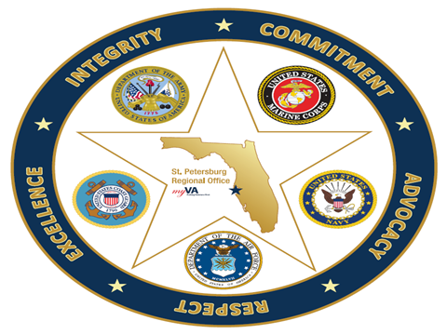
Veterans Service Center (VSC)
Highlights for FYTD
St. Petersburg selected as the only remaining Live Nehmer/BWN processing site, November 2022
Selected as a Prototype Automated Decision Support Site (ADS), December 2022
Processed early PACT Act Processing for Terminal Veterans, December 2022
Officially started PACT processing January 3, 2023
PACT Act Job Fair, February 2023
Outreach Efforts

Slide 3
FYTD Performance (Veterans Served- Output)
Strong overall consistent results
December was challenging due to PACT Training
RO currently ranks in the top 15 in the nation (out of 61)

Slide 4
FYTD Performance- Quality
Quality started off strong but took a dip in November
Robust training plan implemented, lots of newer employees
Quality for last two months has been 100 percent

Slide 5
Veterans Service Center (VSC) –We’re Hiring!
PACT Job Fair success!
Station FTE Raised to 839
203 hires FTYD

Slide 6
Veterans Service Center (VSC) –Outreach
Canvassing the state
47 events completed
71 hours
1,112 Veterans Engaged
Thank you VSOs!

