Slide 1
May 2023
Shelia Jackson, DROCM
VA
Appeals Modernization Act

Slide 2
Outline
AMA Decision Review Selection
VBA Legacy Appeals Workload Overview
Board Full Grants Workload Overview
AMA Toolkit and Resources

Slide 3
Oversight: AMA Decision Reviews
The Veterans Appeals Improvement and Modernization Act of 2017 (AMA), fully implemented on February 19, 2019, provides claimants who disagree with a VA claims decision with the choice of 3 decision review options:
1) supplemental claim, 2) higher-level review, or 3) appeal directly to the Board of Veterans’ Appeals.
VBA has oversight of the following two administrative review options:
Supplemental Claim
Higher-Level Review

Slide 4
AMA – Three Review Options
VBA
BVA
Supplemental Claim | Higher-Level Review | Board Appeal
Replaces “reconsiderations” and “reopening” claims with “new and material” evidence VA will readjudicate a claim if “new and relevant” evidence is presented or identified with a supplemental claim (open record). VA will assist in gathering new and relevant evidence (duty to assist). Effective date for benefits is always protected when submitted within 1 year of prior decision. Tracked and controlled under EP 040 series Decisionmakers are Veterans Service Representatives (VSRs) and Rating VSRs (RVSRs) | More experienced VA employee takes a second look at the same evidence (closed record and no duty to assist). Option for a one-time telephonic informal conference with the higher-level reviewer to discuss the error in the prior decision De novo review with full difference of opinion authority Duty to assist errors returned to lower-level for correction (quality feedback) Tracked and controlled under EP 030 series Decisionmakers are Decision Review Officers (DROs) and Senior VSRs | Evidence only docket: The appellant may submit evidence within 90 days following submission of the NOD. The Board does not have a duty to assist, and the record is otherwise closed. Direct docket: The appellant receives direct review by the Board of the evidence that was before VBA in the decision on appeal. The Board has a 365-day timeliness goal for this docket. Quality feedback loop for VBA. Hearing docket: The appellant is scheduled for a hearing. Additionally, the appellant may submit evidence within 90 days following the scheduled hearing. The Board does not have a duty to assist and the record is otherwise closed.
Notes:
The Supplemental Claim Lane will adjudicate a claim if “new and relevant” evidence is received.
The HLR Lane is a closed record and offers a one-time informal conference.
The BVA Appeal Lane has 3 dockets; evidence only docket, direct docket and the hearing docket.
After receiving an initial VBA decision, Claimants have up to one year to file a notice of disagreement with the Board or have their claim reviewed in the Supplemental Claim Lane or the Higher-Level Review Lane.

Slide 5
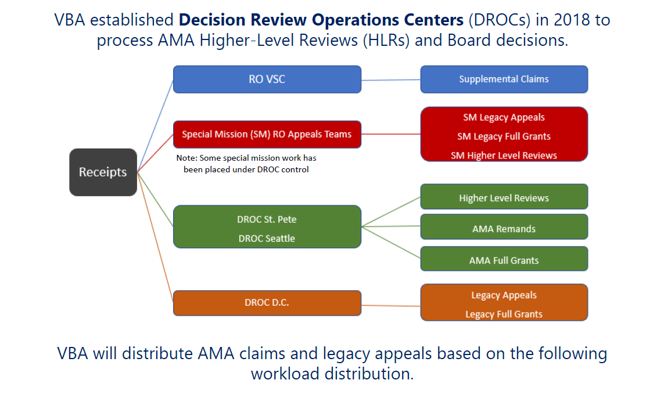
VBA AMA/Appeals Workload Distribution
5

Slide 6
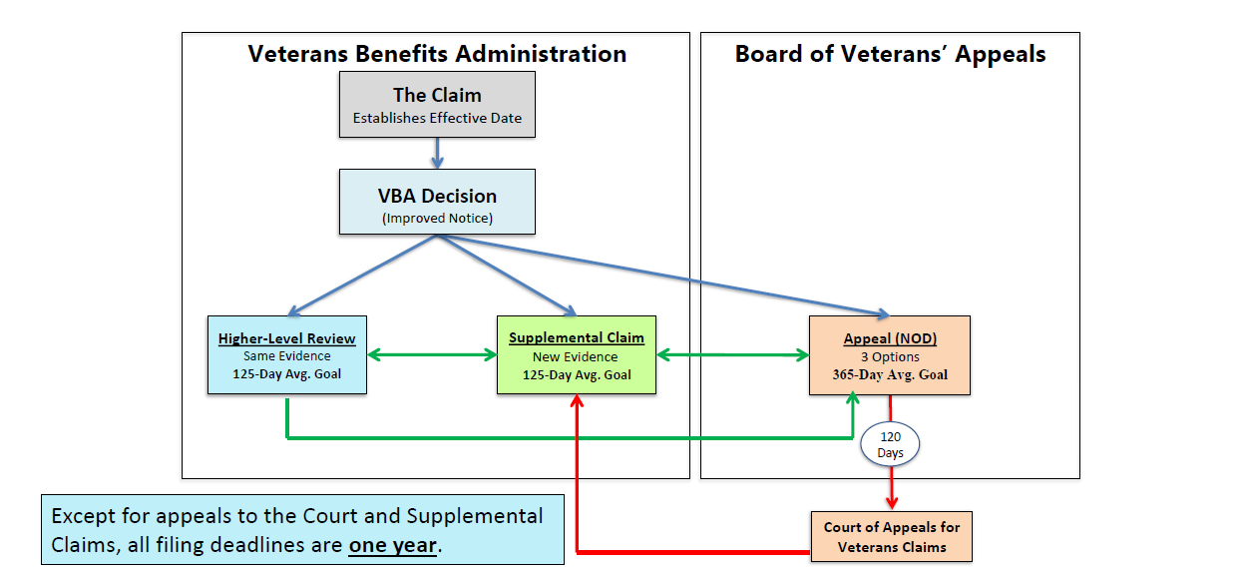
Overview: AMA Review Process

Slide 7
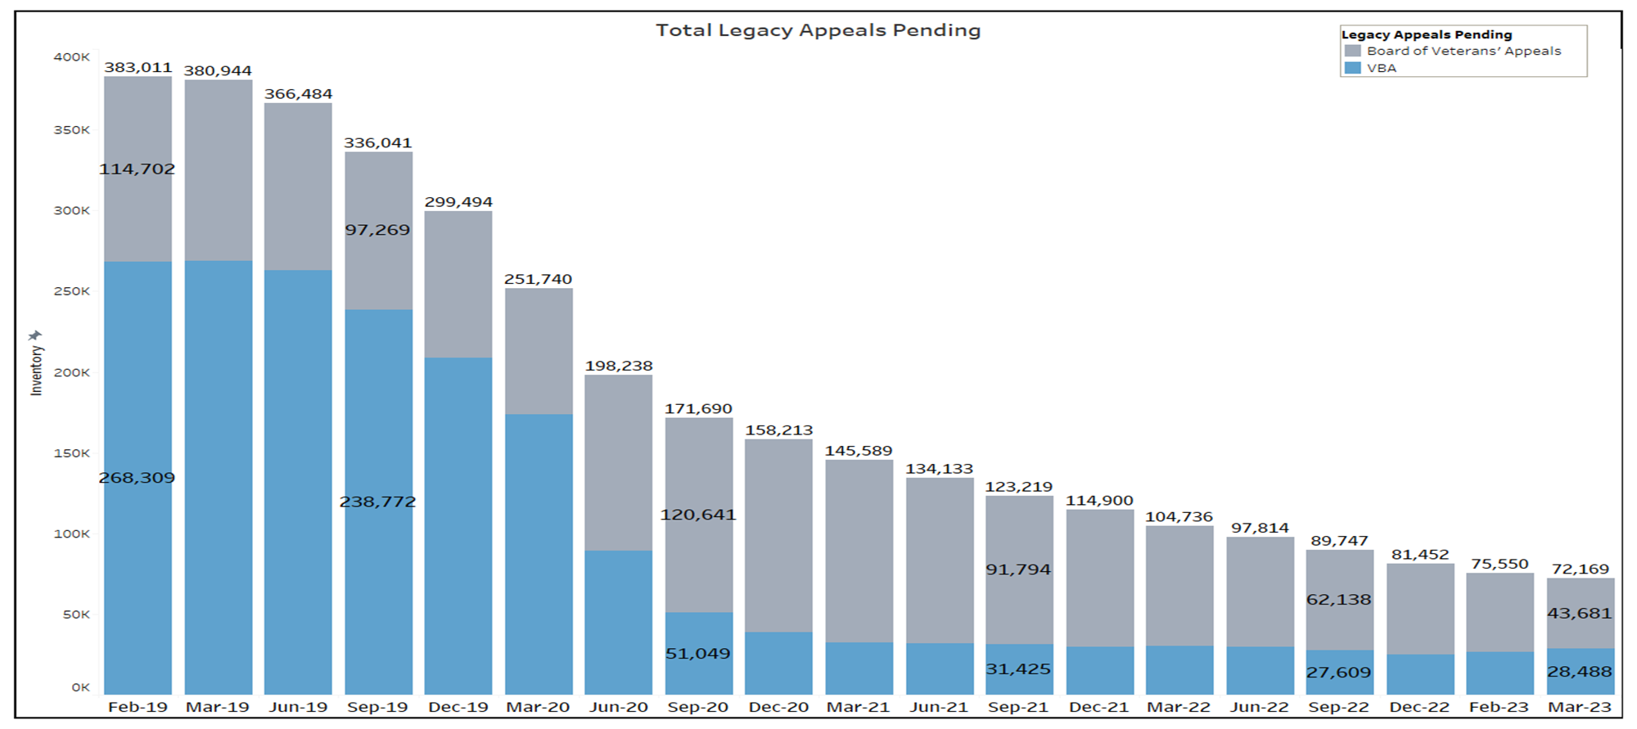
VA’s Legacy Appeals
7

Slide 8
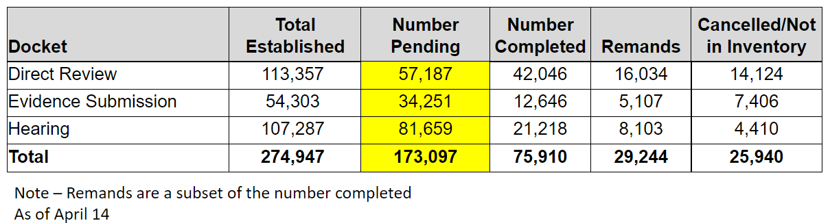
VA Legacy Workload Breakout

Slide 9
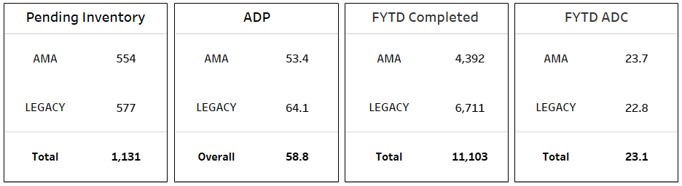
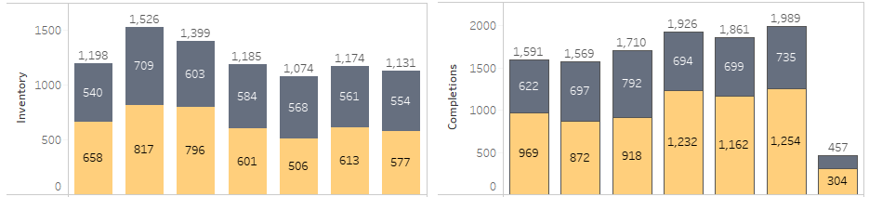
BVA Full Grants Overview

Slide 10
Full Grant Receipts vs Completions
AMA Full Grants are being completed generally on pace with receipts, and inventory is currently 3% lower than EO FY22.
Legacy Full Grant completions have generally outpaced receipts in FY23, overall the Legacy inventory is currently 14% lower than EO FY22.​
Total Full Grant inventory (AMA and Legacy combined) has reduced by 8% since EO FY22.

Slide 11
AMA Decision Review Selection Tools
VBA created tools to assist claimants and accredited representatives with selecting a decision review option that best fits the claimant’s scenario
  Online chart assists Veterans and claimants with choosing a decision review option: www.va.gov/resources/choosing-a-decision-review-option/
  Call center resources assist VBA employees with answering incoming phone calls
  Toolkit assists accredited representatives
Tools improve the customer experience with VBA decision reviews
  Feedback from AMA VSignals surveys and follow-up calls
  Claimants reported wanting more assistance understanding three decision review options
11
Notes:
VBA is constantly working to improve the customer experience with the decision review processes. It has taken several steps to improve the customer experience by providing more resources:
First, we created a new online chart to assist Veterans and claimants with choosing a decision review option. The chart is available at www.va.gov/resources/choosing-a-decision-review-option/
Second, we provided additional resources to the employees who answer incoming calls at the VBA Call Centers, to help them better respond to questions about the decision review options.
Finally, we created a toolkit for accredited representatives to help them provide information on the decision review options to their client. I will be discussing the toolkit on the following three slides.
All of these tools were created based on feedback we received from Veterans and other claimants who responded to the three VBA AMA VSignals surveys.
Survey results and feedback collected from follow-up calls made to a select sample of survey respondents found that claimants wanted more assistance available to them to assist them with understanding the decision review options
The tools were created as a direct response to this feedback

Slide 12
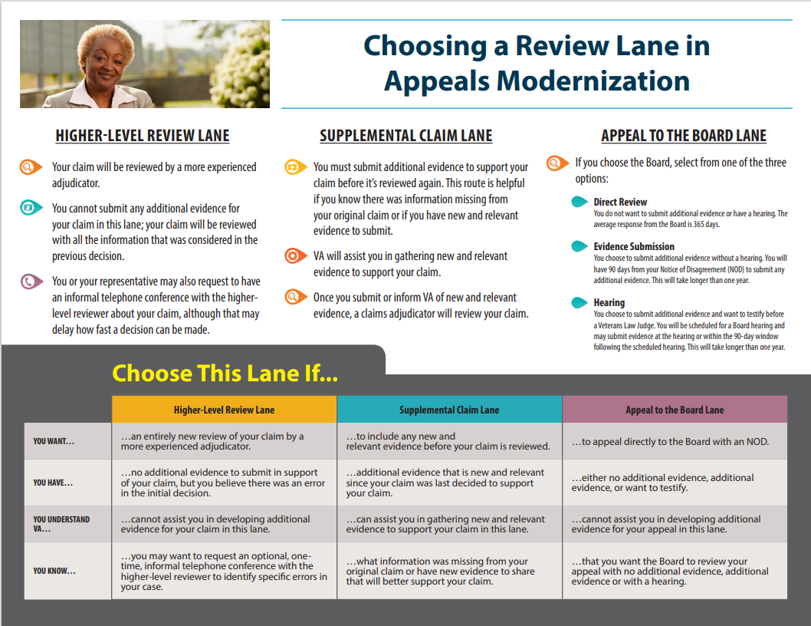
Resources & Materials
The following resources can be found on the VA.gov
website at www.va.gov/decision-reviews
Information on the decision review options
Claim forms and file a higher-level review online
Choosing a decision review option chart
Fact sheet, brochure, infographic, and other resources
FAQs
Get help from a Veterans Service Officer or accredited representative
Connect with VBA:
Facebook: http://www.facebook.com/VeteransBenefits
Twitter: http://twitter.com/VAVetBenefits
Phone: 1-800-827-1000, 8:00 A.M. to 9 P.M. EST

Slide 13

Questions

