Slide 2
Who We Are
Established by the Florida Legislature in 2008
Direct Support Organization of Florida Department of Veterans’
Affairs (FDVA)
501(C)(3) Nonprofit - Accountability
Independent Audit ▪ FDVA statutory oversight ▪ 990 forms are on HelpFlVets.org.
FVF is registered with the Florida Department of Agriculture & Consumer Resources.

Slide 3
Serve All Florida Veterans
375 Florida Veterans Service Organizations (VSO’s)
67 Counties - 172 CVSO’s
Partnerships
Florida Veteran’s Council, Crisis Center Tampa Bay, Mission of Mercy , NE FL Women Veterans, 5 Star Veteran’s Center Jacksonville, Heroes’ Mile Deltona, Bay Area Legal Tampa Free Veteran Legal Helpline, Veteran’s Treatment Court, Project Vet Relief, Florida Association of Managing Entities (FAME) Rural and Low Income Mental Health
Low Cost Affordable Housing, VA Advisor on Veteran Homelessness
Governor’s Suicide Prevention Challenge

Slide 4
100% Firewatch Suicide Prevention Qualified
Toxic Exposure Town Halls / Pact Act – Molina Health
Bridging for the future with current data and outreach
Collaborating with new partners – CVEB, Community Veterans Engagement Board working between community organizations and the VA with Coordinated Assistance Network www.CANportal.org

Slide 5
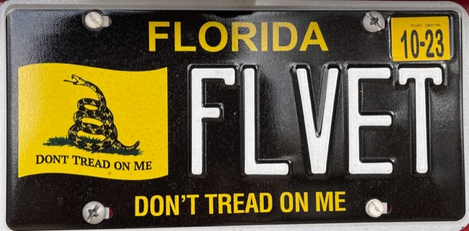
Gadsden Flag License Plate –
90% direct to Veterans.
10% to get into magazines and newspapers

Slide 6
Current Program Involvement
Mission of Mercy
Veteran Nursing Home Dental
Ashley’s Cottage
Rural Area Initiative
Project Vet Relief
Funded Servers 4 Heroes

Slide 7
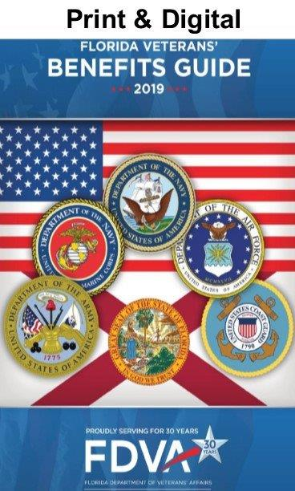
VA Survivors & Burial Benefits Kit

