Slide 1
Florida veterans support line Suicide Prevention
Clara A. Reynolds, President & CEO
Manuel A. Guevara-Ruiz, Veteran Ambassador

Slide 2
Since 2015
844-MYFLVET
Care Coordination
Notes:
The Florida Veterans Support Line (FVSL), 1-844-MYFLVET, opened in 2014 for the five counties surrounding Hillsborough County and was expanded statewide in 2019. Currently, there are nine subcontracts, employing 31 Veterans around the state to provide Peer-to-Peer Care Coordination and Resource Development/Management. Crisis Center staff answers 100% of the 844-MYFLVET calls to assess the needs of the caller and link them to the Veteran Peer Care Coordinator closest to their community. Veterans can also call their local 211 for an automated transfer to the FVSL. 101,000 calls handled since 2015.

Slide 3
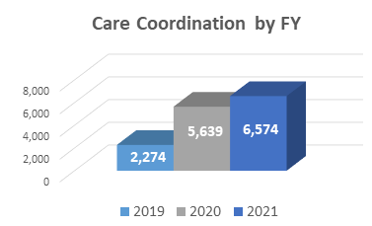
connection
Notes:
In Fiscal Year 2021, 6,574 Veterans were connected to Peer Care Coordination. Supports provided included intervention for suicidal concerns, connections to VA services, mental health linkages and connections to local providers of Veterans services. 78,882 resources provided to veterans.

Slide 4
SUICIDE PREVENTION
INSIGHTS
ACKNOWLEDGMENT
ACTION
Notes:
Manny

Slide 5
Clara Reynolds, President & CEO creynolds@crisiscenter.com
Notes:
Clara Wrap-Up

