Slide 1
Lesson Two: Exposure Claims
Florida Department of Veterans’ Affairs and County Veteran Service Officers Association Spring Conference
May 2022

Slide 2
Lesson Learning Objectives
Recognize claims for diseases and disabilities presumed to be service-connected due to exposure.
Learn about the presumptive rules that apply to Agent Orange/herbicide exposure claims.
Learn about the presumptive rules that apply to different types of Gulf War claims.
Learn about the presumptive rules that apply to Camp LeJeune claims.
Learn about the presumptive rules that apply to radiation exposure claims.
Notes:
In this lesson we will learn to recognize claims for diseases and disabilities presumed to be service-connected due to exposure. To do this we will,
[*click*] Learn about the presumptive rules that apply to Agent Orange/herbicide exposure claims.
[*click*] Learn about the presumptive rules that apply to different types of Gulf War claims.
[*click*] Learn about the presumptive rules that apply to Camp LeJeune claims, and
[*click*] Learn about the presumptive rules that apply to radiation exposure claims.

Slide 3
Presumptive Conditions Recap
For a Veteran with:
qualifying service, and
qualifying health condition
Presumptive service connection removes the need for the Veteran to show VA a nexus between an in-service event and the condition.
Notes:
Before we talk about exposure claims, let’s review the basics of presumptive service connection.
The keys to presumptive service connection are [*click*] having qualifying service and [*click*] a qualifying health condition.
For a Veteran who has both, [*click*] the presumption eliminates the need for the Veteran to provide VA with a nexus opinion linking the condition to service.

Slide 4
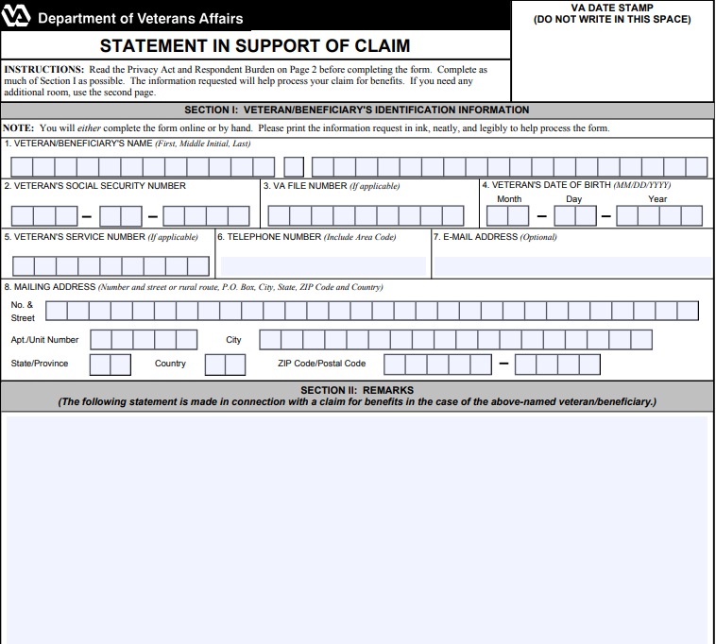
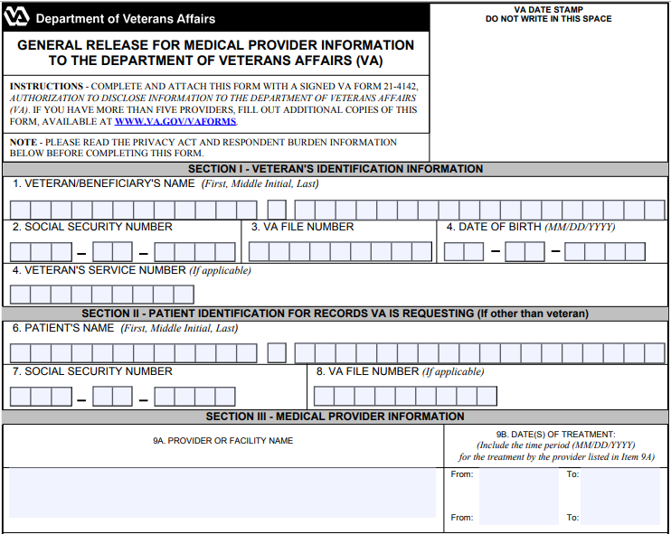
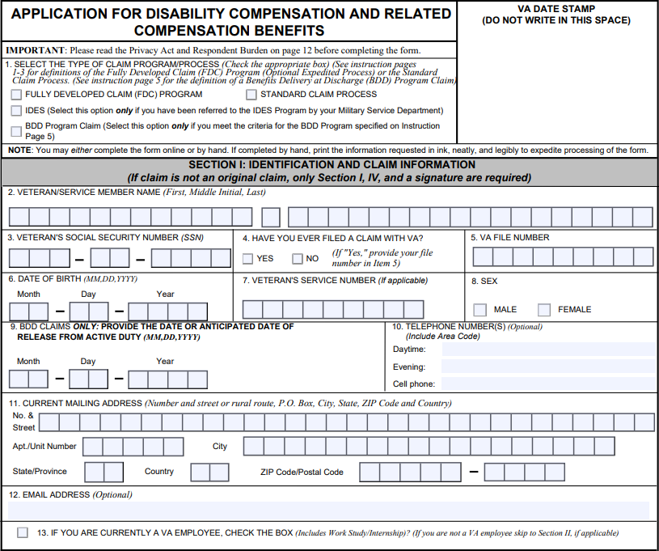
Filing Exposure Claims
There are no special forms for filing exposure claims.
Initiate with Form 21-526EZ or Form 20-0995.
Use Form 21-4142 to identify relevant private medical records.
Use Form 21-4138 to submit a lay statement with relevant details if necessary.
Notes:
The first thing to understand about filing exposure claims is that there are no special forms for doing so.
[*click*] Exposure claims are initiated with a Form 21-526EZ or 20-0995. You can also use an Intent to File beforehand if you need to.
[*click*] When necessary, use Form 21-4142 to identify relevant private medical records, such as treatment records showing the current diagnosis.
[*click*] Also, when necessary, use Form 21-4138 to submit a lay statement with relevant details. As we will see, for some types of exposure claims the occurrence of the exposure will be presumed simply because the Veteran was in a certain place at a certain time. However, for some other types of claims, it is crucial for the Veteran to provide specific details of what happened in service.

Slide 5
Exposure Claim Presumptions
There are two different presumptions!
Qualifying Service = presumption of exposure.
Qualifying Health Condition = presumption of causation.
A claim may be granted using both, one, or neither presumption!
Notes:
Now let’s get into the substance of exposure claims.
When we apply presumptives to exposure claims, there are actually two different presumptions.
First, [*click*] there is one set of presumptions about who was exposed to what in service.
Second, [*click*] there is a separate set of presumptions about what conditions are caused by such exposures.
[*click*] VA benefits can be awarded to a Veteran for a condition on a direct basis even if neither of the presumptions apply. The presumptions simply serve to make one or both of the elements easier to satisfy.
Beginning with the next slide, we are going to discuss four different kinds of exposure claims. There are many different laws creating different kinds of exposure claims and the details of how each type of claim works are different.

Slide 6
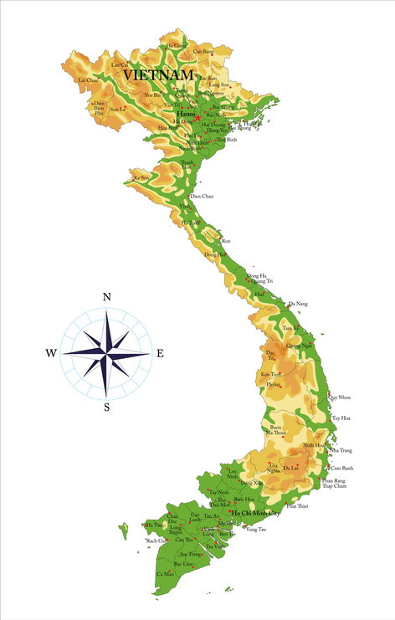
Herbicide-Agent Orange
General Qualifying Service:
Set foot in Republic of Vietnam between January 9, 1962, and May 7, 1975.
Served on board ships in the territorial waters of Vietnam within 12 nautical miles.
Excluded by VA regulations:
Merely flew over Vietnam airspace.
(except for non-Hodgkin’s lymphoma presumption created under the 1984 Act).
Notes:
We’ll begin with the most common kind exposure claim that you are likely to see. A claim based upon exposure to Agent Orange or other tactical herbicides in service.
We’ll begin with the presumption of exposure. There are actually many different kinds of service where exposure is presumed.
The first set of presumptions are pretty general and the details of an individual’s service will typically not be important.
[*click*] If the Veteran set foot in Vietnam between January 1962 and May 1975, then the Veteran is presumed to have been exposed to herbicides.
[*click*] Similarly, if the Veteran served on board ship within 12 nautical miles of Vietnam, then the presumption also applies.
It does not matter what the Veteran was doing or how it happened. Simply showing either kind of presence will work.
However, there is an exception to this presumption. [*click*] Flying over Vietnam does not create a presumption of exposure.
Of course, there is an exception to this exception. [*click*] Benefits are still available for non-Hodgkin’s lymphoma because that presumption was originally created under a different act of Congress based upon general data about Vietnam service.

Slide 7
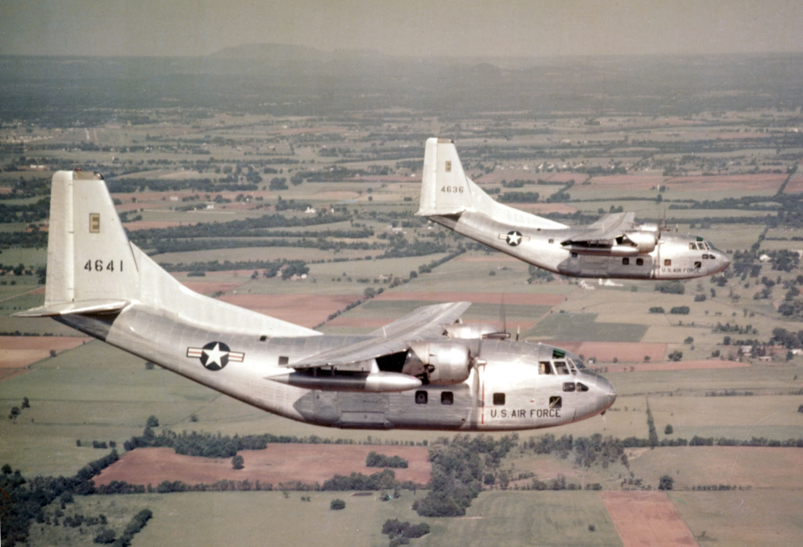
Other Herbicide Exposures
Specific Qualifying Service:
Served on the perimeter of airbases in Thailand used by the U.S. Air Force.
Served on or near the Korean Demilitarized Zone (DMZ) between Sept. 1, 1967, and Aug. 31, 1972.
Operated, maintained, or served onboard C-123s used to spray herbicides.
A detailed statement on a Form 21-4138 is usually needed.
Notes:
Separate from the two general presumptions, there are four other types of military service where exposure is presumed by VA.
These presumptions are much narrower, and the details matter.
[*click*] First, is for those that served on the perimeter of an air base in Thailand. VA will apply this presumption automatically for certain MOSes, but you will often need to help the Veteran submit a lay statement explaining in detail how their service involved being on the perimeter of the air base.
[*click*] Second, is for those who served on or near the demilitarized zone in Korea, which is called the DMZ. Sometimes this will be in a Veteran’s records, but this is another area where a lay statement will often help provided needed detail. Note that there is no definition of what it means to have been “near” the DMZ so you can seek this presumption any time it seems reasonable to apply it.
[*click*] Third, there is a presumption for those that worked on the Ranch Hand C-123s after the planes finished service Vietnam. Simply having been on one of these planes once is not sufficient. The Veteran must show that they operated, maintained, or served onboard.
For these types of claims, a statement on a Form 21-4138 is usually needed to prove exposure because the details of the service matter and are often not in the service records.

Slide 8
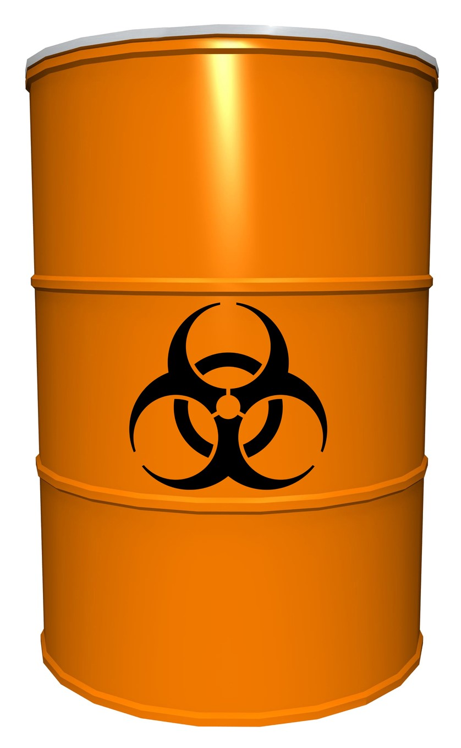
Herbicide Testing and Storage
Agent Orange was tested, stored, and used in many other places.
https://www.publichealth.va.gov/docs/agentorange/dod_herbicides_outside_vietnam.pdf.
16 pages of other times and places where herbicides were tested or stored.
From 1945 to 1977.
Claims are not limited to these recognized times and places!
Notes:
[*click*] Finally, there are several dozen other very specific places and times where VA recognizes that Agent Orange was used or stored.
[*click*] VA maintains a 16-page list that is included your materials. Remember to check VA’s website for updates whenever you have such a claim. It does change from time to time.
Note that the list covers 32 years, from 1945 to 1977.
[*click*] Also remember that claims are not limited to the times and places recognized by VA.
Exposure can always be proven by direct evidence, if available.

Slide 9
The Presumption of Causation
Qualifying Health Conditions:
Listed at 38 C.F.R. § 3.309(e), include leukemia, Parkinson’s disease, Hodgkin’s disease, type 2 diabetes, prostate cancer, ischemic heart disease, lung cancer, etc.
Bladder cancer, hypothyroidism, and Parkinsonism have recently been added to the list.
Use Form 21-4142 to get private treatment records of the diagnosis.
Notes:
Showing exposure is just the first step.
Now let’s talk about the conditions that are presumed to be related to exposure to herbicides.
There are many different conditions that are presumed to be related.
[*click*] The conditions include leukemia, Parkinson’s disease, Hodgkin’s disease, type 2 diabetes, prostate cancer, and ischemic heart disease.
[*click*] Be aware that bladder cancer, hypothyroidism, and Parkinsonism have recently been added to the list.
Also be aware that there is substantial evidence linking hypertension to Agent Orange exposure, but VA does not recognize a presumption of causation for hypertension. Nonetheless, you can still win these claims with a favorable medical nexus opinion. We’ll talk about what should be in such a medical opinion at the very end of this lesson.
[*click*] If the Veteran was diagnosed by a private provider, be sure to use Form 21-4142 to allow VA to obtain these treatment records. Of course, if you have a copy, you can also just include them with the application.

Slide 10
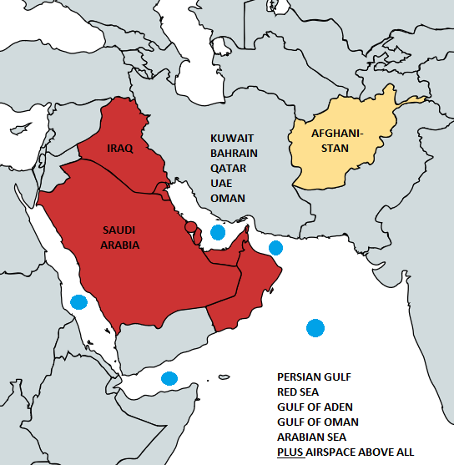
Gulf War Conditions
Qualifying Service: Deployed to Southwest Asia from August 2, 1990, through the present (excludes Afghanistan, except for infectious diseases). See 38 U.S.C. § 101(33).
Qualifying Health Conditions:
Undiagnosed illnesses (UDX)
Chronic multi-symptom illness
Particulate-matter conditions
Infectious diseases
Notes:
Now let’s turn the second major type of exposure claim that you are likely to encounter: Gulf War claims.
VA denies about 90 percent of Gulf War claims. But when filed properly, you can win these claims.
[*click*] Qualifying service begins when the Gulf War began on August 2, 1990, and it continues through the present.
According to the law, the Persian Gulf War started on August 2, 1990, and the conflict continues. Any Veteran with service in Southwest Asia during Persian Gulf War, from 1990 to present, is a Gulf War veteran.
Many Veterans don’t realize that they fall within the definition of Persian Gulf War veteran.
They don’t realize how VA presumptions covers the entire time period from August 1990 through present ~ that’s more nearly 32 years.
Even if a Veteran deployed last week to Southwest Asia, then the Veteran has Gulf War service, thus opening the door to a Gulf War presumption.
You can see the map here of areas accepted in the Southwest Asia theater of operations. This area is defined by regulation.
There are four types of Gulf War illness conditions that qualify a presumption.
[*click*] Undiagnosed illnesses (UDX)
[*click*] Chronic multi-symptom illness,
[*click*] Particulate-matter conditions, and
[*click*] Infectious diseases
Note that service in Afghanistan is not included for undiagnosed illnesses and chronic multi-symptom illness. But it is included for particulate-matter conditions and infectious diseases.
We will talk about each of these in turn.

Slide 11
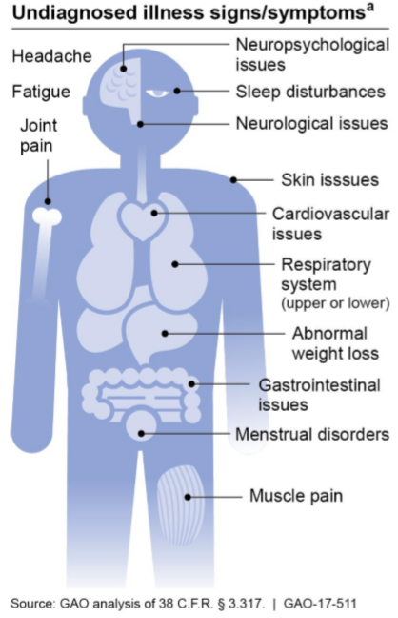
Undiagnosed Illnesses
Except for a list of “signs and symptoms,” VA’s regulation provides no additional guidance for what constitutes an undiagnosed illness.
A UDX claim is difficult to win because most VA doctors provide diagnoses for patients’ symptoms.
If a Veteran has a diagnosis, then there is no undiagnosed illness.
If different doctors cannot agree on the Veteran’s diagnosis, you can argue that the condition is undiagnosed.
Notes:
The first class of Gulf War presumptive illnesses is an undiagnosed illness, often abbreviated as a “UDX.”
[*click*] VA’s regulation provides no guidance for what constitutes a UDX, except for the list of signs and symptoms.
There are many possible signs or symptoms. The graphic is from the 2017 GAO report and simply puts the symptoms with their respective body part.
[*click*] UDX claims are hard to win because once a diagnosis is made, then the Veteran’s condition is no longer “undiagnosed,” and thus no longer a presumptive.
[*click*] If a Veteran has a diagnosis, then there is no undiagnosed illness.
[*click*] However, if different doctors cannot agree on the Veteran’s diagnosis, you can argue that the condition is actually undiagnosed.

Slide 12
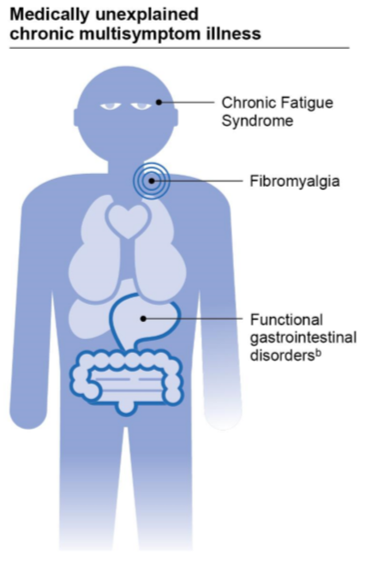
MUCMI
MUCMI is a “diagnosed illness without conclusive pathophysiology or etiology.”
Etiology: cause of a disease
Pathophysiology: the bodily changes caused by a disease
VA recognizes fibromyalgia, chronic fatigue syndrome, and functional gastrointestinal disorders as MUCMIs.
Other conditions may be MUCMIs on a case-by-case basis. If either of the above is not conclusive, then the disease is a MUCMI. See Stewart v. Wilkie, 30 Vet.App. 383 (2018).
Source: GAO Report
Notes:
The second class of presumptive illness for deployed Gulf War Veterans is a medically unexplained chronic multisymptom illness, often called a “MUCMI.”
Unlike UDX, VA’s MUCMI regulation provides guidance about MUCMI.
MUCMI is defined by VA’s regulation, which has a lot of detail about what is or is not considered a MUCMI.
VA’s language is difficult to understand, even for lawyers and judges, so we’ll going to walk through it.
[*click*] A MUCMI is a diagnosed illness without conclusive pathophysiology or etiology.
First, you see that there has to be a diagnosis of an illness. This is immediately different from UDX.
[*click*] Etiology means the cause of a disease.
[*click*] Pathophysiology means the bodily changes caused by that disease.
[*click*] VA recognizes fibromyalgia, chronic fatigue syndrome, and functional gastrointestinal disorders as MUCMIs.
[*click*] However, other conditions may be MUCMIs on a case-by-case basis.
According to a 2018 court case, a MUCMI is a disease where either the cause or the bodily changes caused by the disease are not conclusive.

Slide 13
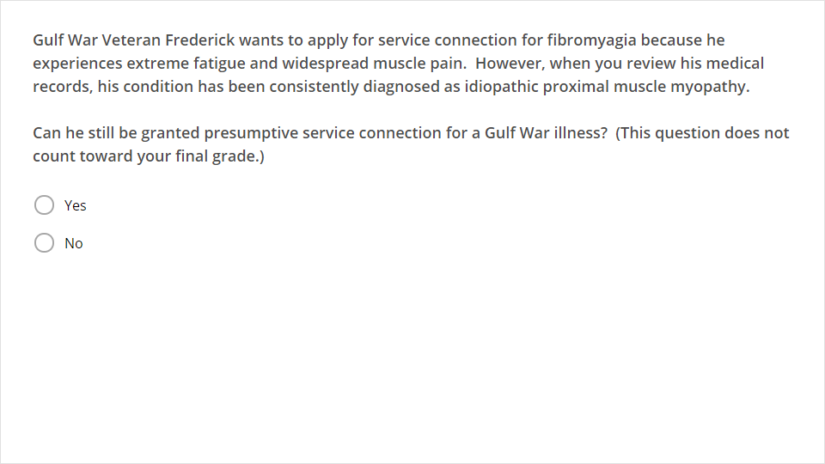
Quiz
Click the Quiz button to edit this object

Slide 14
Answer
Yes!
His condition has a diagnosis, so he probably cannot win under a UDX theory.
However, his condition can be granted service connection as a MUCMI even though it isn’t fibromyalgia.
Frederick’s condition has been labeled “idiopathic” and, therefore, it is a MUCMI because its etiology is unknown.
“Idiopathic” is a medical term meaning that the diagnosis does not have an identifiable cause.
Notes:
The answer is Yes!
[*click*] Frederick’s condition has a diagnosis, so he probably cannot win under a UDX theory unless you discover a lot of other conflicting diagnoses.
[*click*] However, his condition can be granted service connection as a MUCMI even though it isn’t fibromyalgia.
[*click*] “Idiopathic” is a medical term meaning that the diagnosis does not have an identifiable cause.
[*click*] Frederick’s condition has been labeled “idiopathic” and therefore it is a MUCMI because its etiology is unknown.

Slide 15
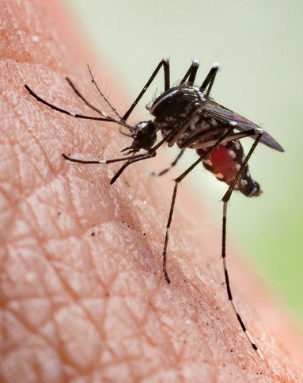
Gulf War Infectious Diseases
Infectious diseases:
9 diseases are listed (ex. brucellosis, malaria, TB, West Nile virus). See 38 C.F.R. § 3.317(c)-(d).
Must be manifest to a degree of 10% or more within one year of separation from service.
Malaria: 1 year from separation or within incubation period.
No time limit for TB and leishmaniasis
Qualifying service for infectious diseases includes Afghanistan after Sept. 19, 2001.
Notes:
The third class of qualifying Gulf War health conditions are infectious diseases. These are not that common and often overlooked when they do come up.
[*click*] There are nine diseases listed. Examples are brucellosis (a bacterial infection), malaria, tuberculosis (TB), and West Nile virus.
As with tropical diseases, these infections must be manifest to a degree of 10% or more disabling within a year or exit from service.
[*click*] The exceptions are malaria, which can also be onset within the normal incubation period of the disease.
[*click*] and also TB and leishmaniasis, which is caused by parasites passed by sand fly bites, can have their onset any time after exit from service.
[*click*] Finally, the infectious disease provisions include service in Afghanistan from September 2001 through present.
Remember, Afghanistan veterans are not included with the presumptions for undiagnosed illnesses and chronic multi-symptom illnesses.

Slide 16
Infectious Diseases Residuals
Long term effects may be service-connected, and examples include:
Brucellosis — arthritis, hearing loss, eye issues
Coxiella burnetti—chronic hepatitis
West Nile — variable physical, functional, or cognitive disabilities
Advocacy Tip: A medical opinion will be needed to link the residual to the presumed infection.
Notes:
[*click*] It’s important to note that the long-term effects of these infections can also be service connected. Here we have here listed a few of the residuals of three of the diseases.
[*click*] Brucellosis can lead to arthritis, hearing loss, and eye problems.
[*click*] Coxiella burnetti can lead to chronic hepatitis.
West Nile virus, which you’ve probably heard mentioned in the news, can cause variable physical, functional, or cognitive disabilities.
These are serious residuals. [*click*] It’s important to understand that even though VA will presume the original infection is related to service, a medical opinion will be needed to link the residual to the presumed infection. If you need time, file an Intent to File while you seek this opinion.

Slide 17
Particulate Matter Exposures
VA has released interim final rules creating new presumptions based on particulate matter exposures. 38 C.F.R. § 3.320.
Qualifying service: (1) Veterans who served in Southwest Asia during the Persian Gulf War and/or (2), in Afghanistan, Syria, Djibouti, or Uzbekistan after September 19, 2001, during the Persian Gulf War.
These Veterans are presumed to have been exposed to particulate matter.
Notes:
The fourth and final Gulf War illness class is relatively new.
[*click*] In August 2021, VA announced an interim final rule creating presumptive service connection for Gulf War veterans based upon exposure to particulate matter.
An interim rule means that it went into effect immediately, but that some details could be changed when the final version is released.
[*click*] For this presumption, there are two types of qualifying service. First, Veterans who served in the Southwest Asia theater of operations during the Persian Gulf War. Second, Veterans who served in Afghanistan, Syria, Djibouti, or Uzbekistan after September 19, 2001, during the Persian Gulf War.
Note that the inclusion of Syria, Djibouti, and Uzbekistan makes this broader than the other presumptions
[*click*] Veterans with qualifying service are presumed to have been exposed to particulate matter.

Slide 18
Particulate Matter Conditions
Qualifying conditions: asthma, rhinitis, sinusitis to include rhinosinusitis.
The condition must have manifest to any degree (including noncompensable) within 10 years from the Veteran’s date of separation of military service that includes a qualifying period of service.
Does not apply to acute manifestations or diseases that are seasonal in nature.
Notes:
[*click*] The qualifying conditions under this rule are asthma, rhinitis, and sinusitis to include rhinosinusitis.
[*click*] The condition must have manifest to any degree (including noncompensable) within 10 years from the Veteran’s date of separation of military service that includes a qualifying period of service.
[*click*] This presumption does not apply to acute manifestations or diseases that are seasonal in nature. So service connection will not be granted for a one-time episode of the disease or for seasonal allergies.

Slide 19
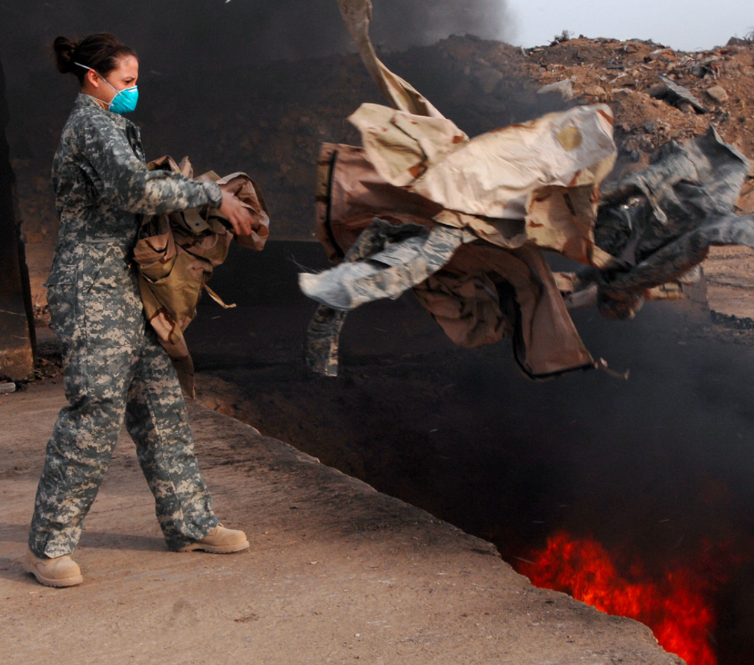
Burn Pits
In the Gulf War theater, service members were often instructed to dispose of waste and trash in “burn pits.”
The burn pits produced smoke and fumes and particulate matter.
VA’s Public Health office admits Veterans “may experience health effects related to this exposure.”
Visit VA’s public health website for more information.
U.S. service member tosses trash into a Burn Pit in Iraq, 2008. Source: Wikipedia (public domain)
Notes:
Now let’s talk about burn pits.
[*click*] In the Gulf War theater, service members were often instructed to dispose of waste and trash in “burn pits.”
[*click*] The burn pits produced smoke and fumes and particulate matter.
[*click*] VA’s Public Health office admits Veterans “may experience health effects related to this exposure.”
[*click*] You can visit VA’s public health website for more information.

Slide 20
Burn Pit Exposure Claims
There are no presumptive rules for burn pit claims!
Until Congress or VA creates a presumption, Veterans must prove every single element using direct service connection before winning a claim.
The elements of a claim related to a burn pit exposure are the same as any other VA claim:
Present disability
In-service injury or event
Nexus (connection) between the two
Notes:
[*click*] Although you hear a lot about burn pits, there are no special rules for claims based upon burn pit exposure
[*click*] Until Congress or VA creates a presumption, Veterans must prove every single element using direct service connection before winning a claim.
Because there’s no burn pit presumption, then you must treat the claim as any other type of claim.
[*click*] You must prove the elements of service connection…
[*click*] In other words, you will need evidence of a present disability, an in-service injury or event, and of a nexus between the two
For a claim based upon burn-pit exposure, the in-service event is the exposure to a burn pit. Crucially, you will need a favorable medical opinion to prove the nexus. Work with the Veteran and his or her doctor to obtain one.

Slide 21
Camp Lejeune
Qualifying Service: Spent cumulative total of 30 days at Camp Lejeune between August 1, 1953, and December 31, 1987.
Qualifying Health Conditions: Listed at 38 C.F.R. § 3.309(f): including kidney cancer, liver cancer, non-Hodgkin’s lymphoma, adult leukemia, multiple myeloma, Parkinson’s disease, aplastic anemia and other myelodysplastic syndromes, bladder cancer.
Family members who lived at the base with the Veteran are eligible for reimbursement of medical expenses for 15 different conditions. Use VA Form 10-10068b to apply.
Notes:
A third kind of presumptive exposure claim you will see is for Veterans exposed to contaminated drinking water at Camp Lejeune, North Carolina.
The water supply there was contaminated with benzene and other hazardous industrial chemicals from the 1950s through the 1980s.
[*click*] The presumption applies to any service member, including National Guard and Reserve, who served a total of at least 30 days on base during that time period. The 30 days do not have to have been continuous.
[*click*] The eight qualifying health conditions are mostly forms of cancer, as well as Parkinson's disease and aplastic anemia.
[*click*] In addition to benefits for the Veteran, family members who lived at the base with the Veteran are eligible for reimbursement of medical expenses for 15 different conditions. Use VA Form 10-10068b to apply.

Slide 22
Radiation Exposed Veterans
Qualifying Service: Participated in radiation-risk activities around atomic bomb blast sites in Japan, nuclear weapon test sites, and other high-risk locations. See 38 C.F.R. § 3.309(d)(3).
Qualifying Health Conditions: Listed at 38 C.F.R. §§ 3.309(d) and 3.311, including many types of cancer.
Advocacy Tip: Look carefully at the spelling for each island where the Veteran served in the Pacific Ocean for nuclear weapons testing.
Notes:
The final class involves conditions associated with radiation exposure at places like
[*click*] World War II bomb sites in Hiroshima and Nagasaki, nuclear weapon test sites around the world, and enriched uranium plants in Oak Ridge, Tennessee and Paducah, Kentucky.
[*click*] VA lists many types of cancers associated with radiation exposure.
Look carefully at the names of the islands in the Pacific where the U.S. tested nuclear weapons, as some have different spellings and have even changed names.

Slide 23
Non-Presumptive Conditions
Direct service connection for exposure is still possible for conditions VA did not list as presumptive. See Combee v. Brown, 34 F.3d 1039 (Fed. Cir. 1994).
Proof must be based upon specific risk factors of the individual Veteran. See Polovick v. Shinseki, 23 Vet.App. 48 (2009).
Provide expert opinion that discusses:
Why the Veteran’s case is special, and
Why exposure is at least as likely as not to be the underlying cause.
Advocacy Tip: Gathering evidence or a nexus opinion may take time. File an Intent to File, VA Form 21-0966, to preserve the Veteran’s claim effective date.
Notes:
[*click*] Direct service connection for exposure is still possible for conditions VA did not list as presumptive.
Therefore, You may be able to prove that a health condition is related to one of these exposures even if it’s not one that VA has presumed to be related to service.
[*click*] To do this, you’ll need to show a nexus between the condition and specific risk factors of the individual Veteran in your case.
You will need an expert opinion that discusses:
[*click*] Why the Veteran’s case is special, and
[*click*] Why exposure is at least as likely as not to be the underlying cause.
For example, say you had a Veteran who served for four years in-country in Vietnam. Now he has developed brain cancer. However, brain cancer is not on VA’s list of qualifying conditions.
In this situation, the doctor could write a nexus opinion for the Veteran. The doctor could say the Veteran’s exposure was greater than most people’s, and his brain cancer was at least as likely as not caused exposure in service.
[*click*] Be sure to file an Intent to File, Form 21-0966, to save the Veteran’s effective date while you seek evidence or a favorable nexus opinion.

