Slide 1
Lesson One:
Presumptive Conditions
Florida Department of Veterans’ Affairs and County Veteran Service Officers Association Spring Conference
May 2022
Notes:
UPDATE AUDIO

Slide 2
Lesson Learning Objectives
Recognize claims for diseases and disabilities where VA can grant service connection on a presumptive basis:
Evaluate claims to determine whether they meet military service qualifications for presumptive service connection.
Evaluate claims to determine whether they meet health condition qualifications for presumptive service connection.
Evaluate claims to determine whether they meet time restrictions for presumptive service connection.
Notes:
UPDATE AUDIO
-We’ve already had several lessons on how to establish connection to service. This lesson will cover another way, presumptive service connection.
-We will look at the special rules that apply to disease caused by exposure to certain situations or toxins.
-[click] We will look at the disease and disabilities that can be presumptively service-connected.
-[click] For each presumptive group we will look at the military service requirements, [click] the health condition requirements, [click] and the time restrictions for the onset of the presumptive disease.

Slide 3
Presumptive Conditions Overview
Certain diseases and disabilities are presumed by VA to be related to military service:
Tropical Diseases: 38 CFR § 3.309(b)
Prisoner of War: 38 CFR § 3.309(c)
Radiation: 38 CFR § 3.309(d)
Herbicide - Agent Orange: 38 CFR § 3.309(e)
Gulf War Illness: 38 CFR § 3.317(e)
Camp LeJeune: 38 CFR § 3.309(f)
Particulate Matter / Burn Pits: 38 CFR § 3.320 * New in 2021!
For a Veteran with qualifying service and a qualifying health condition, presumption removes the need to show a nexus between the Veteran’s military service and the Veteran’s current condition.
Notes:
Congress and VA have decided that certain diseases and disabilities can be presumed to be related to military service if the Veteran was exposed to certain conditions at certain times.
These conditions can be broken down into the seven major classes you see listed here. They range from tropical diseases to contaminated water at Camp Lejeune. The newest class applies to Veterans who were exposed to particulate matter, or burn pits. We will go over each of these groups in this lesson.
If the Veteran qualifies for one of these presumptive conditions, then the Veteran is relieved from the burden of having to prove a nexus between their current health condition and military service. The nexus is already satisfied by law.
Although most of these are all lumped under one regulation (38 CFR Section 3.309), these sevenclasses stem from several different laws passed by Congress at different times, and the rules do not operate in the same way for each class.
To take advantage of one of these presumptive conditions, the Veteran has to meet qualifications in terms of their military service and health condition. In some cases, they also have to meet time restrictions.

Slide 4
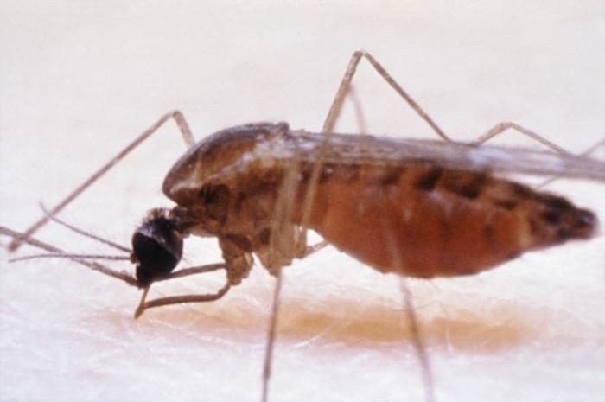
1: Tropical Diseases
Qualifying Service: Served in a tropical area.
Qualifying Health Conditions:
Listed at 38 C.F.R. § 3.309(b), including cholera, dysentery, malaria, yellow fever, and resultant disorders or diseases due to treatment of such diseases, or as a preventative thereof.
Time Restriction:
Condition must have manifested to a degree of 10% or more within one year of service or within the incubation period for the condition.
Photo: CDC
Presumptions apply to any Veteran with service in a tropical area.
Notes:
The first class is for tropical diseases.
[click] These rules apply to any Veteran who served in a tropical area [click] if they contracted one of the health conditions listed in 38 CFR 3.309(b) [click] .
The most common ones are for cholera, dysentery, malaria, and yellow fever.
You can see here a mosquito, which can transmit many of these tropical diseases.
[click] Like chronic conditions, the disease has to manifest to a compensable degree within one year of service, although sometimes you can show that the commonly accepted incubation period for certain conditions is longer than one year.

Slide 5
2: Prisoner of War
Qualifying Service: Was Prisoner of War (POW)
Qualifying Health Conditions: 38 C.F.R. § 3.309(c)(1)
Includes psychosis, anxiety conditions, depression, residuals of
frostbite, posttraumatic osteoarthritis, certain heart diseases,
and stroke.
Qualifying Health Conditions with at least 30 days as POW:
38 C.F.R. § 3.309(c)(2) Includes the above plus avitaminosis, chronic dysentery, malnutrition, irritable bowel syndrome, peptic ulcer disease, peripheral neuropathy, cirrhosis of the liver.
Time Restriction: None, if manifested to a degree of 10% or more at any time after exit from service
Notes:
The second presumptive class relates to former prisoners of war (POWs).
VA has reviewed numerous studies on the effects of imprisonment.
POWs could experience ill-treatment/torture, malnourishment, and psychological trauma. They also could live in unsanitary conditions and suffer from various infectious diseases. Presumptive conditions is this class are a result of these conditions.
There are two separate provisions under this class. [click] The first is for veterans who were POWs for any period of time.
The qualifying conditions include psychoses and other mental health conditions, residuals of frostbite, certain types of arthritis and heart disease, and stroke.
[click] The second provision under this class is for veterans who were POWs for 30 days or more.
These POWs are presumptively service connected for any of the conditions in the first provision, plus dysentery, malnutrition, IBS, a cirrhosis.
[click] Any condition must be manifest to a degree of 10 percent or more disabling at any time after exit from service. It doesn’t matter how long after service the conditions manifests, the presumption still applies.

Slide 6
3: Radiation Exposed Veterans
Qualifying Service:
Participated in radiation-risk activities around atomic bomb blast sites in Japan, nuclear weapon test sites, and other high-risk locations.
Qualifying Health Conditions:
Listed at 38 C.F.R. §§ 3.309(d) and 3.311, including many types of cancer.
Time Restrictions: None.
Advocacy tip: Look carefully at the names and spelling of Pacific islands where the U.S. tested or stored nuclear weapons and waste.
Notes:
[click] The third one is for conditions associated with radiation exposure at places like World War II bomb sites in Hiroshima and Nagasaki, nuclear weapon test sites around the world, and enriched uranium plants in Oak Ridge, Tennessee and Paducah, Kentucky.
[click] VA lists many types of cancers associated with radiation exposure.
[click] And the conditions can manifest anytime after service.
[click] Look carefully at the names of the islands in the Pacific where the U.S. tested nuclear weapons, as some have different spellings and have even changed names.

Slide 7
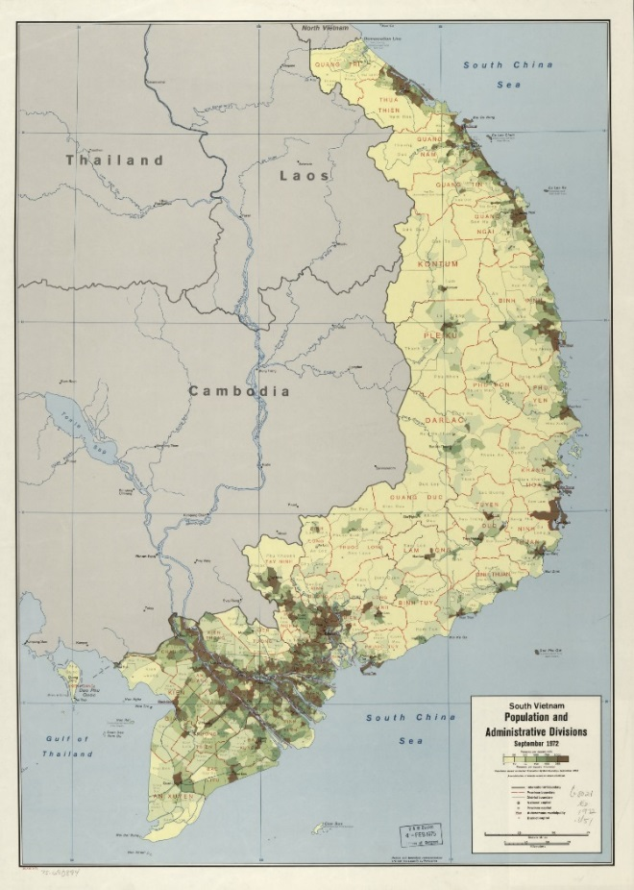
4: Herbicide-Agent Orange
Exposure to herbicides is presumed if:
Qualifying Service:
Service in Republic of Vietnam between January 9, 1962, and May 7, 1975.
Served on the perimeter of airbases in Thailand used by the U.S. Air Force.
Served on the Korean Demilitarized Zone between April 1, 1968 and August 31, 1972.
Operated, maintained, or served onboard C-123s used to spray herbicides.
Excluded by VA regulations:
Merely flew over Vietnam airspace.
Photo: Library of Congress
Notes:
The presumptions related to herbicide exposure are probably the most well-known. Veterans are presumed to be exposed to herbicides, including Agent Orange, if they meet one of the following service requirements:
[click] The most common is if they set foot in Vietnam or served on a ship in the territorial waters of Vietnam during the dates you see here.
This also applies to those who served on [click] perimeter of airbases in Thailand, [click] in the Korean Demilitarized Zone in the late 60s/early 70s, and [click] on aircraft that sprayed herbicides.
However, VA excludes Veterans who only flew over Vietnamese airspace.

Slide 8
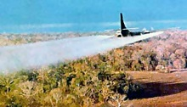
4: Herbicide Cont.
Qualifying Health Conditions:
Listed at 38 C.F.R. § 3.309(e), including leukemia, Parkinson’s disease,
Hodgkin’s disease, type 2 diabetes, prostate cancer, ischemic heart
disease, etc.
Time Restrictions:
None, if manifested to a degree of
10% of more at any time after exit
from service (with exceptions for
chloracne, porphyria cutanea tarda,
and early-onset peripheral
neuropathy).
Photo: VA
Notes:
-[click] If a Veteran was presumptively exposed to herbicides, then VA will presume diseases listed at 3.309(e) were related to the Veterans exposure to hebricides. This list includes leukemia, Parkinson’s, Hodgkin’s disease, diabetes, prostate cancer, ischemic heart disease, and numerous others.
-[click] There are no time restrictions for these diseases to start. If any of these qualifying health conditions manifest to 10% or more at any time after exit from service.
-Although there is an exception for chloracne and early-onset peripheral neuropathy.

Slide 9
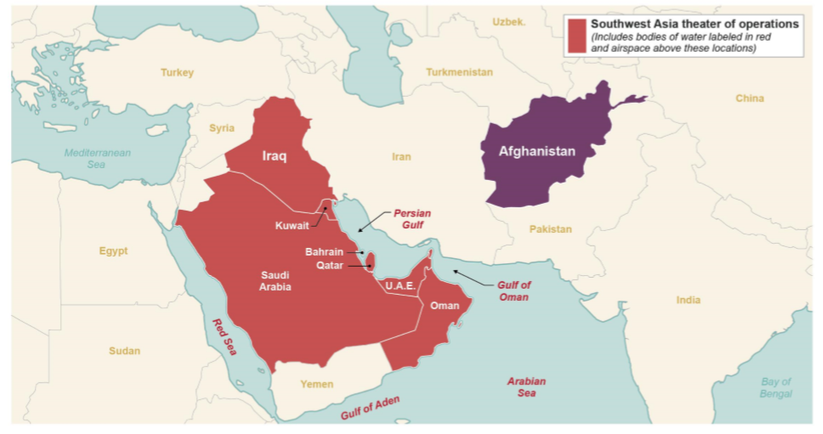
5: Gulf War Illness
Qualifying Service:
Served in Southwest Asia from August 2, 1990, through the present (excludes Afghanistan, except for infectious diseases).
Qualifying Health Conditions:
Listed at 38 C.F.R. § 3.317:
Undiagnosed illnesses (UDX)
Chronic multi-symptom illness, such as chronic fatigue syndrome, fibromyalgia, functional gastrointestinal disorders
Infectious diseases
Time Restrictions:
Condition must manifest before December 31, 2026.
Notes:
UPDATE AUDIO
Another big category of presumptive service connection is based on service in the Gulf War.
[click] Qualifying service for Class 5 begins when the Gulf War began on August 2, 1990, and it continues through the present. Even if a Veteran deployed last week to Southwest Asia, then the Veteran has Gulf War service, thus opening the door to a Gulf War presumption.
[click] You can see the map here of areas accepted in the Southwest Asia theater of operations listed in red. This includes the bodies of water listed in red AND the airspace over these areas. So unlike the herbicide exposure, flying over the airspace counts for the Gulf War presumption.
Afghanistan only counts for infectious diseases, not the other health conditions.
There are three types of Gulf War illness conditions that qualify for this presumption.
[click] The first and most difficult is undiagnosed illness.
[click] The second is Chronic Multi-symptom Illness.
[click] Third is, infectious diseases. We will go over all three categories in the next slides
[click] The Veteran’s condition must manifest before December 31, 2026.

Slide 10
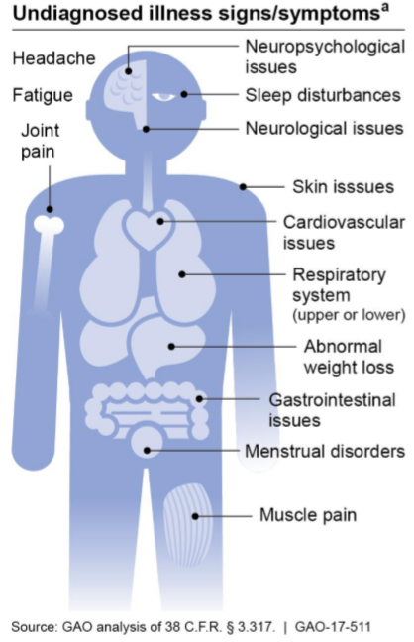
5: Undiagnosed Illness
VA regulations list signs and symptoms of undiagnosed illness, but no additional guidance.
A UDX claim is difficult to win because most VA doctors provide diagnoses for patients’ symptoms.
Try seeking direct service connection for these symptoms.
Notes:
So lets explore the two big categories of Gulf War presumptive health conditions. First in undiagnosed illness.
[click] VA’s regulation provides a list of signs and symptoms of an undiagnosed illness, but no additional guidance.
[click] The graphic is from the 2017 GAO report and simply puts the symptoms with their respective body part. These signs and symptoms include headaches, fatigue, joint plain, and pain problems, along with the others you see listed here.
[click] Undiagnosed illness claims are hard to win because once a diagnosis is made, then the Veteran’s condition is no longer “undiagnosed,” and thus no longer a presumptive. However, medical doctors are trained to find a diagnosis. So usually VA examiners will assign each symptom some diagnosis, meaning it is no longer an undiagnosed illness for this presumption.
For this reason, we advise trying to establish direct service connection for the symptom first, since undiagnosed illness claims are hard to win.

Slide 11
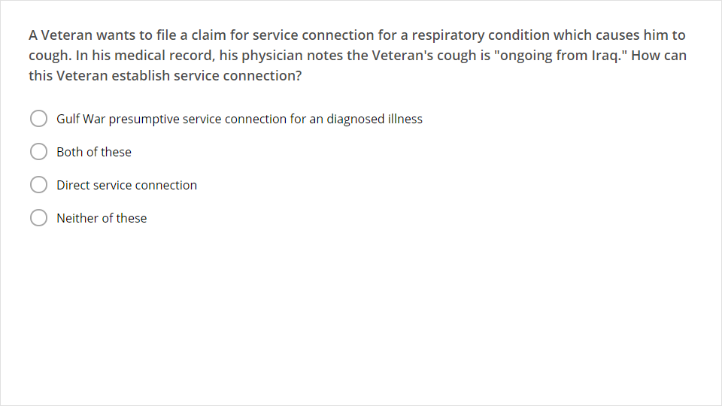
Quiz
Click the Quiz button to edit this object

Slide 12
Question Answer
Both of these
This Veteran can establish service connection two ways:
He can establish direct service connection, because his cough started in service and is ongoing.
He can also establish presumptive Gulf War service connection because respiratory symptoms are signs and symptoms of an undiagnosed illness, and he served in Iraq.
Notes:
-The best answer in this case is Both of these. This Veteran can establish service connection two ways:
[click] he can establish direct service connection, because his cough started in service and is ongoing
[click] he can also establish presumptive Gulf War service connection because respiratory symptoms are signs and symptoms of an undiagnosed illness, and he served in Iraq.

Slide 13
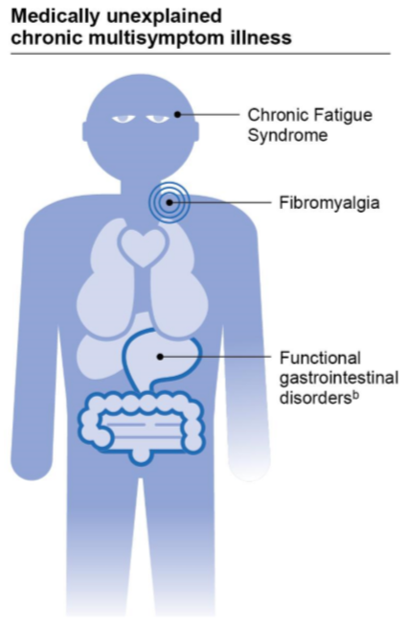
5: MUCMI
VA’s regulations provide more guidance about MUCMIs.
MUCMI is a “diagnosed illness without conclusive pathophysiology or etiology.”
Etiology: cause of a disease
Pathophysiology: the bodily changes caused by a disease
The Court has stated that if either of the above is not conclusive, then the disease is a MUCMI.
Notes:
The second class of presumptive illness for deployed Gulf War Veterans medically unexplained chronic multisymptom illness, often called MUCMI.
[click] MUCMI is defined by VA’s regulation, which has a lot of detail about what is or is not considered a MUCMI.
[click] A MUCMI is a diagnosed illness without conclusive pathophysiology or etiology.
First, you see that there has to be a diagnosis of an illness. This is immediately different from an undiagnosed illness.
[click] Etiology means the cause of a disease.
[click] Pathophysiology means the bodily changes caused by that disease.
[click] According to a 2018 court case, a MUCMI is a disease where either the cause or the bodily changes caused by the disease are not conclusive. Stewart v. Wilkie, 30 Vet.App. 383 (2018).
Chronic multisymptom illnesses of partially understood etiology and pathophysiology are not considered medically unexplained. For this reason, diabetes and multiple sclerosis are listed as specific conditions that are not MUCMI.
[click] This graphic includes some common MUCMIs, including chronic fatigue syndrome, fibromyalgia, and functional gastroinstestinal disorders.
If a Veteran served in the Gulf War and develops at MUCMI at any time before December 31, 2021, then the MUCMI should be presumptively service connected.

Slide 14
5: Infectious Disease
9 diseases are listed (ex. brucellosis, malaria, TB, West Nile virus).
Must be manifest to a degree of 10% or more within one year of separation from service.
Malaria: 1 year from separation or within incubation period.
No time limit for TB and leishmaniasis
Long term effects may be service-connected.
Ex. Brucellosis--arthritis, hearing loss, eye issues
Ex. Coxiella burnetti--chronic hepatitis
Ex. West Nile--variable physical, functional, or cognitive disabilities
Qualifying service for infectious diseases includes Afghanistan after Sept. 19, 2001.
Notes:
An overlooked class of qualifying Gulf War health conditions are infectious diseases.
[click] There are nine infections diseases listed in VA regulations. Examples include, malaria, tuberculosis (TB), and West Nile virus.
[click] As with tropical diseases, these infections must be manifest to a degree of 10% or more disabling within a year or exit from service.
[click] The exceptions include malaria, which can also be onset within the normal incubation period of the disease and [click] TB which can have its onset any time after exit from service.
[click] It’s important to note that the long-term effects of these infections can also be service connected. We have here listed a few of the residuals of three of the diseases. . West Nile virus, which you’ve probably heard mentioned in the news, can cause variable physical, functional, or cognitive disabilities.
These are serious residuals. If a doctor can link those conditions to the original infection, service connection can be granted.
[click] Finally, the infectious disease provisions include service in Afghanistan from September 2001 through present.
Remember, Afghanistan veterans are not included with the presumptions for undiagnosed illnesses and chronic multi-symptom illnesses.

Slide 15
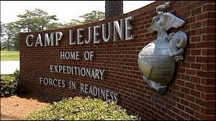
6: Camp LeJeune
Qualifying Service:
Spent cumulative total of 30 days at Camp Lejeune between August 1, 1953, and December 31, 1987.
Qualifying Health Conditions:
Listed at 38 C.F.R. § 3.309(f): including kidney cancer, liver cancer, non-Hodgkin’s lymphoma, adult leukemia, multiple myeloma, Parkinson’s disease, aplastic anemia and other myelodysplastic syndromes, bladder cancer.
Time Restriction: None.
Photo: VA
Notes:
UPDATE AUDIO
Another class of presumptive conditions is for Veterans exposed to contaminated drinking water at Camp Lejeune, North Carolina.
The water supply there was contaminated with benzene and other hazardous industrial chemicals from the 1950s through the 1980s.
[click] The presumption applies to any service member, including National Guard and Reserve, who served a total of at least 30 days on base during that time period. The 30 days do not have to have been continuous.
[click] Eight qualifying health conditions are listed at 3.309(f). These are mostly forms of cancer, as well as Parkinson's disease and aplastic anemia.
[click] There is no time restriction on this presumption. So if a Veteran with qualifying service develops any of these eight conditions at any time, then they should be presumptively service connected.

Slide 16
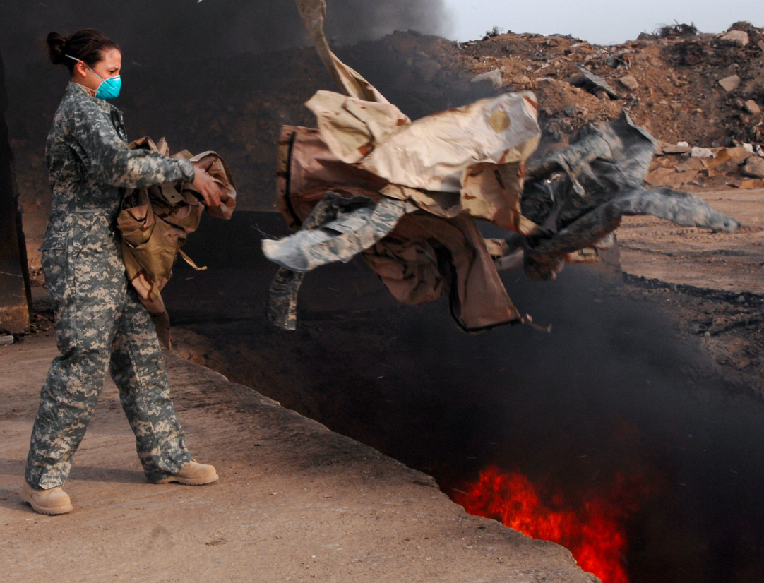
7: Particulate Matter (Burn Pits)
In the Gulf War theater, plus other deployment areas, service members were often instructed to dispose of waste and trash in huge “Burn Pits.”
Hundreds of Burn Pits produced smoke, fumes, and toxic pollution.
The Public Health department of VA acknowledges that Veterans “may experience health effects related to this exposure.”
Photo: VA
Notes:
ADD AUDIO
-VA’s newest category of presumptive service connection is for Veterans who developed certain respiratory illnesses after they were exposed to particulate matter from burn pits during service.
-*In the Gulf War theater, plus some other areas we will talk about, service members were often instructed to dispose of waste and trash in huge burn pits.
-*These burn pits produced smoke, fumes, and toxic pollution. VA has acknowledged that Veterans “may experience health effects related to this exposure.”
-*In recognition of these health effects, VA added the new class of presumptive service connection for certain respiratory conditions following exposure to Burn Pits in the summer of 2021. VA has indicated that they will continue to study these health effects and may add additional presumptive conditions in the future. Bergmann and Moore will be sure to let you know if new health conditions are added to this list.

Slide 17
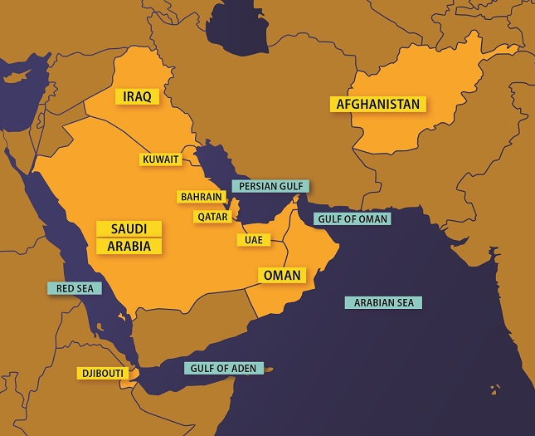
7: Particulate Matter Cont.
Qualifying Service:
Southwest Asia (SWA) on or after August 2, 1990. See 38 C.F.R. § 3.317
Plus Afghanistan, Syria, Djibouti, or Uzbekistan on or after September 19, 2001. See 38 C.F.R. § 3.320
Qualifying Health Conditions:
Asthma
Rhinitis
Sinusitis, to include rhinosinusitis
Photo: VA
Notes:
ADD AUDIO
Let’s start with the qualifying service in order to take advantage of the newest presumptive class for exposure to particulate matter, or burn pits.
*This includes Veterans who served in any of the countries of bodies of water included in VA’s definition of the Southwest Asia theater of operations on or after August 2, 1990. Just like we talked about in the Gulf War presumptive class.
*For the new Burn Pit presumptions, VA also added Veterans who served in Aghanistan, Syria, Djibouti, or Uzbekistan on or after September 19, 2001. Not the different date for these additional countries.
This map is from VA. It includes some of the qualifying countries and water areas. But note this map has not yet been updated to also include Syria and Uzbekistan.
It does not matter what the Veteran was doing or when they served in this region, or how long they were in the area. The time requirement is as short as part of one day. Simply showing any kind of presence will work.
For now, the list of qualifying health conditions only includes three conditions: *asthma, *rhinitis, and *sinusitis, which includes rhinosinusitis.

Slide 18
Non-Presumptive Conditions
Direct service connection for exposure is still possible to prove for conditions not on the presumptive lists. See Combee v. Brown, 34 F.3d 1039 (Fed. Circ. 1994).
Proof must be based upon specific risk factors of the individual Veteran.
Provide expert opinion on:
Why the Veteran’s case is special, and
Why the Veteran’s exposure is at least as likely as not to be the underlying cause.
Advocacy tip: You may be able to prove a non-presumptive condition is related to an exposure by arguing for “Direct” service connection.
Notes:
[click] You may be able to prove that a health condition is related to one of these types exposures even if it’s not one that is presumed to be related to service. For example, hypertension is not included in the list at 3.309(e) as diseases that as presumptively caused by exposure to Agent Orange. However, a Veteran may still be able to prove that in his case, his diagnosis of hypertension was caused by his exposure to Agent Orange.
[click] To do this, you’ll need to show nexus between the condition and the exposure in the special case of your Veteran, based on that Veteran’s specific risk factors.
[click] This will usually require an expert medical opinion. This medical expert should provide an opinion on why the Veteran’s case is so special, and why their in-service exposure is at least as likely as not to be the underlying cause.
[click] With good evidence, you may be able to prove a nexus between the non-presumptive condition and one of these exposures, therefore establishing service connection.

