Slide 1
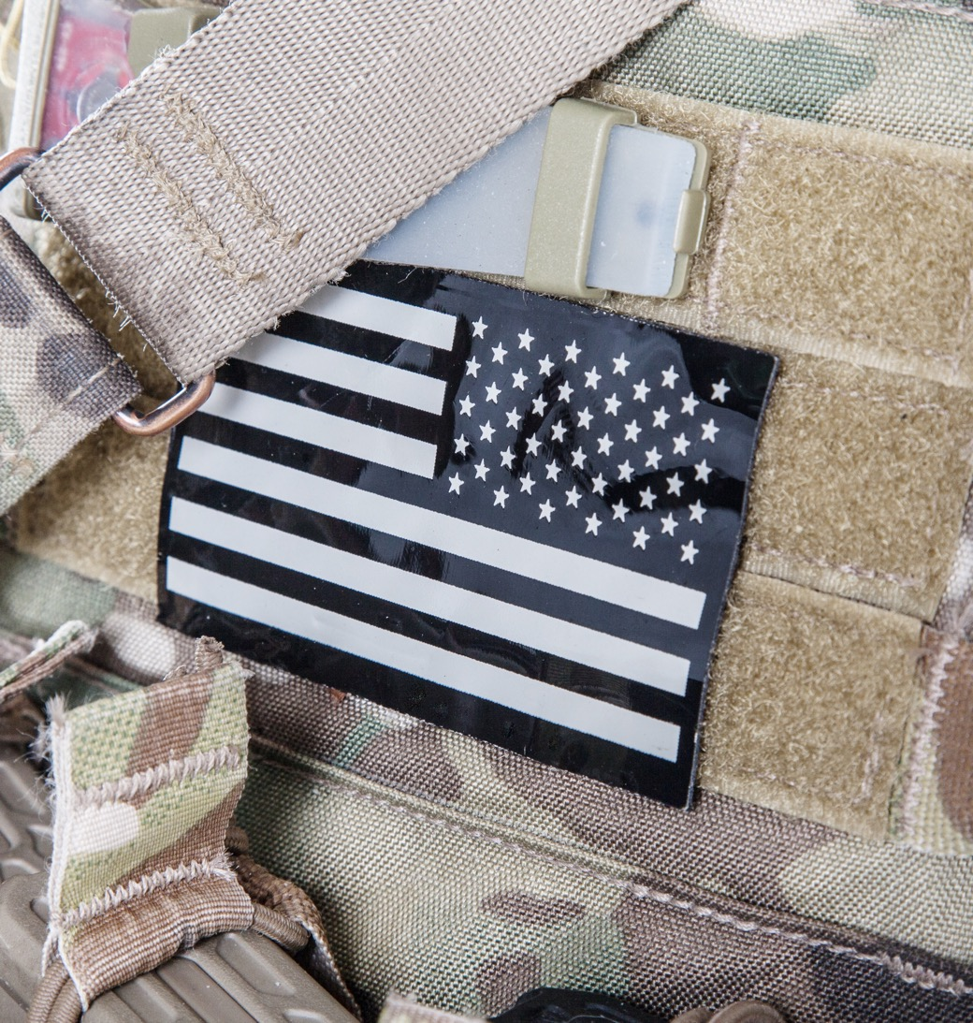


Slide 2
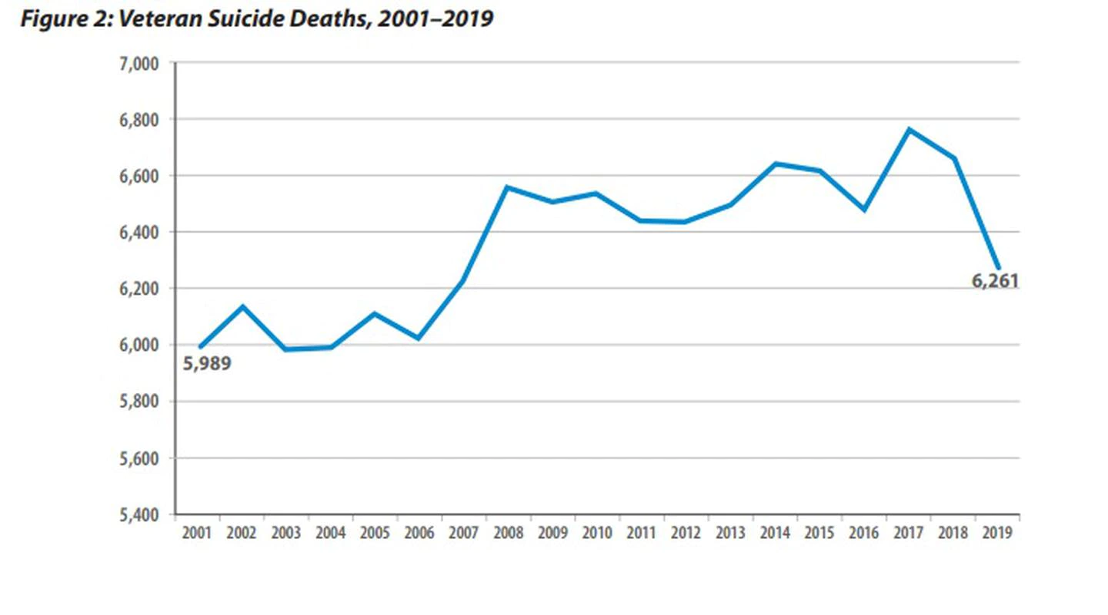
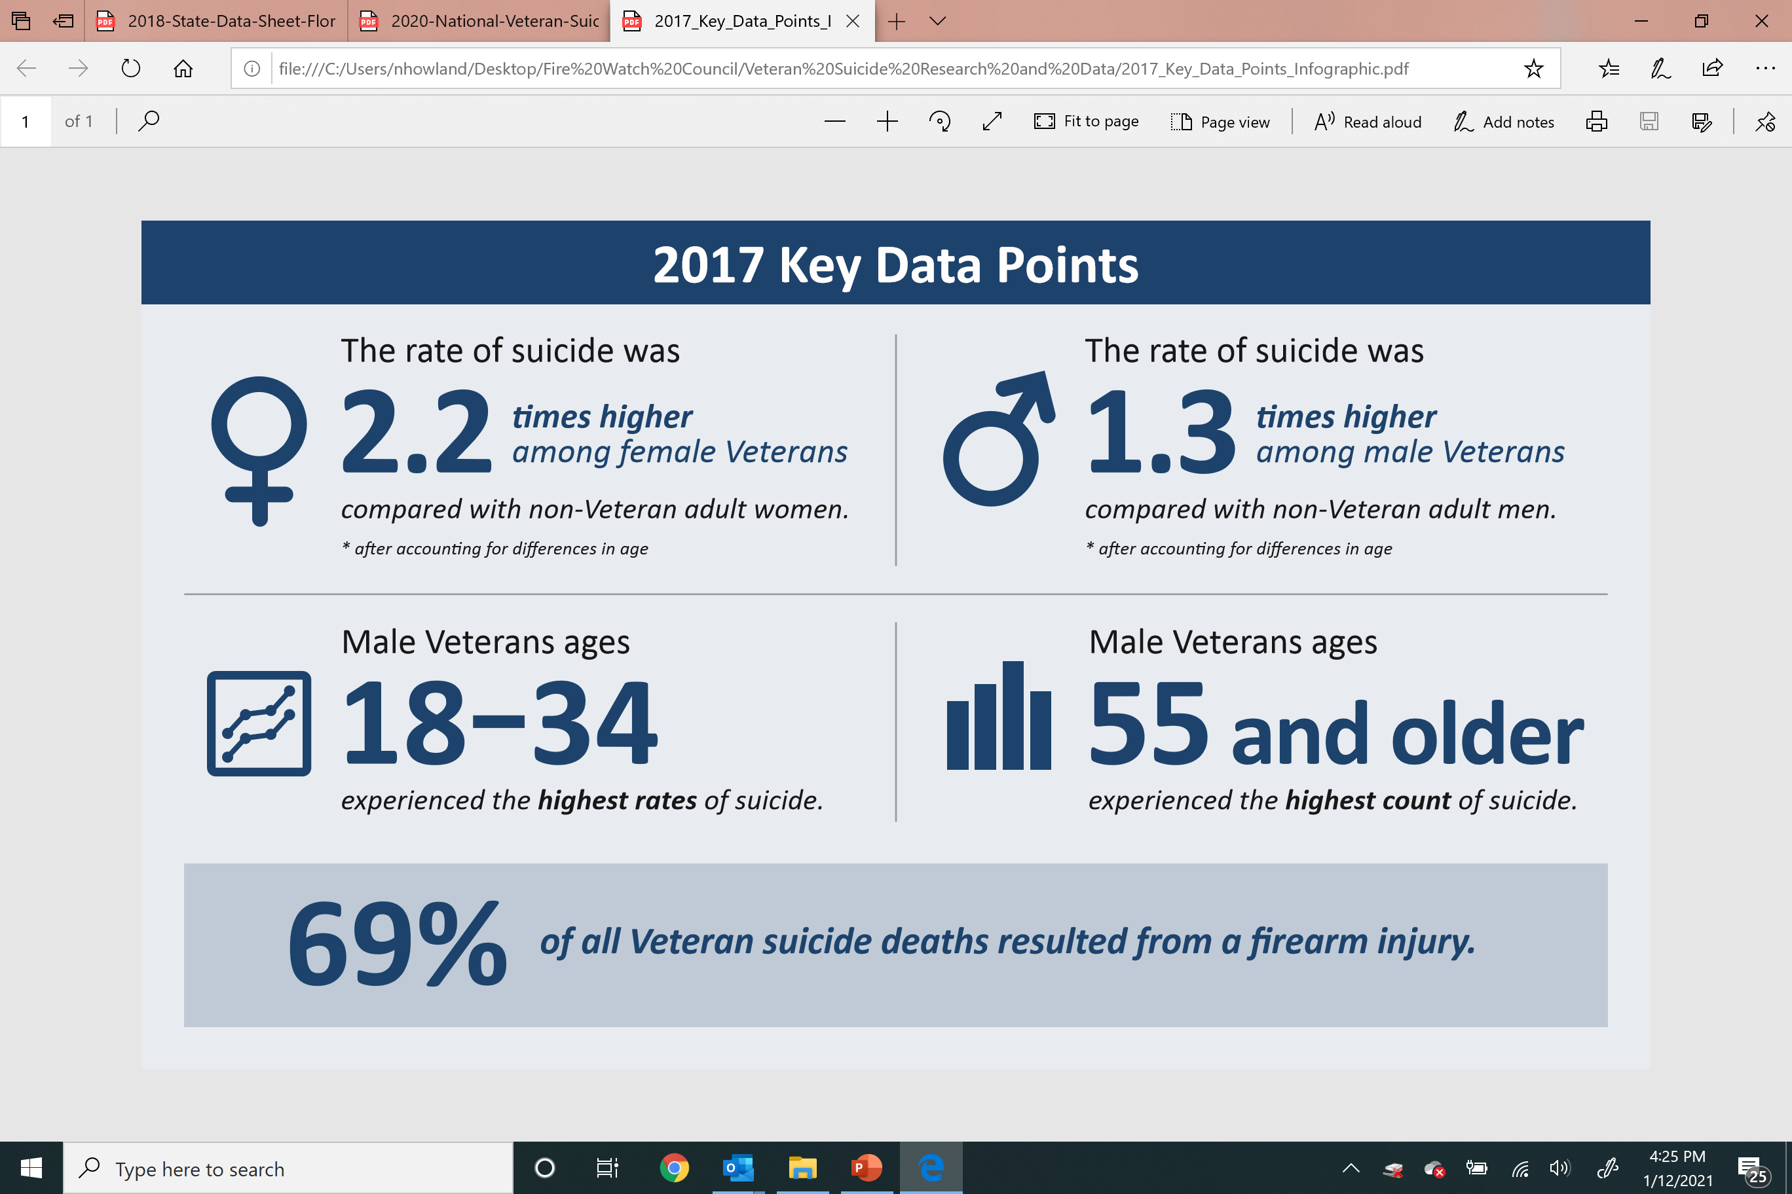
A national crisis.
Notes:
Right graphic needs update

Slide 3
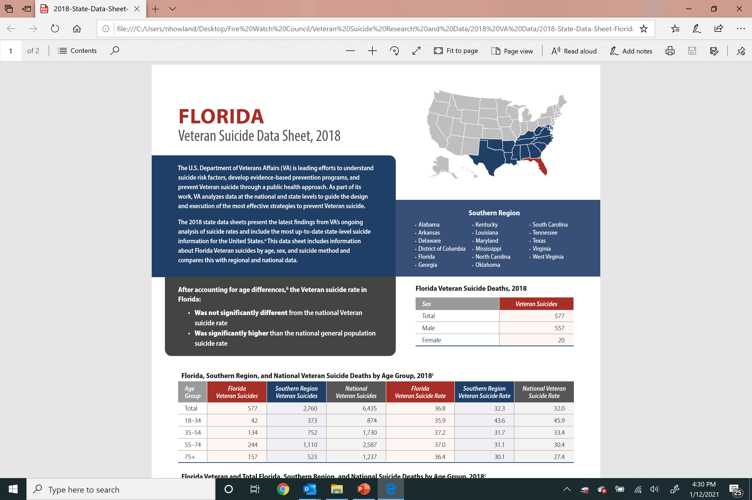
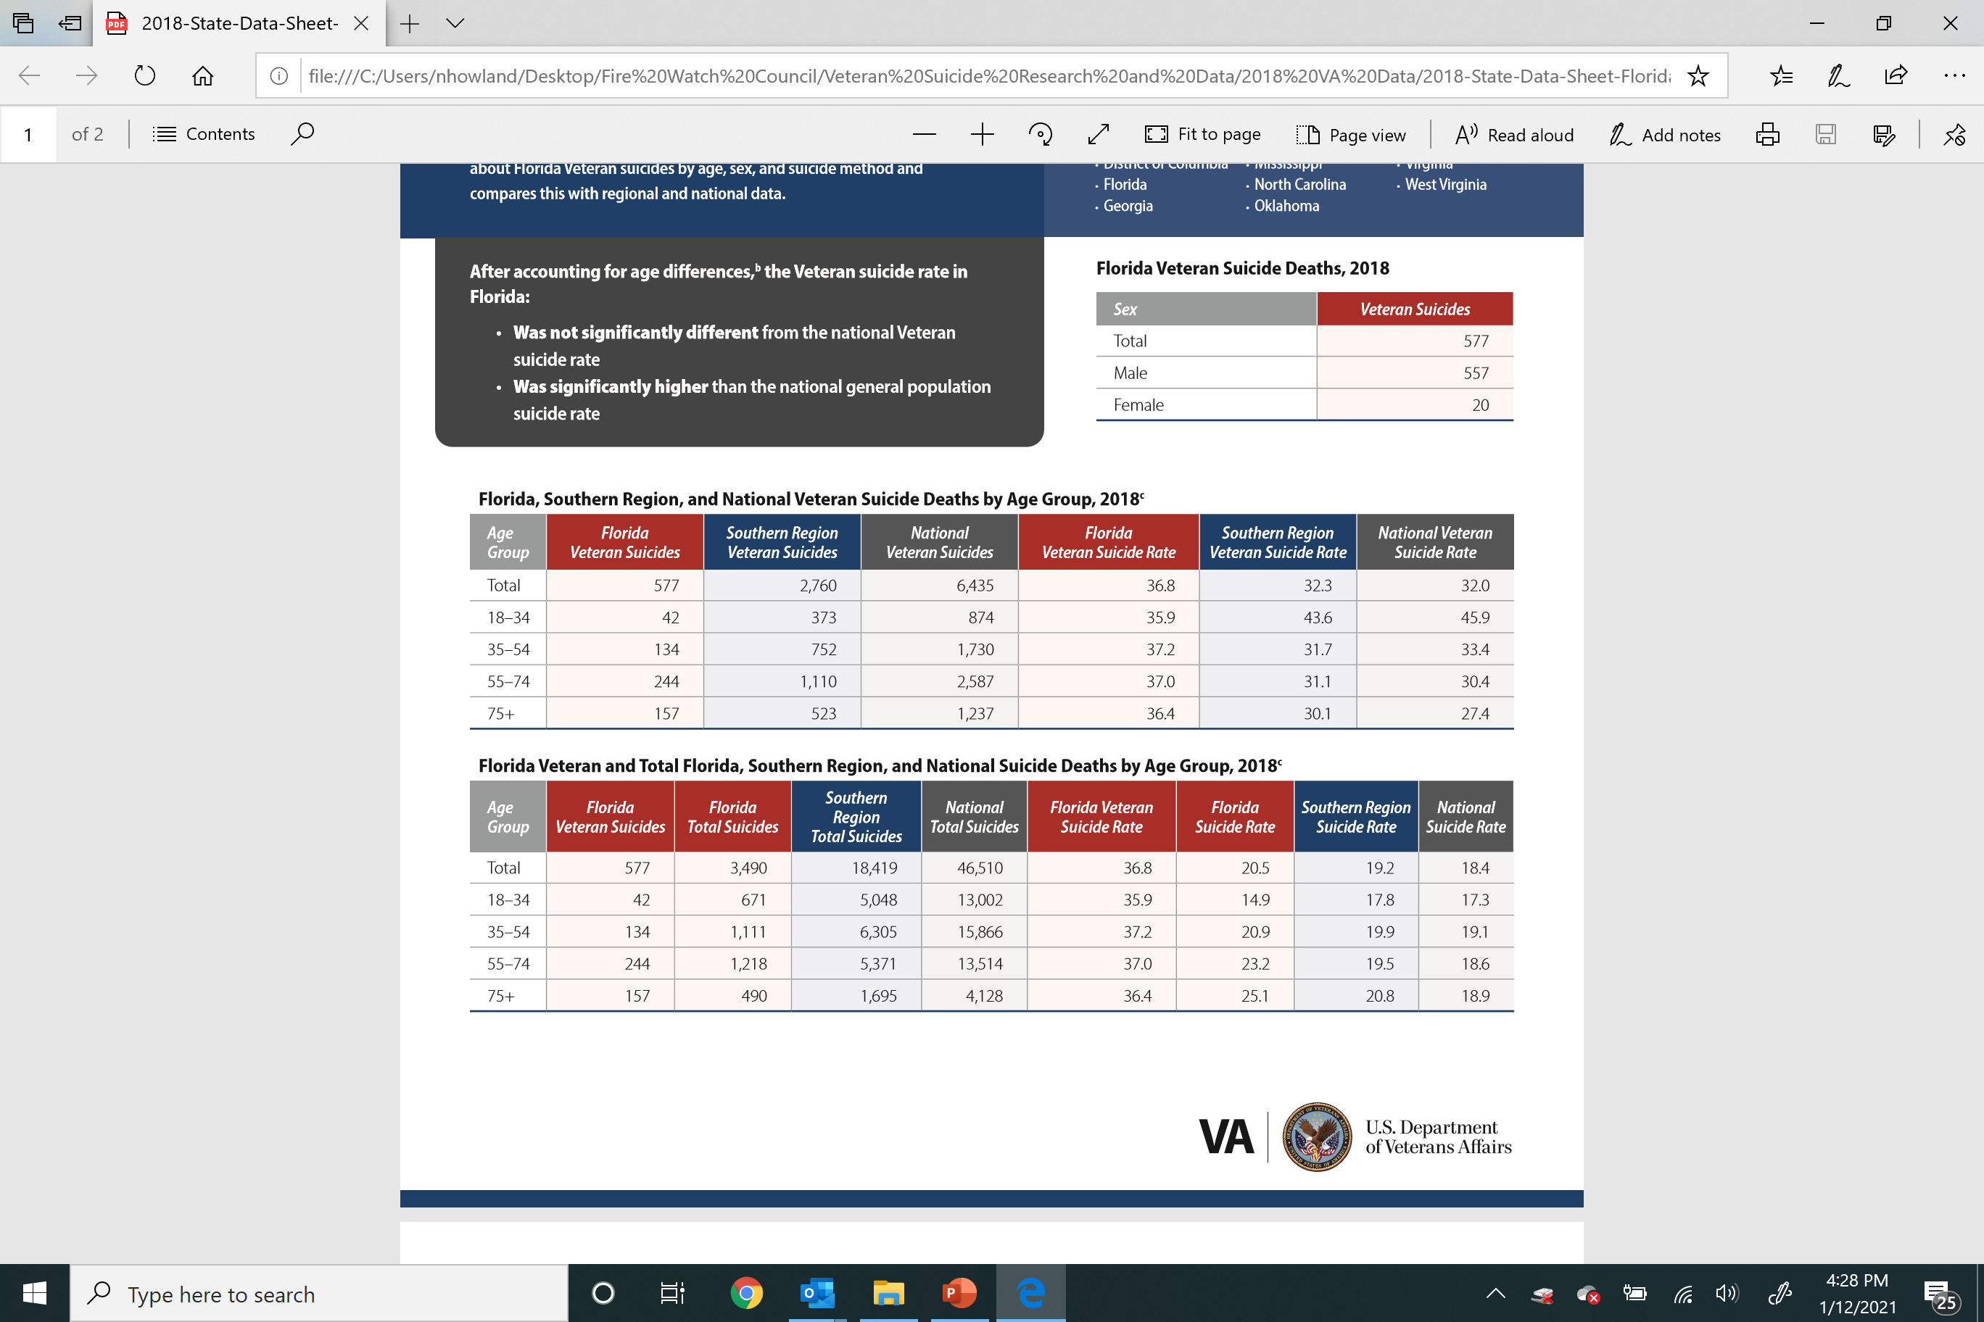
A regional crisis.
Notes:
Regional data needs update

Slide 4
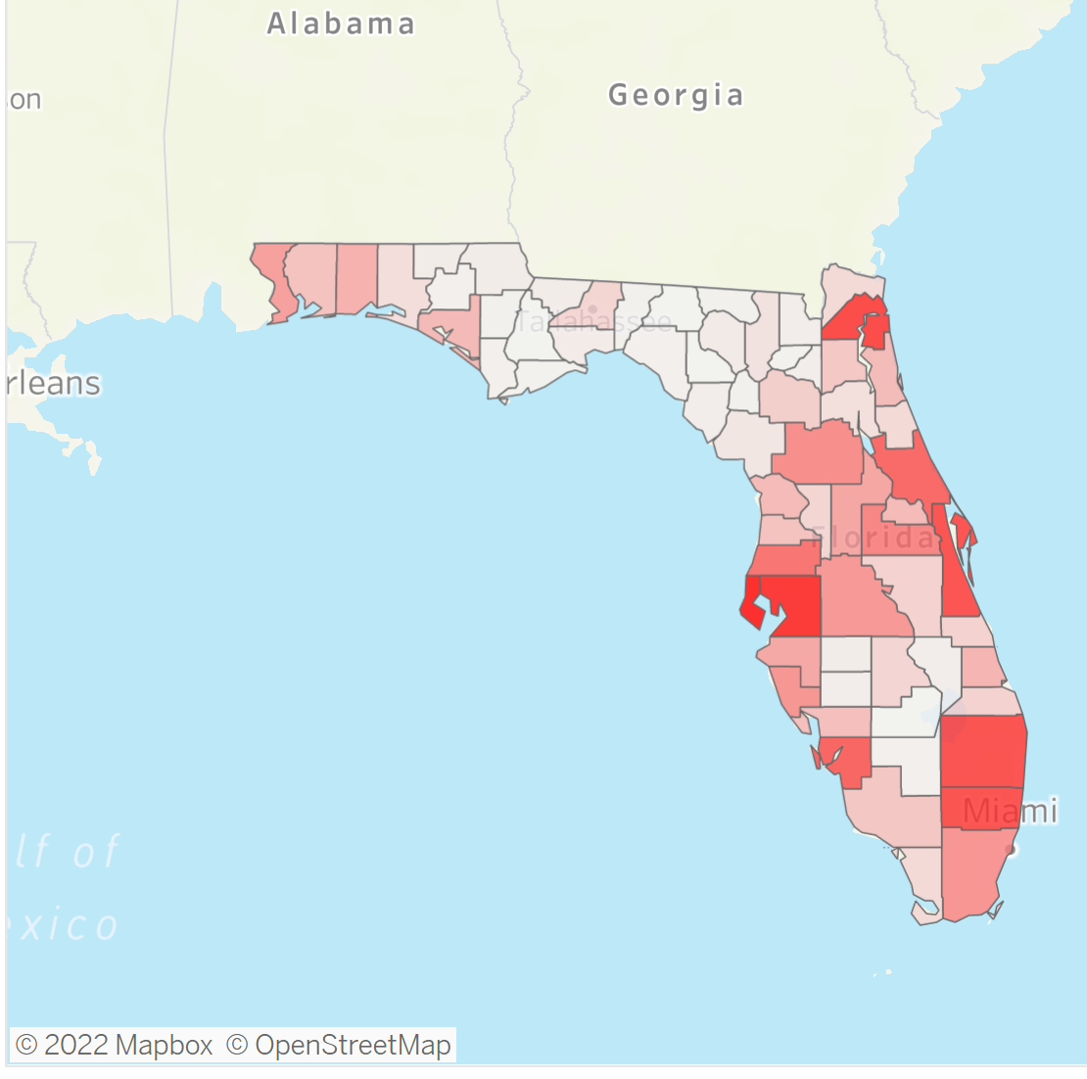
A state crisis.
Florida Veteran Suicide Data 2020
Total Population of Florida | 20,901,636
Percent Veterans | 8.9
Number of Veteran Suicides | 542
Deaths Per 100,000 General | 15.62
Deaths Per 100,000 Veterans | 30.59

Slide 5
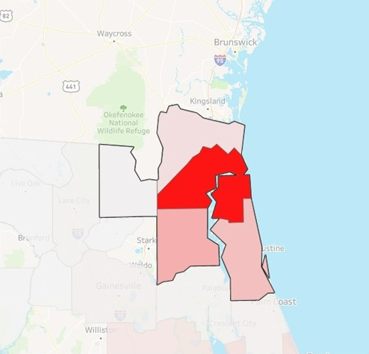
A local crisis.
Year | Count | Per 100,000
2015 | 61 | 33.5
2016 | 55 | 29.8
2017 | 56 | 30.3
2018 | 61 | 33.5
2019 | 78 | 42.2
2020 | 40 | 21.6

Slide 6
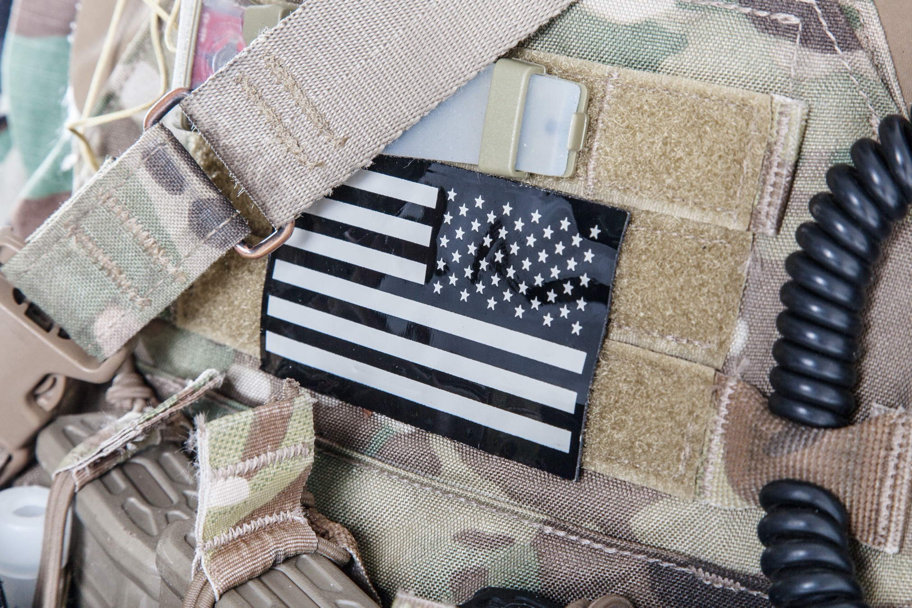
The Challenge
6,261 U.S. Veterans died by suicide in 2019. 636 of those were in Florida. We know that suicide is often preventable with early intervention.
Our Vision
End veteran suicide in Florida
Our Mission
Build an upstream, on-line, and in-person, early intervention network of 10,000+ veterans, civilian champions, business, and community organizations that are trained to identify risk factors of veterans in crisis and to direct those veterans to the community resources they require. Identify and close gaps in those community resources available to our veterans.
Our Values
Collaborative Transparent Evidence-Based Continuous Improvement
The Fire Watch

Slide 7
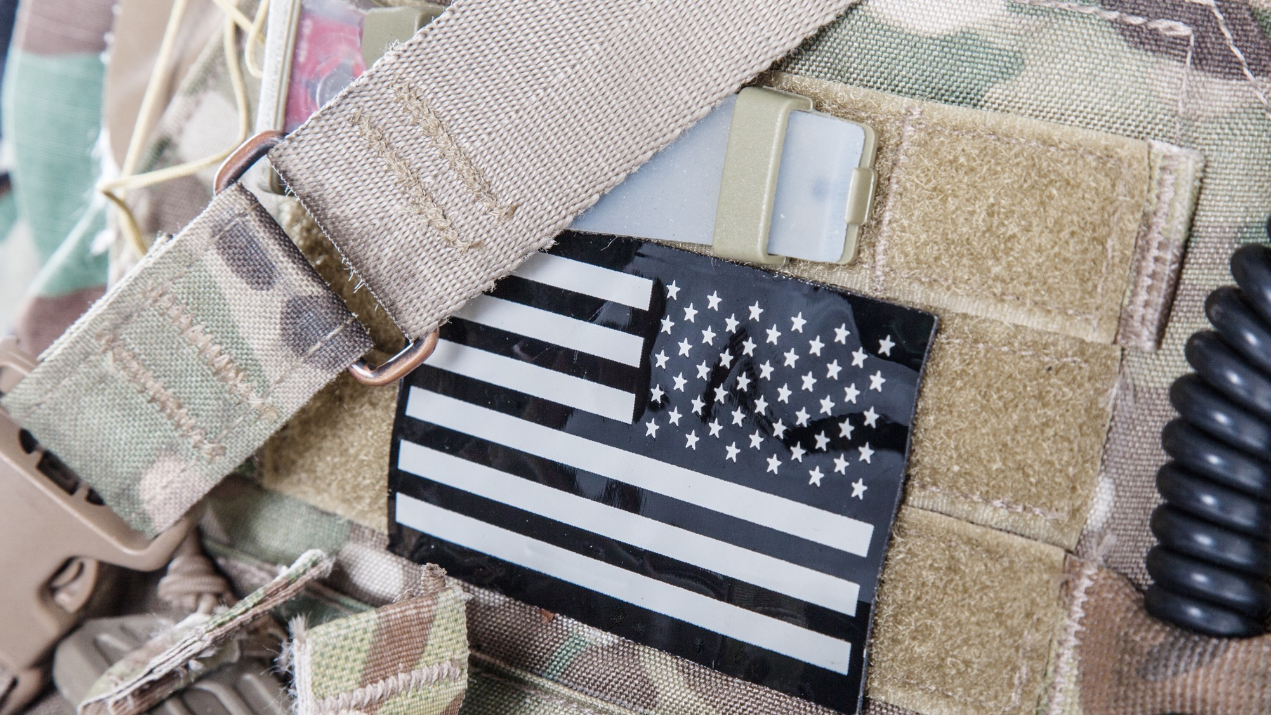
Programs
The Fire Watch
Community Outreach (Connecting Veterans)
Watch Stander Program
Veteran Safe Place Program
Community Coordination (Strengthening Prevention)
Veteran Resource Guide
2020
2021
Other Outreach Programs
Guided by the CDC’s Suicide Prevention Logic Model strategies A.2, I.1, F.1, J.2, D.1.a and D.2.
END VETERAN SUICIDE
SAMHSA Crisis Intercept Mapping
Other Prevention Programs
2020
2021
Governor’s/Mayor’s Challenge
Micro Grants
Data Collection

Slide 8
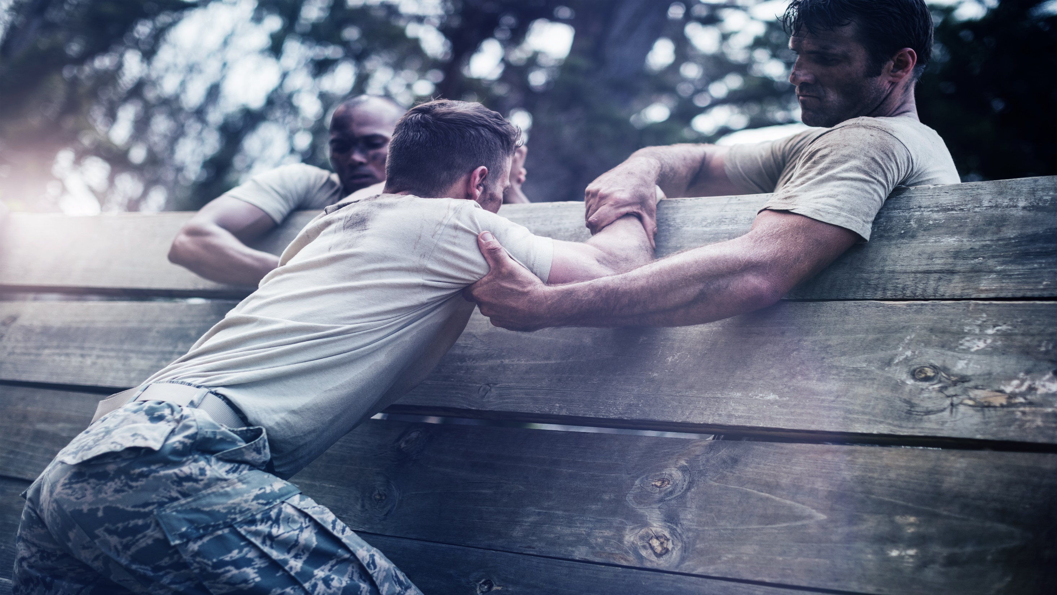
The Watch Stander Program
A community network designed to connect veterans to the resources they need before they slip into crisis
Involves a short on-line learning course to recognize the risk signs of veterans in crisis and how to get them help they need
Other veteran service organizations are our partners; we do not replicate them, but rather direct veterans to them
Anyone can begin the qualification process at www.thefirewatch.org/watch-standers

Slide 9
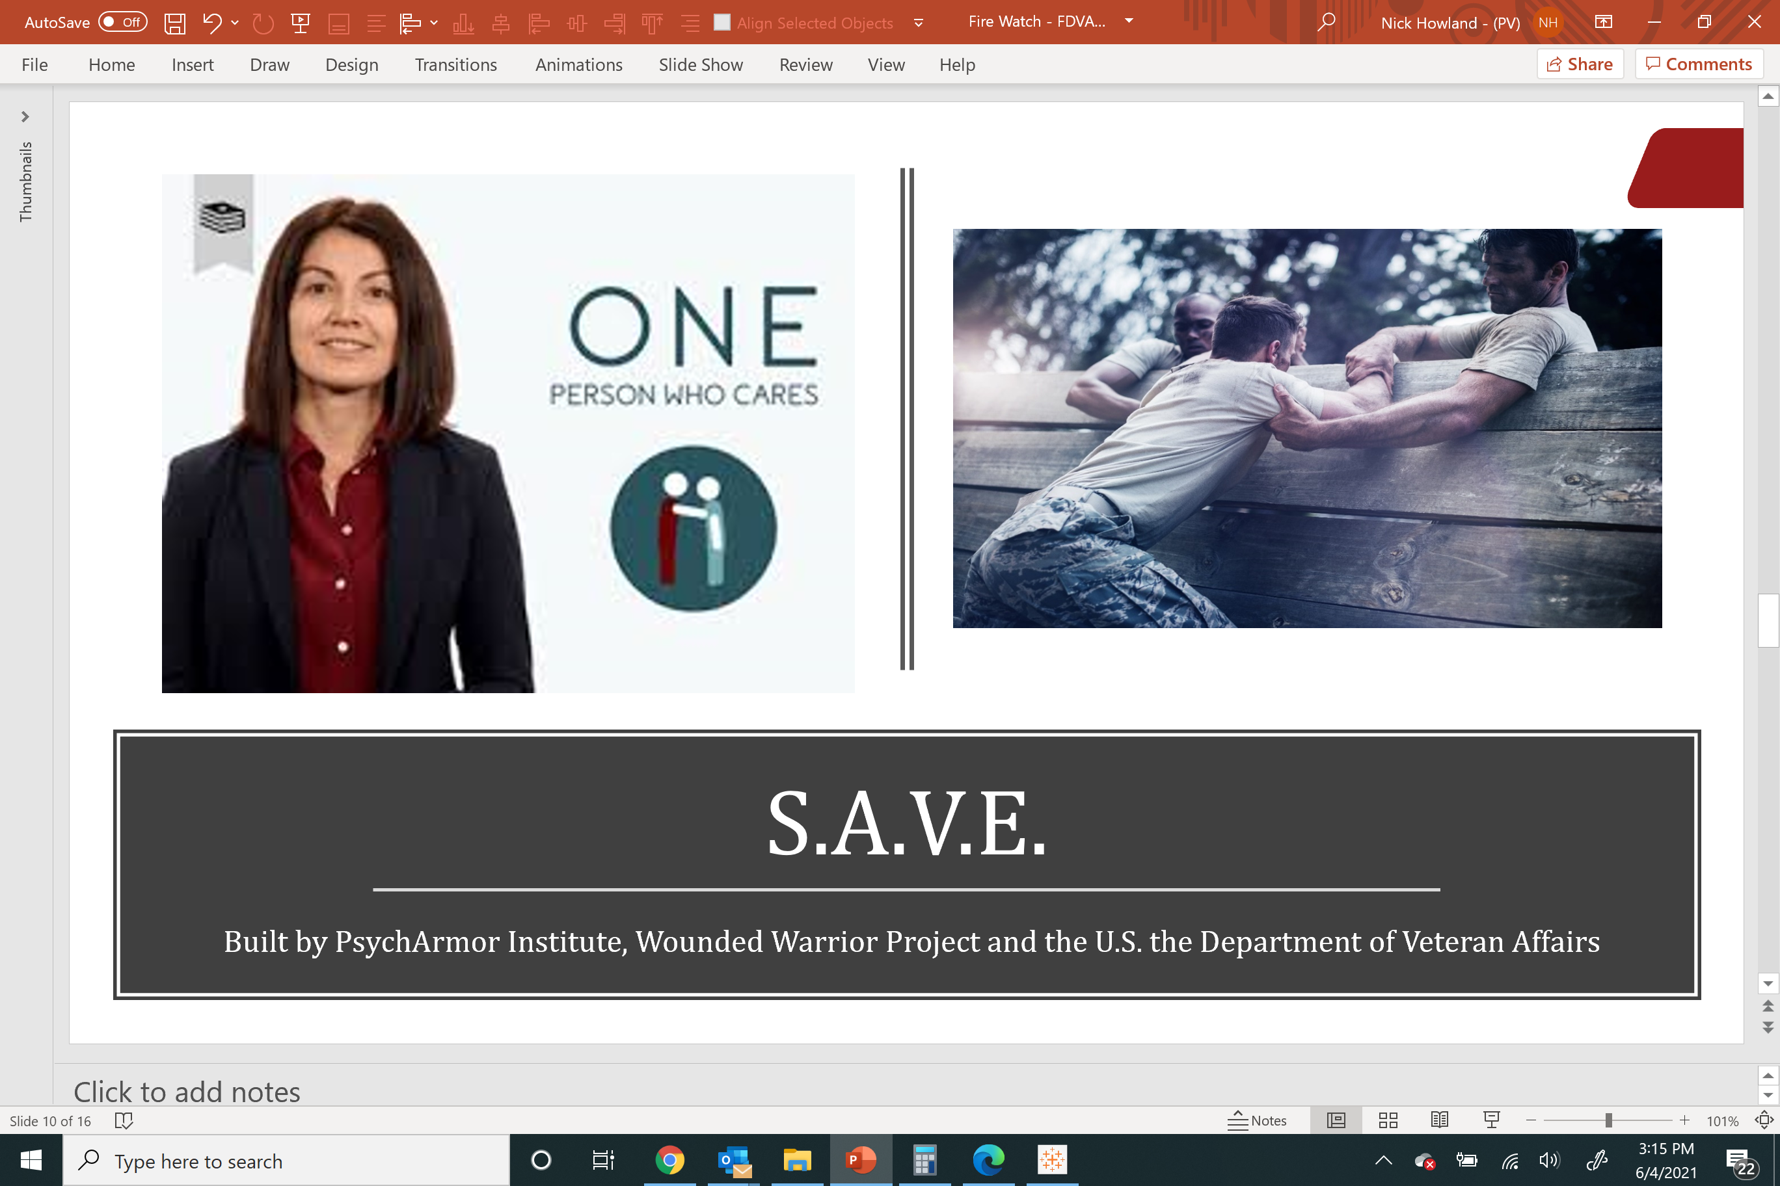
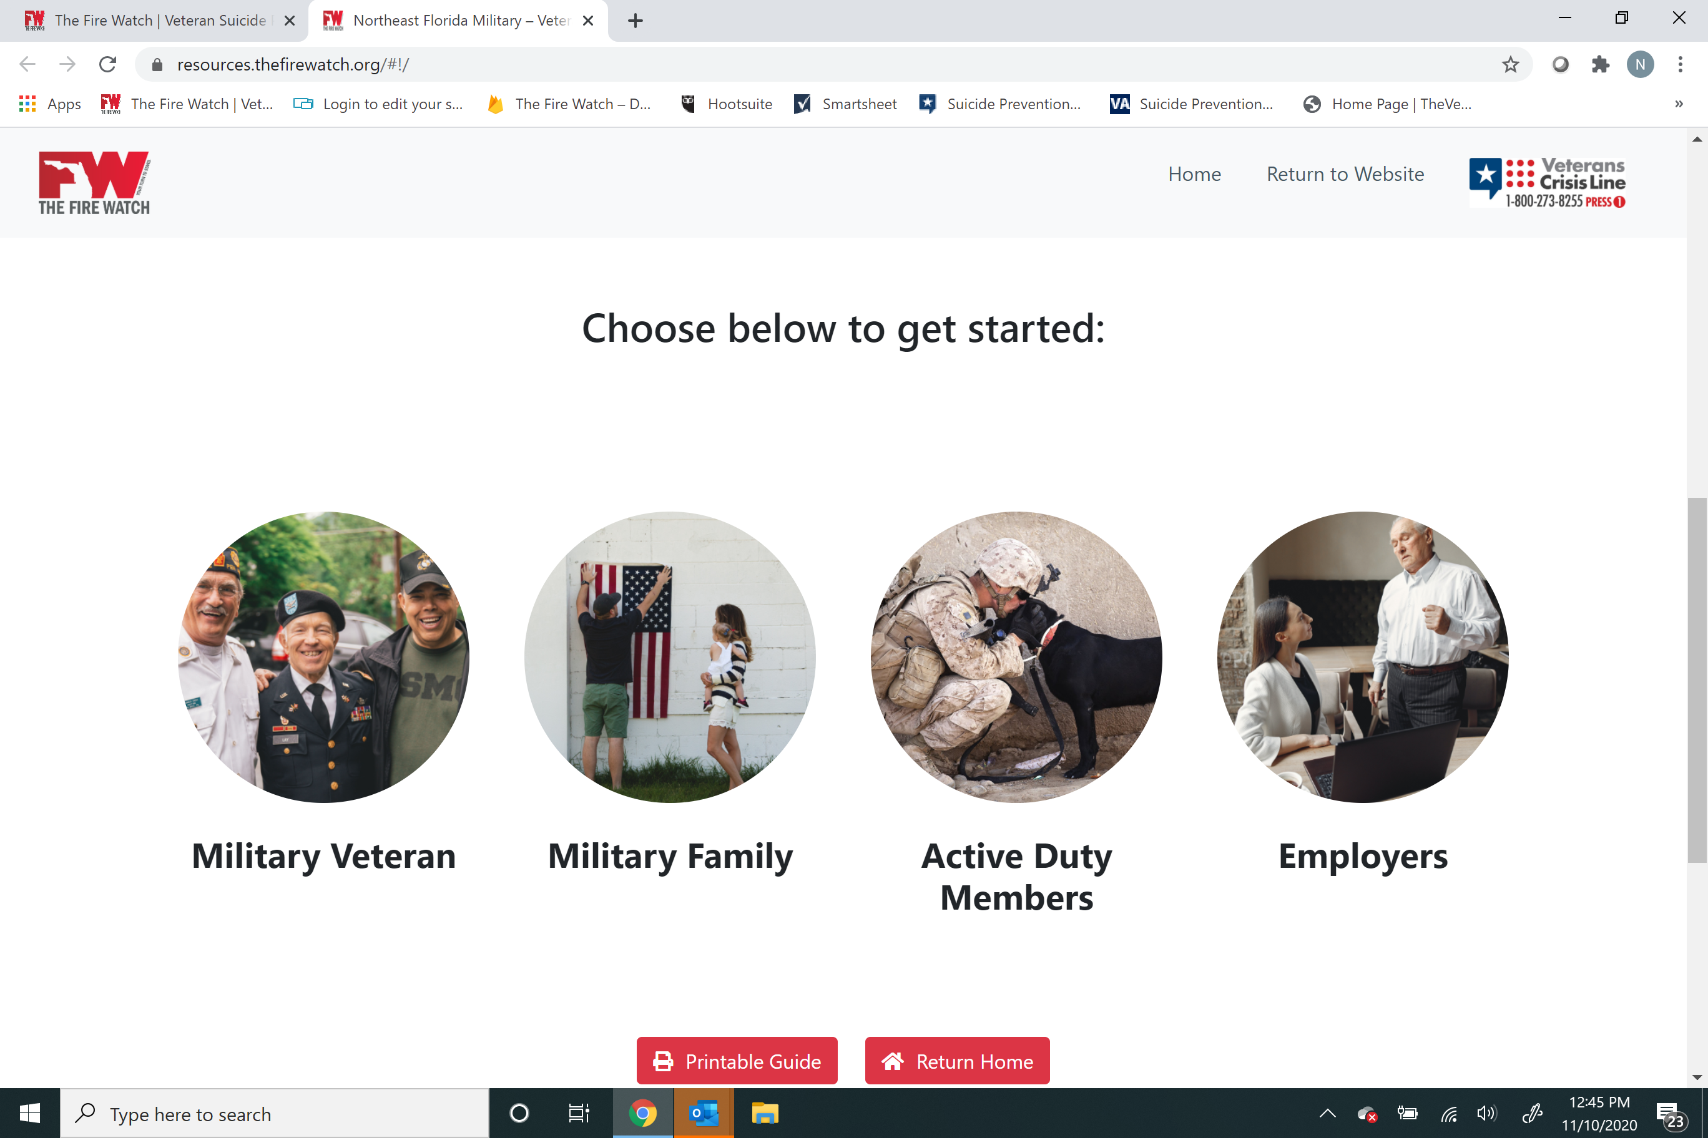
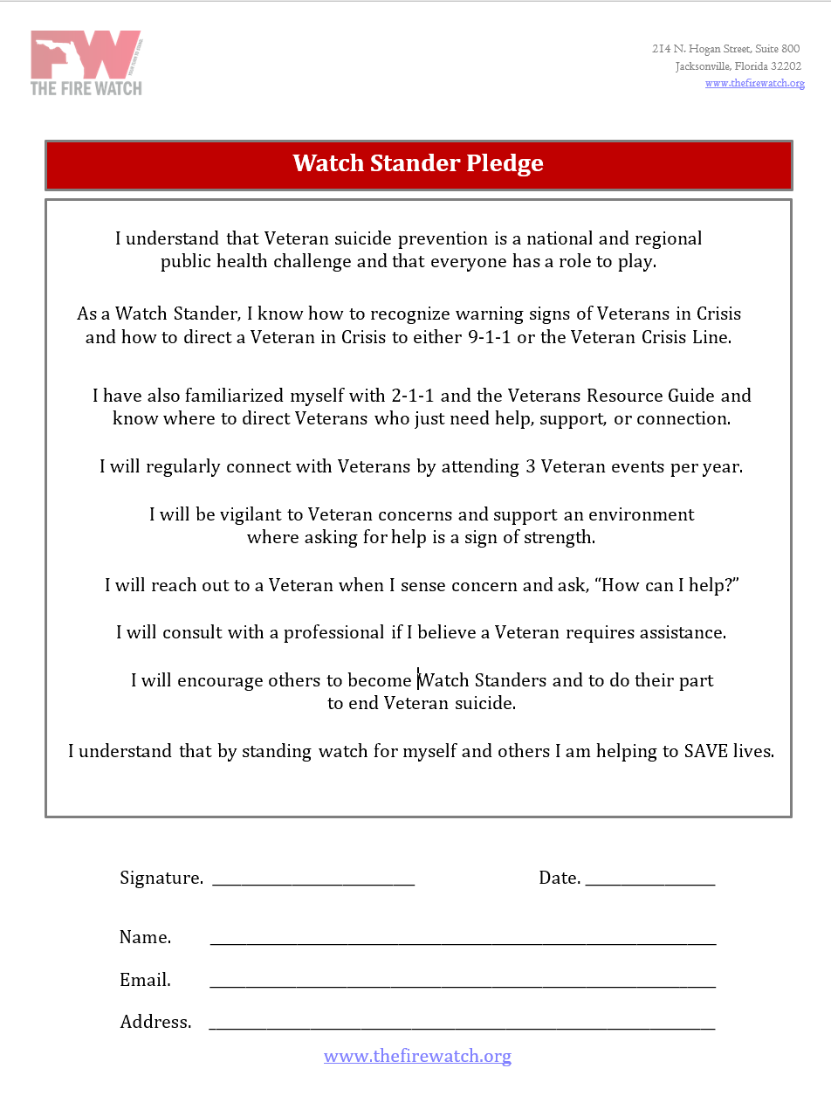
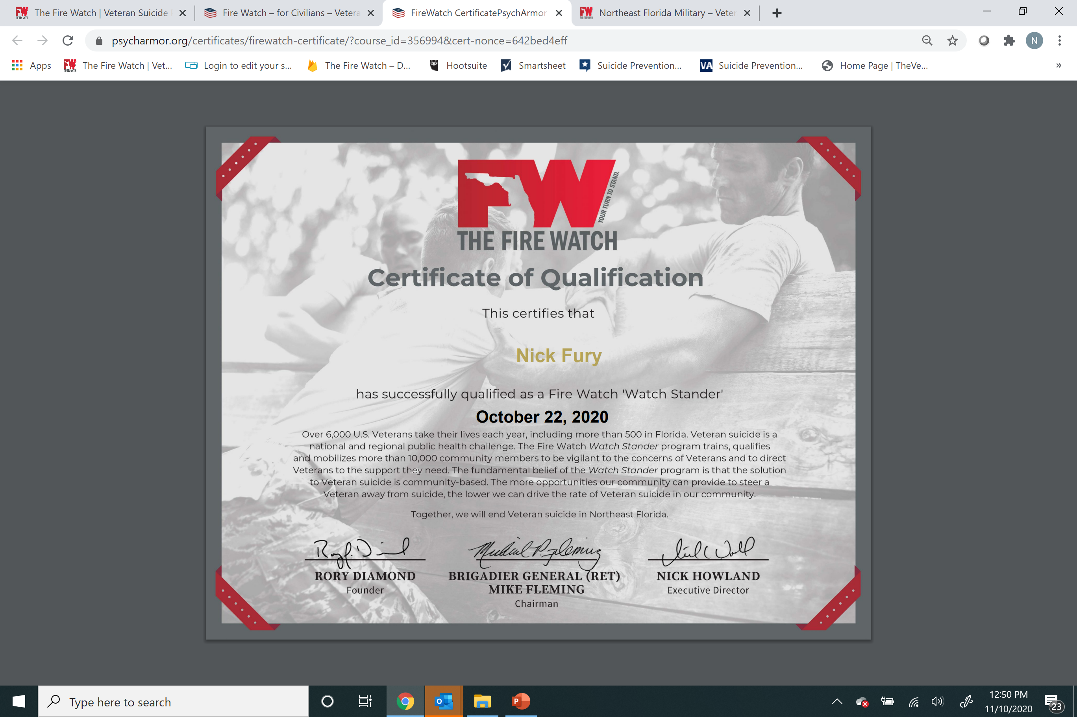
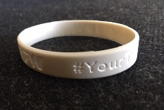
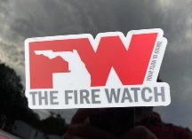
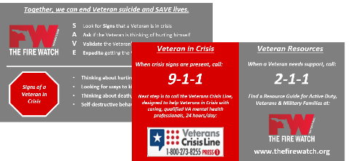
Watch Stander Qualification
Watch S.A.V.E.
Explore the Guide
Sign the Pledge
Stand Watch

Slide 10


Slide 11

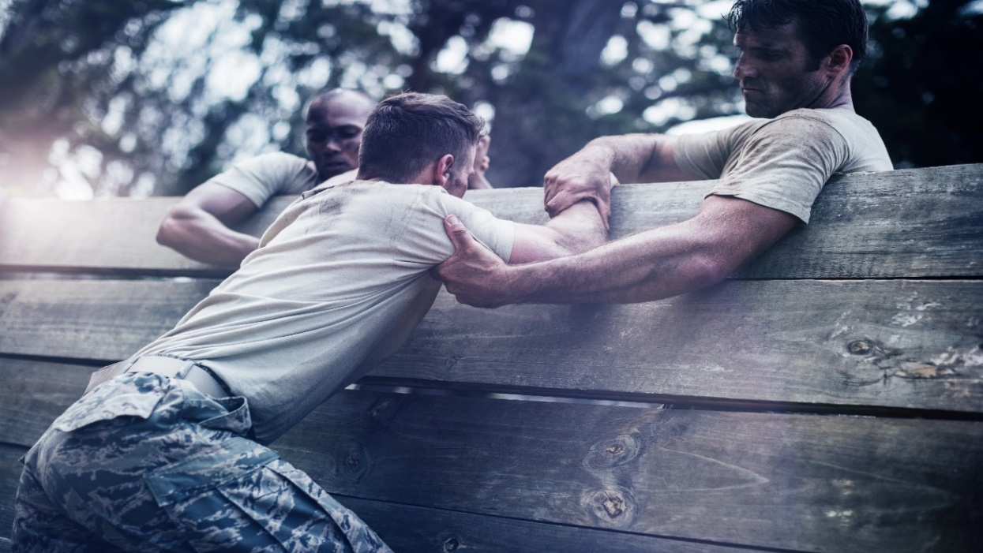
S.A.V.E.
Built by PsychArmor Institute, Wounded Warrior Project and the U.S. the Department of Veteran Affairs

Slide 12
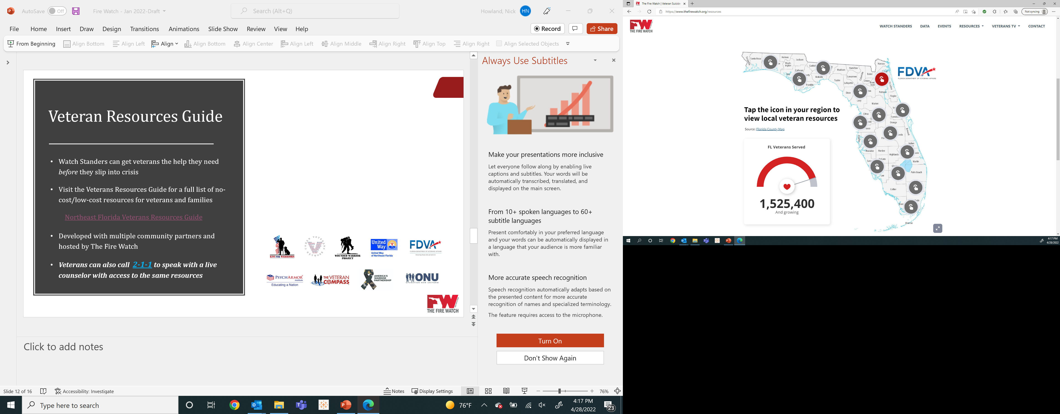
Veteran Resources Guide
Watch Standers can get veterans the help they need before they slip into crisis
Visit the Resources Guide for a full list of no-cost/low-cost resources for veterans and families
  Northeast Florida Veterans Resources Guide
Developed with multiple community partners and hosted by The Fire Watch
Veterans can also call 2-1-1 to speak with a live counselor with access to the same resources

Slide 13
Standing Watch
Complete the training on the portal
  Sign the pledge
  Print and hang your certificate
  Explore other Psych Armor courses
  Download The Fire Watch App
If you provided us an address, look for your Watch Stander package in the mail
  Display the sticker prominently
  Wear the wrist band proudly
  Keep the wallet card handy
Be vigilant to the concerns of veterans
Attend 2 - 3 veteran events per year
Encourage others to join the Watch
Notes:
SAVE to 72797 to sign pledge
VETS to 72797 to sign up as a watch stander

Slide 14
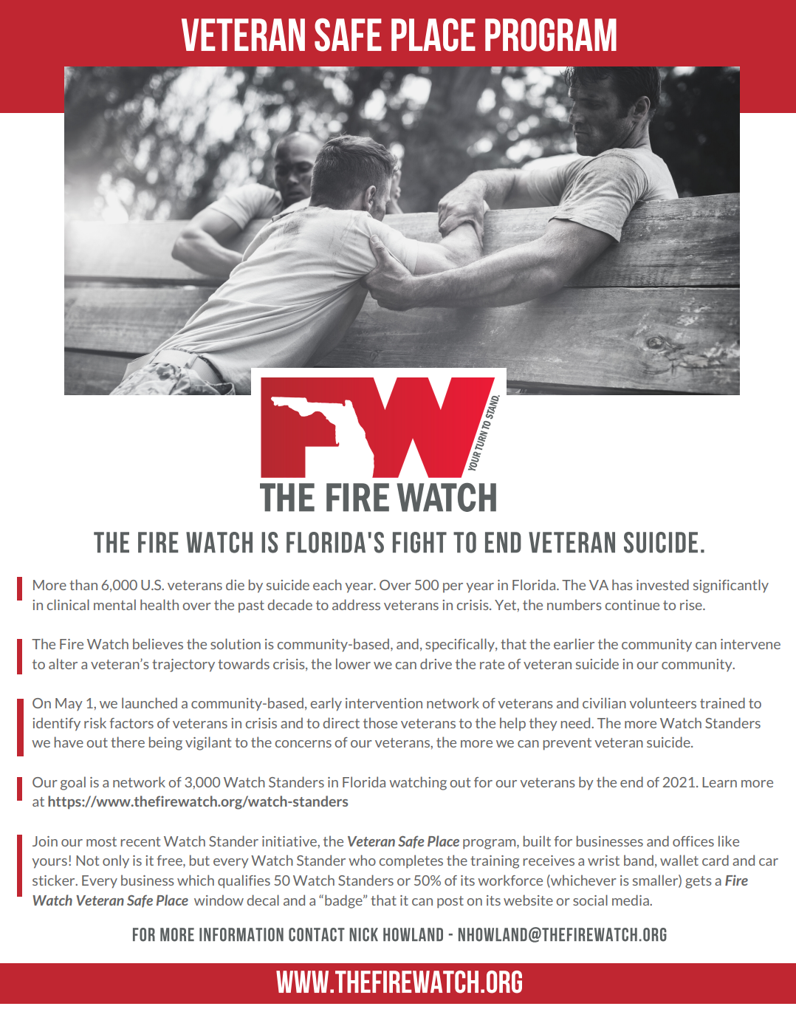


Slide 15
Metrics (as of March 31, 2022)
The Fire Watch
Page Views (LTM)
25,914
App Users
1,236
Veteran Resources
504
Watch Standers
1,896

Slide 16
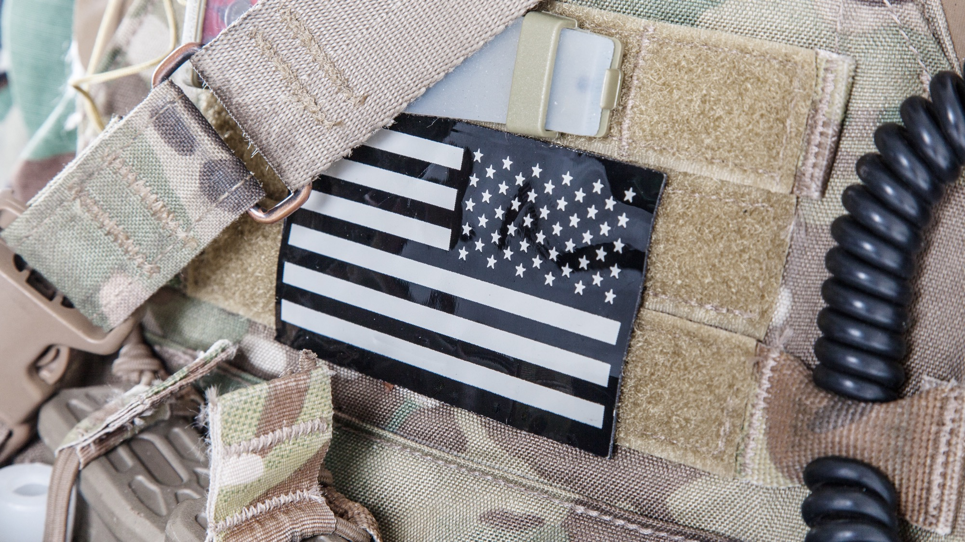

Together, we will end veteran suicide.
info@thefirewatch.org
904.834.9420
#YourTurnToStand

