Slide 1
St. Petersburg Regional Office DROC
September 19, 2019

Slide 3
Workload Distribution
Receipts
VSCs
Supplemental Claims
(New Process)
DROC St. Pete
DROC Seattle
Higher Level Reviews
New Process Full Grants
New Process Remands, RAMP, HLR and Supp
DROC D.C.
Legacy Remands
RO Appeals Teams
Legacy Appeals
Legacy Full Grants
.

Slide 4
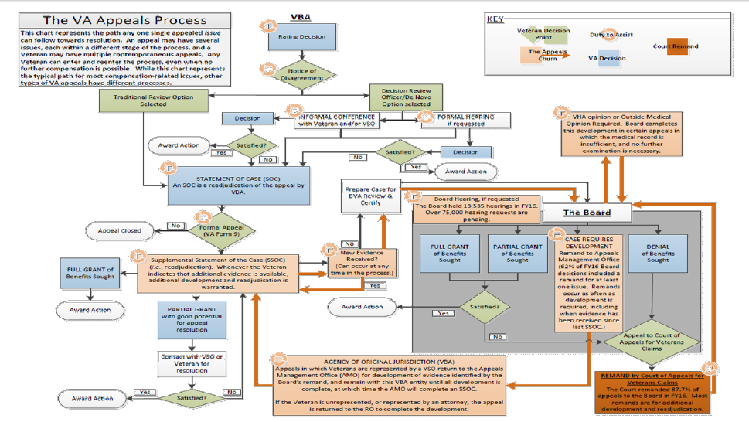

Slide 5
New Decision Review Process
Veterans Benefits Administration
Board of Veterans’ Appeals
The Claim
(Establishes Effective Date)
VBA Decision
(Improved Notice)
Higher-Level Review
Same Evidence
125-Day Avg. Goal
Supplemental Claim
New Evidence
125-Day Avg. Goal
Appeal (NOD)
3 Options
365-Day Avg. Direct Docket Goal
120 Days
Except for appeals to the Court,
all filing deadlines are one year.
Court of Appeals for Veterans Claims

Slide 6
Appeals to the Board
Evidence Only Docket
VBA Decision
Hearing Docket
When this option is selected on the NOD, the appellant will be scheduled for a Board hearing. Additionally, the appellant may submit evidence within the 90 day window following the scheduled hearing. The Board does not have a duty to assist and the record is otherwise closed.
When this option is selected on the NOD, the appellant may submit evidence within the 90 day window following submission of the NOD. The Board does not have a duty to assist and the record is otherwise closed.
NOD
Evidence Docket
Direct Docket
Hearing Docket
Direct Docket
When this option is selected on the NOD, the appellant receives direct review by the Board of the evidence that was before VBA in the decision on appeal. The Board has a 365-day timeliness goal for this docket. Quality feedback loop for VBA.
Additional evidence submitted within 90 days following NOD
Closed record and 365 days timeliness goal
Board hearing and additional evidence submitted within 90 days following hearing
Supplemental Claim
Board Decision
Appeal to CAVC

Slide 8
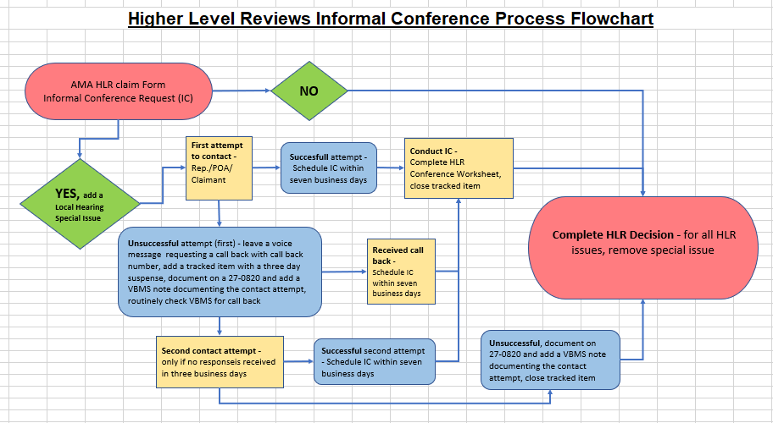
DROC (Informal Conference Flow Chart)

Slide 9
 | Completed Fiscal Year 2022
Informal Conferences | 14,834
BVA Hearings | 1,537
DROC (AMA Metrics)
 | Average Days Pending | National Inventory
Higher Level Reviews | 17 | 8,137
HLR Return / Remands | 117 | 14,935

Slide 10
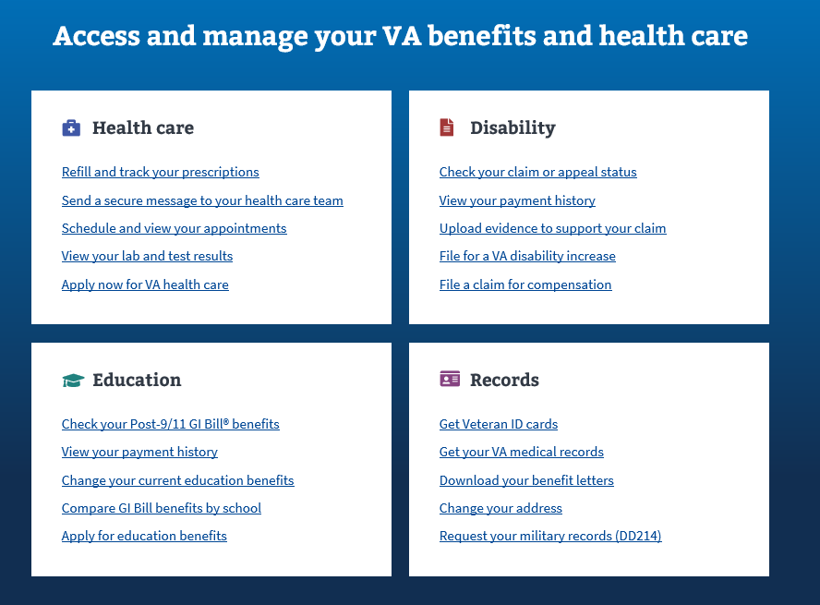
Accessing Your VA Benefits
www.va.gov
One Stop Shop For All VA Benefits
File a claim for compensation
Check your claim or appeal status
Upload evidence to support your claim
Download Benefits Letters
Change your address
Request your DD-214
Get you VA Medical Records
Refill Prescriptions
Send a secure message to your VA provider
10

Slide 11
Accessing Your VA Benefits
Online Resources
Inquiry Routing & Information System (IRIS)
https://iris.custhelp.va.gov
VA on Facebook
www.facebook.com/VeteransAffairs
VA on Twitter
www.twitter.com/DeptVetAffairs
VA Home Page
www.va.gov
Contact VA By Phone
Benefits Information: (800) 827-1000
Education Benefits: (888) 442-4551
Health Care Eligibility: (877) 222-8387
SGLI/VGLI: (800) 419-1473
VA Life Insurance: (800) 669-8477

Slide 12
How to Apply For Benefits
Contact a Veterans Service Organization For Assistance
To obtain a listing of Veteran Service Organizations:
http://www.va.gov/ogc/apps/accreditation/index.asp
Complete an Application
*Original Claims must be submitted on a VA Form 21-526EZ
* Claim can be filed electronically on http://www.VA.GOV
Submit Supporting Evidence and Claims Forms
* DD-214
* Private Medical Treatment Records
* Any Service Treatment Records or Personnel Records in Your Possession

Slide 13
Questions

Slide 14
Thank You For Your Service
To Those Who Have Served

