Slide 2
Who We Are
Established by the Florida Legislature in 2008
Direct Support Organization of Florida Department of Veterans’
Affairs (FDVA)
501(C)(3) Nonprofit - Accountability
Independent Audit ▪ FDVA statutory oversight ▪ 990 forms are on HelpFlVets.org.
FVF is registered with the Florida Department of Agriculture & Consumer Resources.

Slide 3
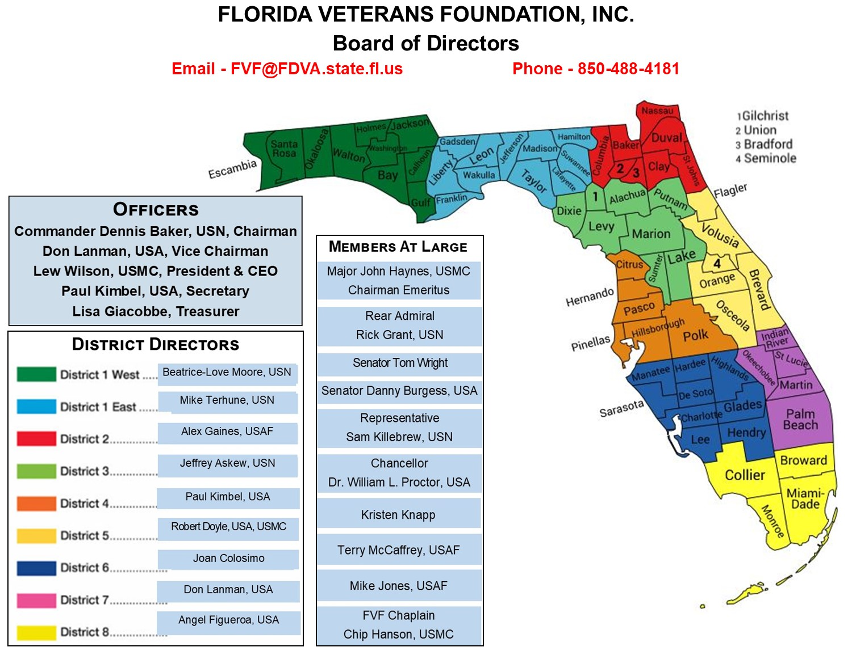
Serving Florida Veterans

Slide 4
Serve All Florida Veterans
Represents Nearly 1.5 million Veterans PLUS their Survivors & Families All Branches of Service and All Service Eras
World War II • Korea • Vietnam • Cold War • Global War on Terror
28,000 Florida Veterans Monthly
Florida Veteran’s Council
375 Florida Veterans Service Organizations (VSO’s)
67 Counties - 135 CVSO’s
Provides Education & Relief Resources to Florida Veterans
Partnerships (DAV, Project Vet Relief, NAVF, BALS, CCTB)

Slide 5
Programs

Slide 6
Aging Wartime Veterans & Survivors
Aging Veterans Benefits
Pension Plus Aid & Attendance (A&A)
20,000 Veterans X $50,000 (Average Benefit)
= $1,000,000,000 In Benefits
At NO COST TO THE VETERAN!
Claims Partners Helped Veterans Claim

Slide 7
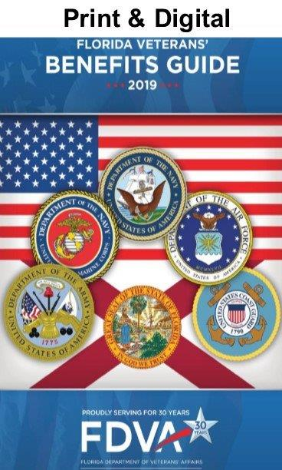
www.HelpFLVets.org Resources
VA Survivors & Burial Benefits Kit

Slide 8
Volunteer
Donate
Support
Lew Wilson
850-488-4181
Extension 1
www.HelpFLVets.org
Email
FVF@FDVA.State.FL.Us

