Slide 1
Veterans Service Center
St. Petersburg
September 2021

Slide 2
Regional Office Management Team

Slide 3
St Petersburg VSC Organizational Chart
Notes:
?

Slide 4
St Petersburg VSC Employees
Notes:
?

Slide 5
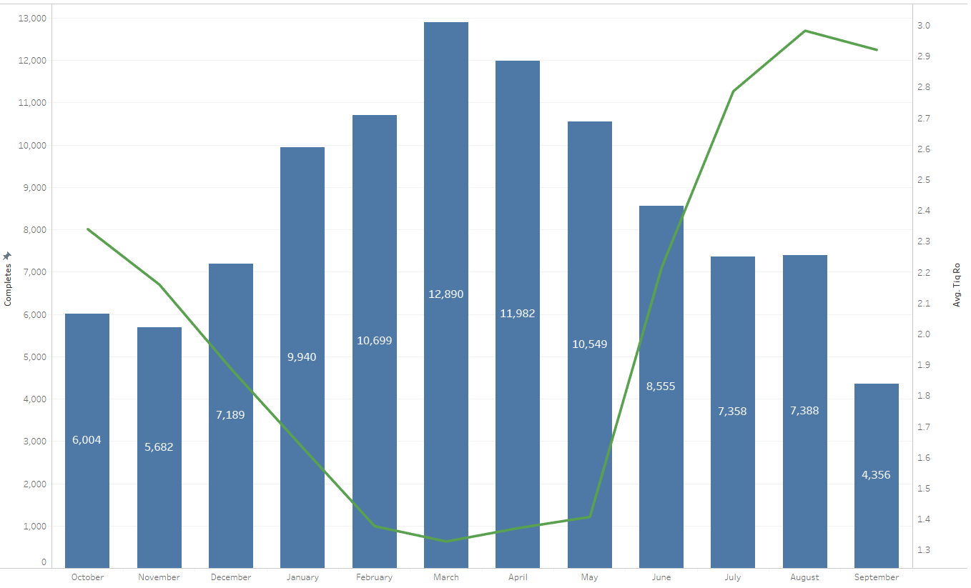
NWQ Production Status
102,592 Completes FYTD
Notes:
Pull December and March for TIQ

Slide 6
Intake Processing Center
IN PERSON HEARINGS | Totals |  | VIRTUAL | Totals
In Person Held | 249 |  | Virtual Held | 120
Cancelled by the POA | 177 |  | Cancelled by the POA | 148
Cancelled by the VSC | 9 |  | Cancelled by the VSC | 19
Declined due to COVID | 2 |  | In Person Requested | 87
Reschedule due to COVID | 5 |  | Declined due to COVID | 0
Rescheduled | 87 |  | Reschedule due to COVID | 0
Exam in lieu of Hearing | 23 |  | Rescheduled | 55
Incarcerated | 1 |  | Exam in lieu of Hearing | 92
Veteran No Show | 29 |  | Incarcerated | 1
Hearing Officer No Show | 0 |  | Veteran No Show | 28
Totals | 582 |  | Hearing Officer No Show | 6
 |  |  | Totals | 556

Slide 7
Mail Automation
Initial mail automation went live January 24, 2020 with over 300,000 pieces of mail processed as of July 1, 2020. Mail Automation searches the assignment queues for relevant packets and reassign them to the Mail Automation queues for processing. Continuous improvements are being made to increase the success rates and enhance the implemented processes.
Mail that cannot be process by mail automation is returned to stations for processing.

Slide 8
Public Contact & Outreach
Inquiries |  |  | Visitors Served
Pending | 104 |  | FYTD | 6,449
Completed FYTD | 5,000 |  | Average Wait time | .46
During FY 2021, VSC employees conducted outreach and provided benefit information in 76 events; and Veteran Centric 188 events.
October 2020 implementation of the use of Wait While scheduling system to schedule phone, video (Nov. 13, 2020), and in-person (Nov. 16, 2020) appointments. Wait While has provided Public Contact with the opportunity to reach Veterans and Service members during the Pandemic.
Hosted its first Virtual Claims Clinic, August 21, 2021, providing benefits and claim information to over 70 Veterans.
Moved from the Lake Nona Clinic to their new Lake Baldwin location, July 5, 2021.
Notes:
% for FYTD.

Slide 9
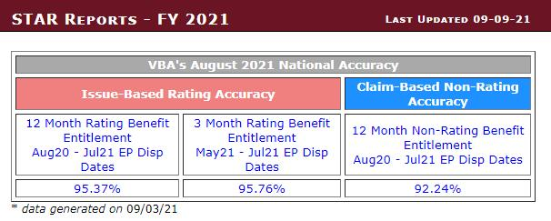

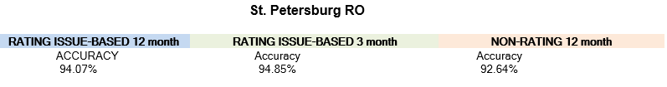
What’s New in Quality?

Slide 10

Questions

