Slide 1
De-escalating People in Crisis
County Veterans Service Officers Association of Florida
Fall Conference and Training
October 2021

Slide 2
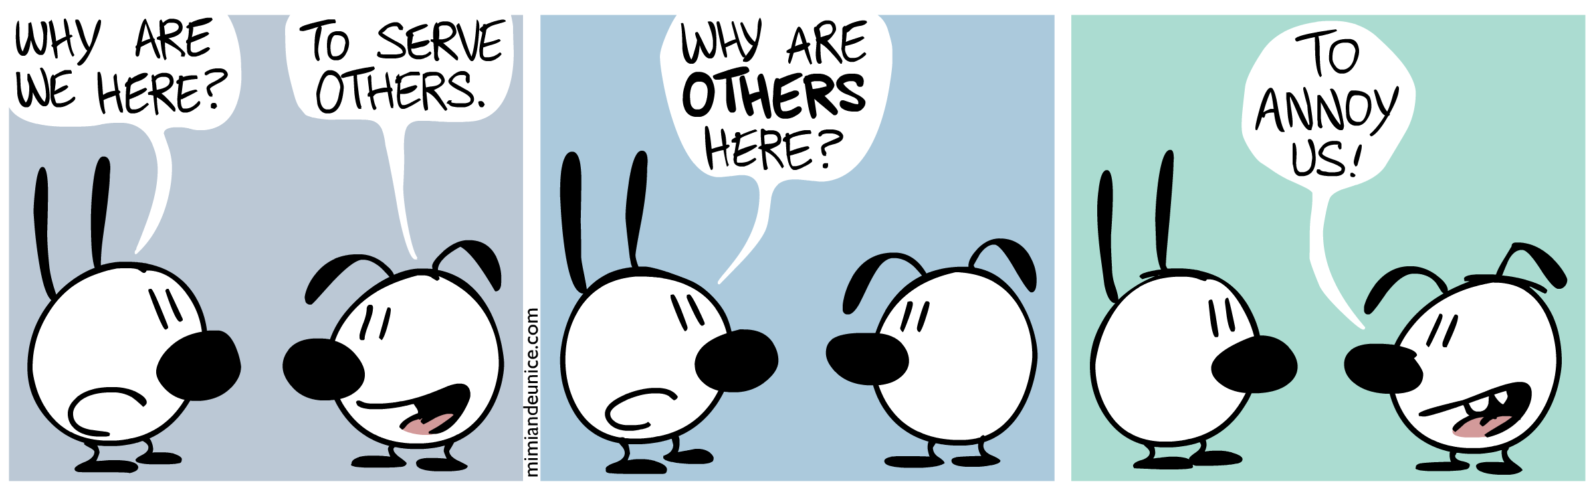
Why are we here today?

Slide 3
Why This De-escalation Training?
Many Veteran Services offices are part of
Human Services Departments
Customers in crisis visit for financial assistance and case management
Most have often experienced trauma
Some Veterans are simply angry with the VA

Slide 4
Sources of Individual Stress
Financial situation
Emotional health
Mental health
Physical health
Work stress
Legal issues
Family dynamics
Personal relationships (or lack of)
LIFE!

Slide 5
De-escalation
to decrease in extent, volume, or scope
  Merriam-Webster
reduction of the intensity of a conflict or potentially violent situation
  Oxford Dictionary

Slide 7


Many Types of Anger
Some are SILENT
Some are LOUD

Slide 8
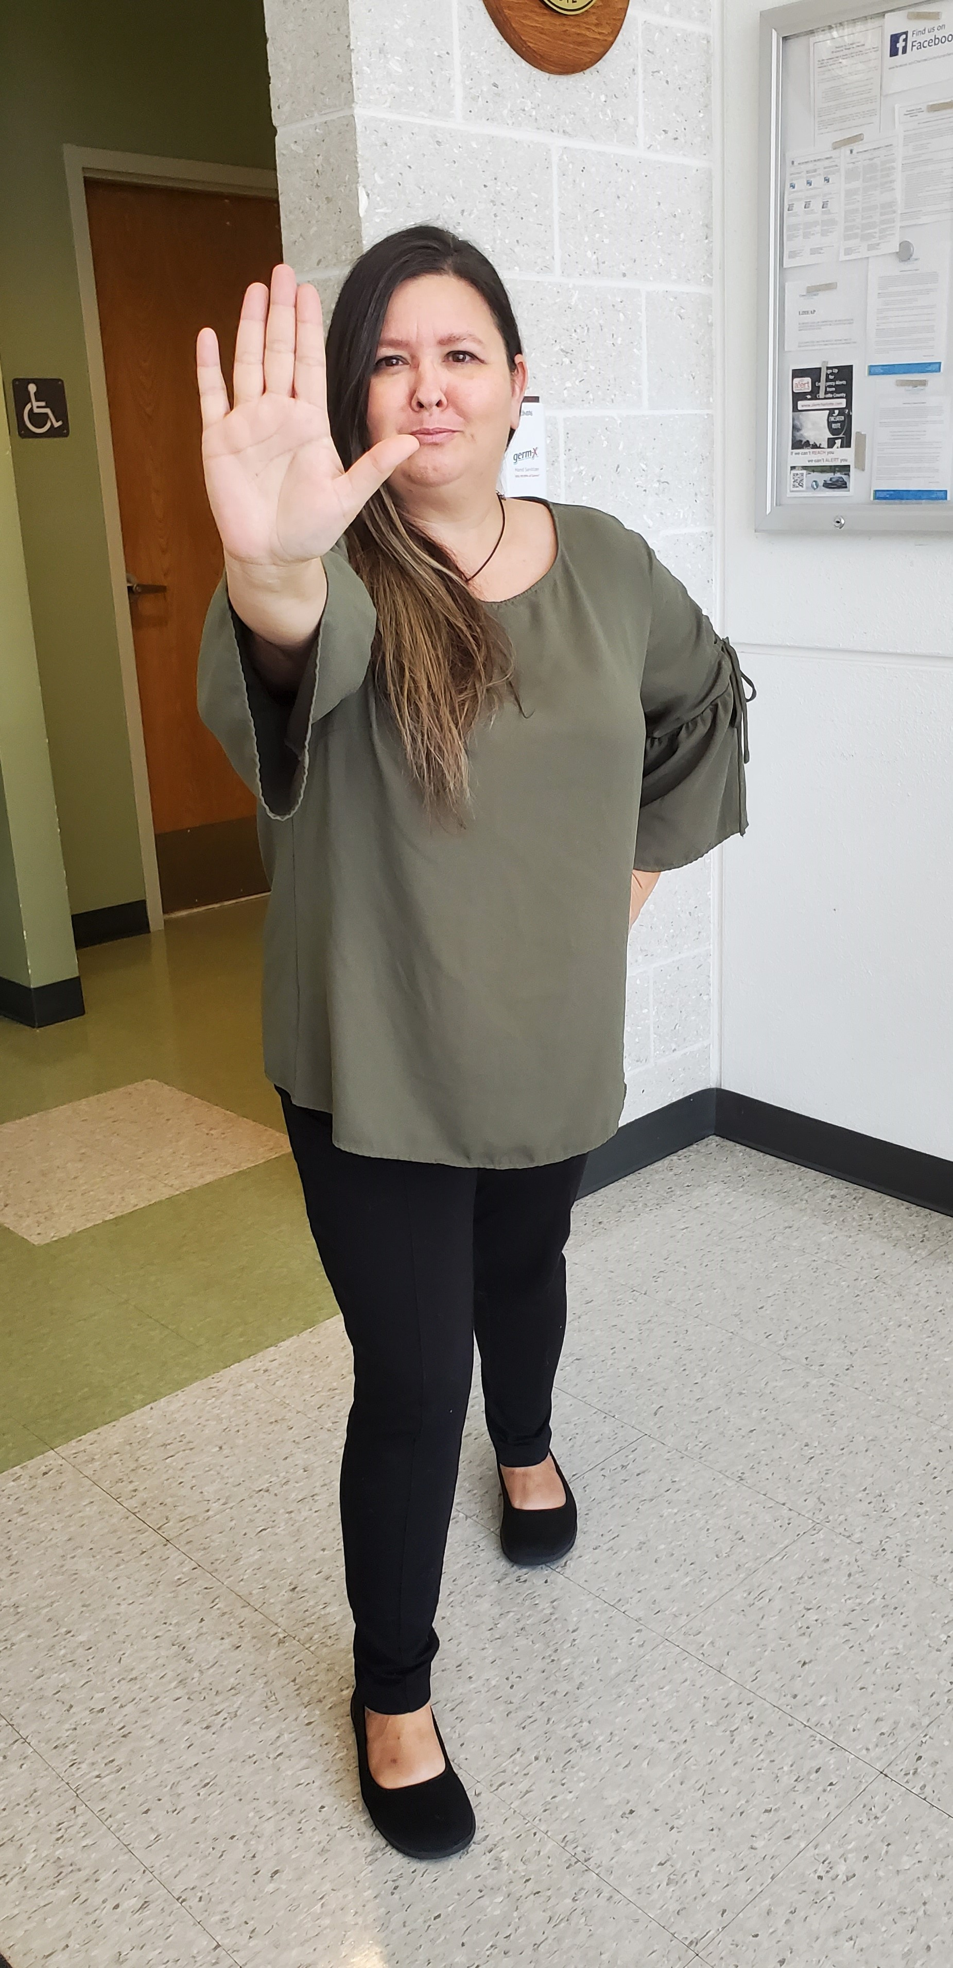


Angry Person’s View
Escalating Person
What person wants:
their unmet needs met!
YOU

Slide 9
What’s Gained By Verbally Acting Out
Person gets something they want or out of something they don’t like
Likely learned behavior
Doing their best to get their needs met:
  Power
  Freedom
  Love and belonging
  Fun

Slide 10

Anger is an acid that can do more harm to the vessel in which it is stored than to anything on which it is poured.
– Mark Twain, American writer

Slide 11
Emotional Intelligence (EQ)
We can not effectively de-escalate a situation if we can not de-escalate ourselves.
Keep our emotions in check
Challenging, but important!

Slide 12
Heightened Emotional Responses
Anger or gross over-reaction
Not objective
Not rational
Unmanaged emotions ‘hijack’ reasoning and logic, contributing to responses we may subsequently regret

Slide 13
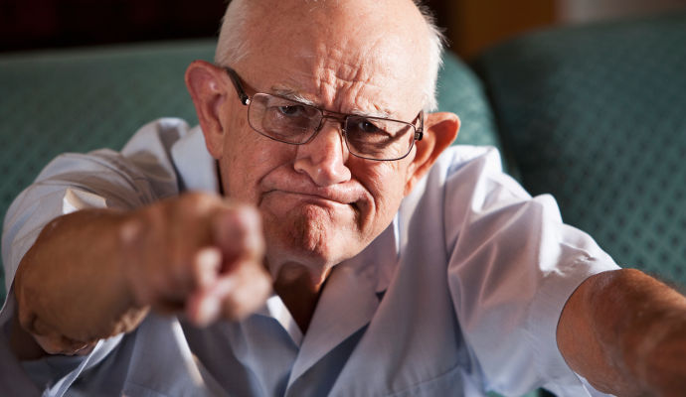
What do YOU experience at work?

Slide 14
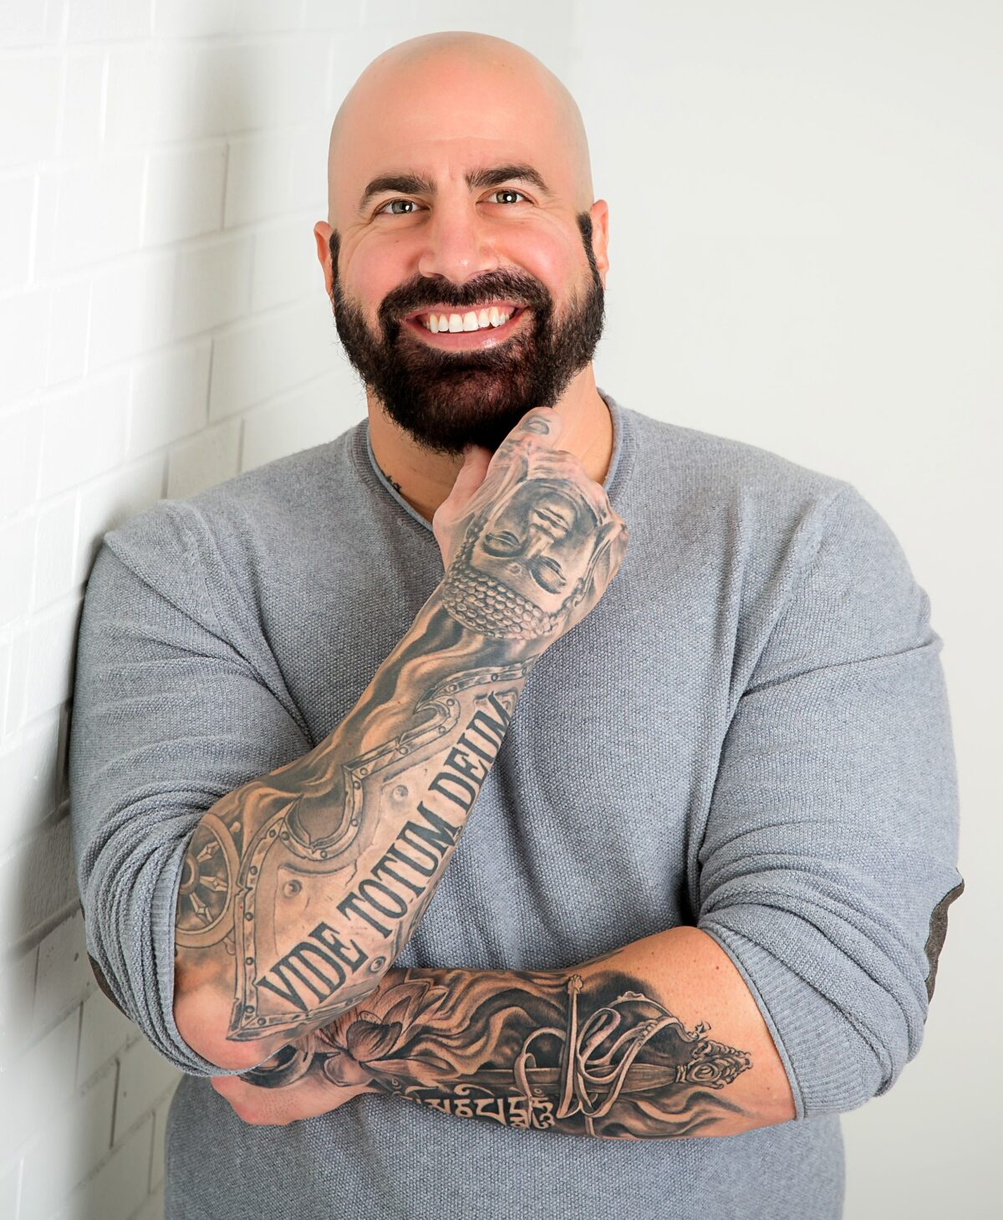
How to De-escalate Someone
Dr. Christian Conte
#MuchPeace
https://www.youtube.com/watch?v=4qsfBCatgX8

Slide 15
Three Steps to De-escalation
Validate – recognize how other person feels
Help people find options – there is always a choice
Provide a safe emotional space – respect their free will to choose

Slide 16

What would YOU do?
You ask a person how you can help. They shove a chair, swear, walk to the other side of the room and yell,
“YOU PROBABLY CAN’T! Nobody has been able to help me yet!”

Slide 17

What would YOU do?
You explain to a Veteran she needs to provide a diagnosis for her claim. An empty pill bottle is not appropriate evidence.
She rises from her chair and makes a fist. You ask her to leave your office.
On her way out she turns off your light and states, “I’LL MAKE SURE YOU GO TO HELL!”

Slide 18
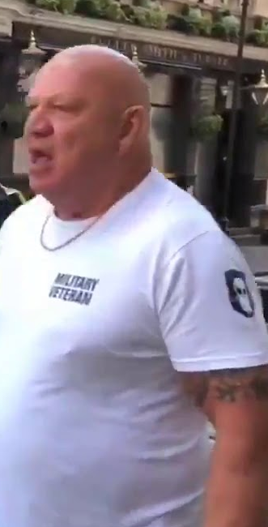
What would YOU do?
The person is complaining about not seeing a Veteran Service Officer. The more he talks about not getting in, the angrier he is getting.
Seeing a service officer is not an option since all VSOs are with clients and have no openings for the rest of the day.

Slide 19

Still Not Sure?

Slide 20
De-escalation Resources
Crisis Prevention Institute
  https://www.crisisprevention.com/
OACAS Library Guides
  https://oacas.libguides.com/deescalation
Texas Medical Liability Trust Risk Management
  https://hub.tmlt.org/tmlt-blog/de-escalation-techniques-and-resources
Dr. Christian Conte
  http://www.drchristianconte.com/

