Slide 1
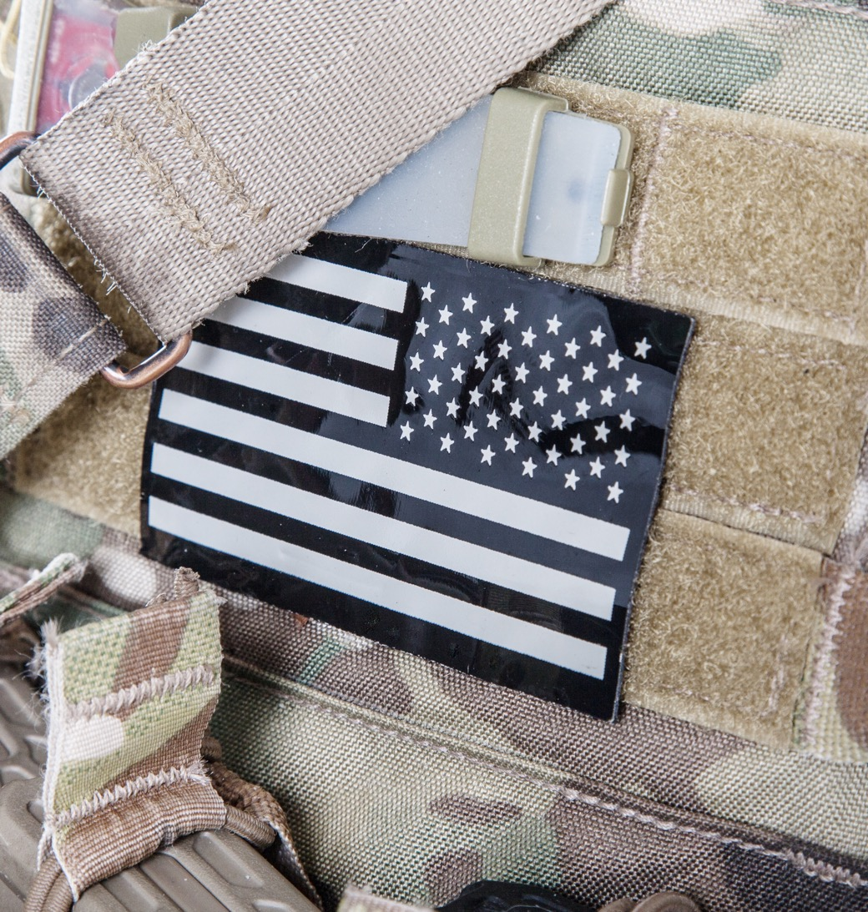


Slide 2
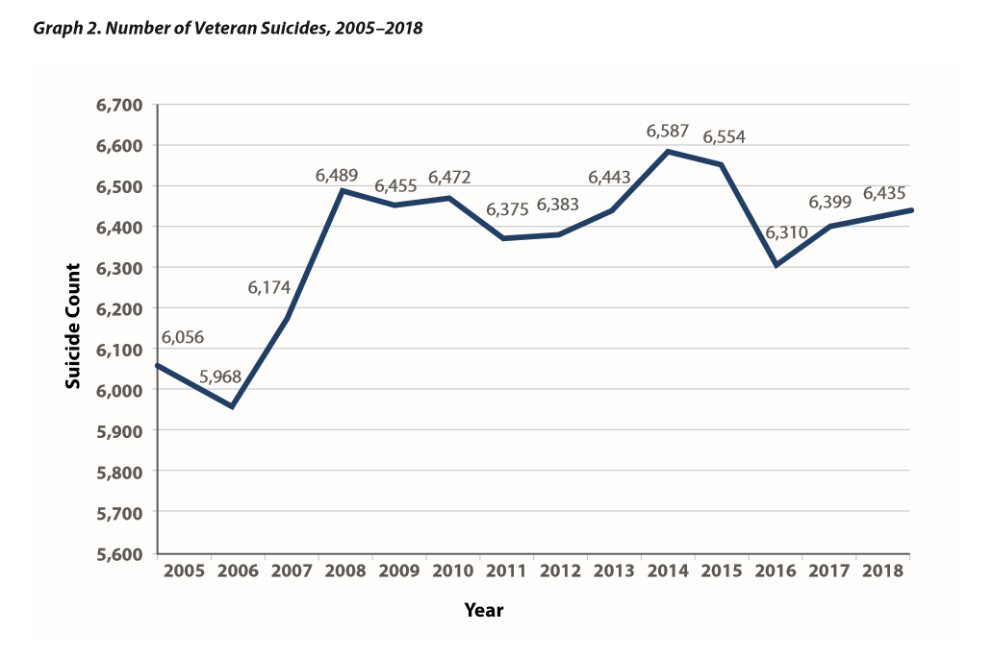
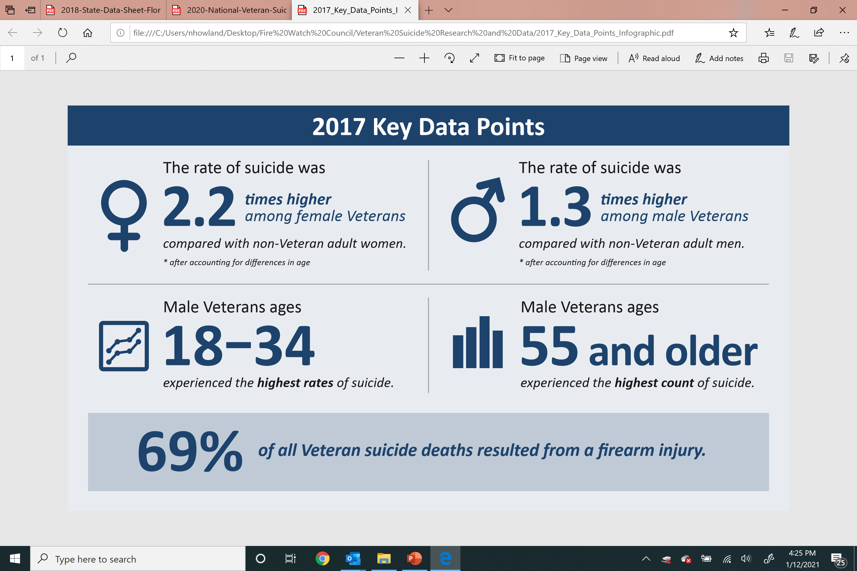
A national crisis.

Slide 3
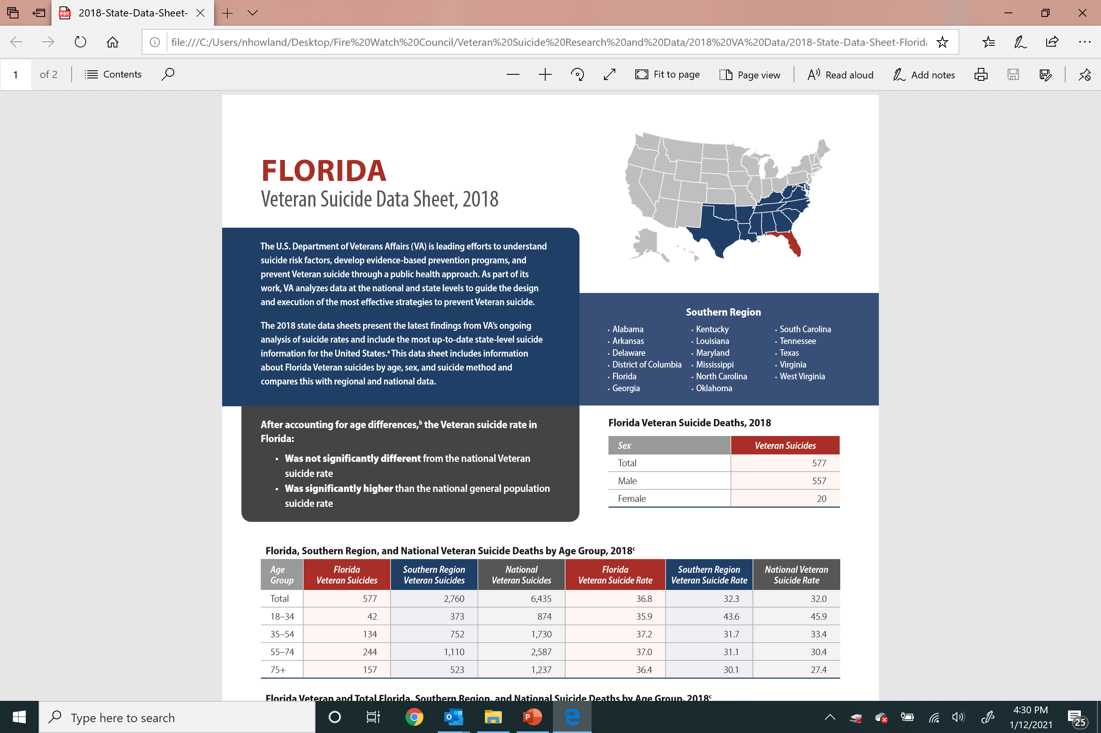
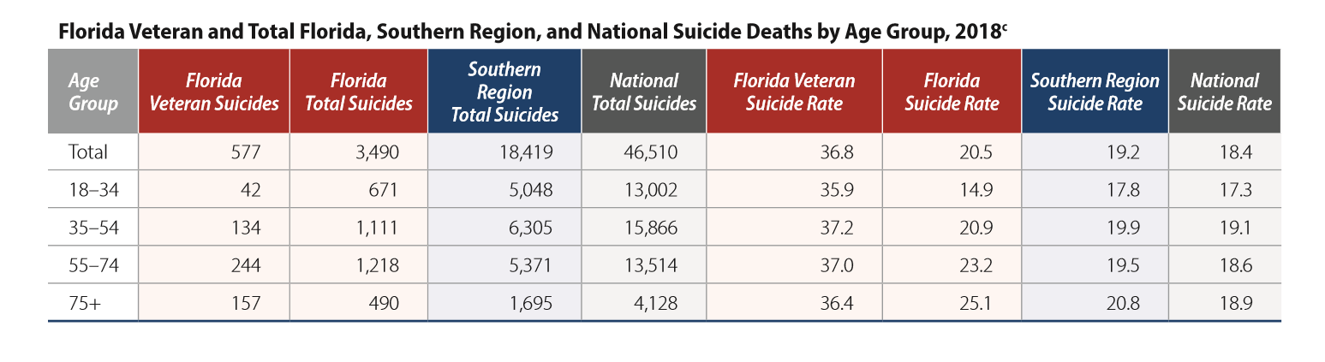
A state crisis.

Slide 4
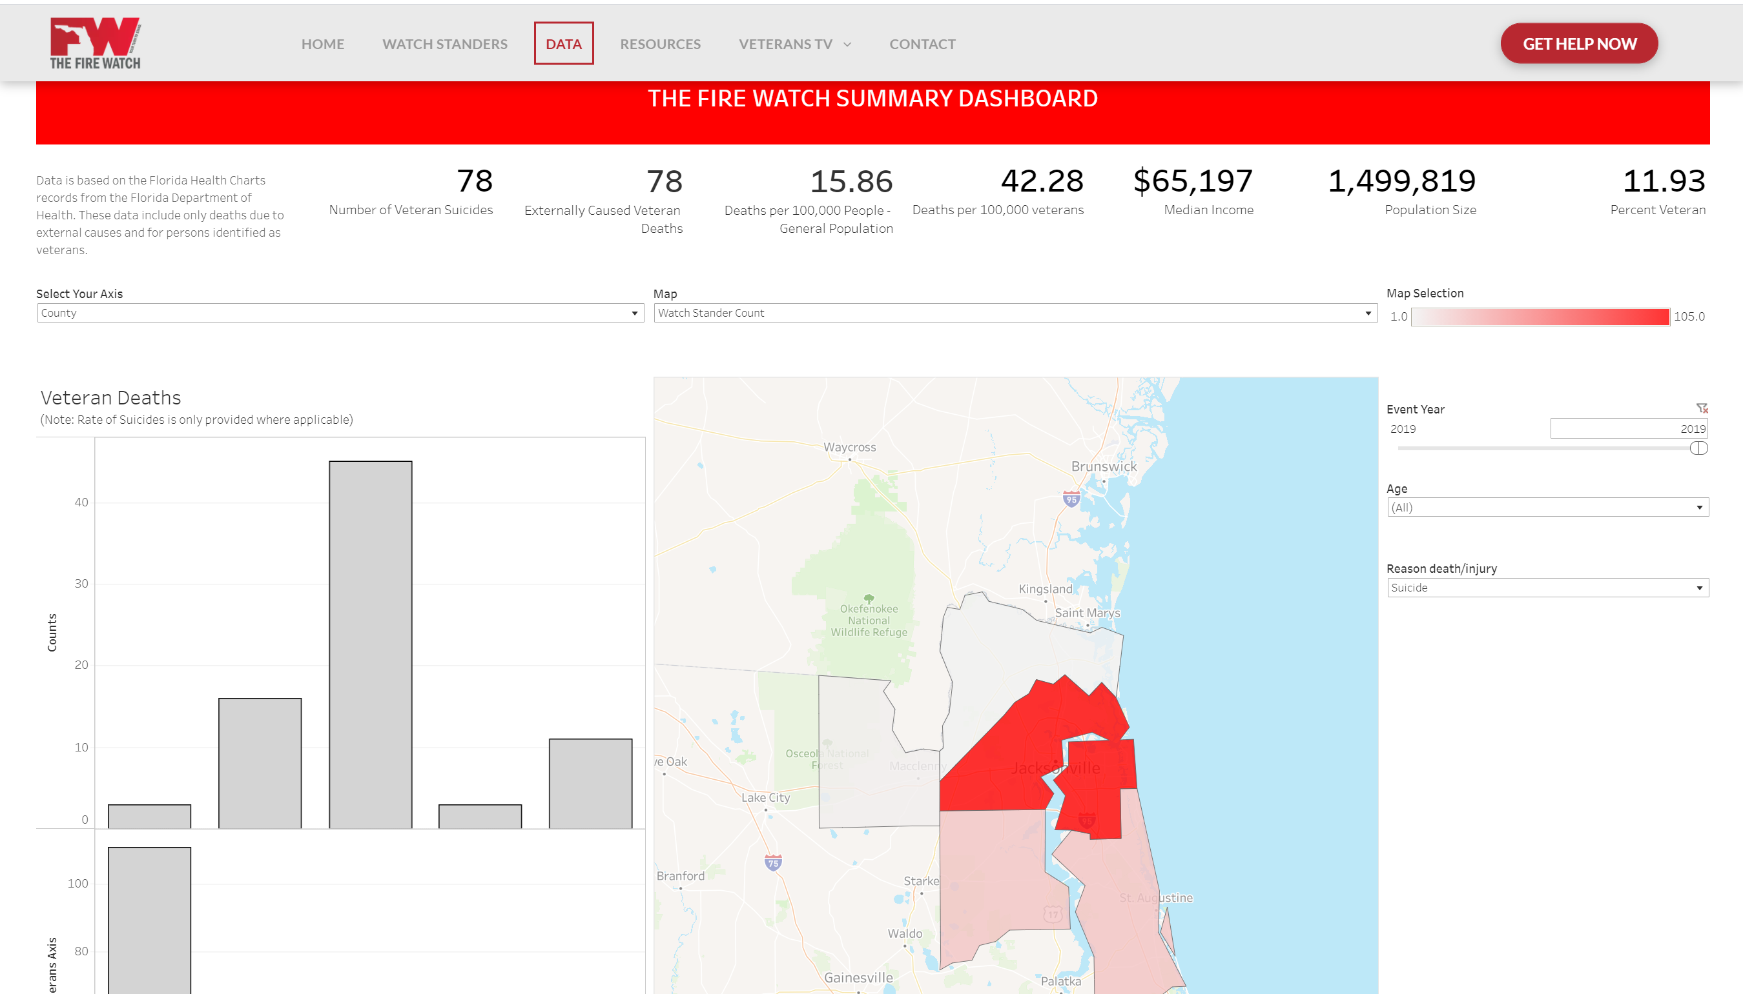
A regional crisis.

Slide 5
The NE Florida Solution
The Fire Watch
Each County contributed seed funding and a Council Member
The Fire Watch Council was formed by Baker, Clay, Duval (Jax), Nassau and St. Johns Counties in November 2019 pursuant to Section 163.01, Florida Statutes, to coordinate regional efforts to reduce military veteran suicides in Northeast Florida.
Baker
Clay
Each County designated one County Commissioner to serve as a liaison between the Fire Watch Council and the respective County Commission
Duval
Nassau
Must comply with Florida Sunshine laws
St. Johns

Slide 6
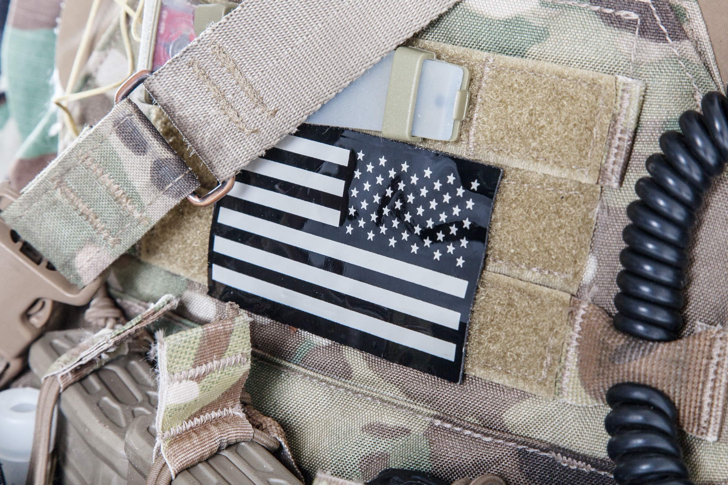
The Fire Watch

Slide 7
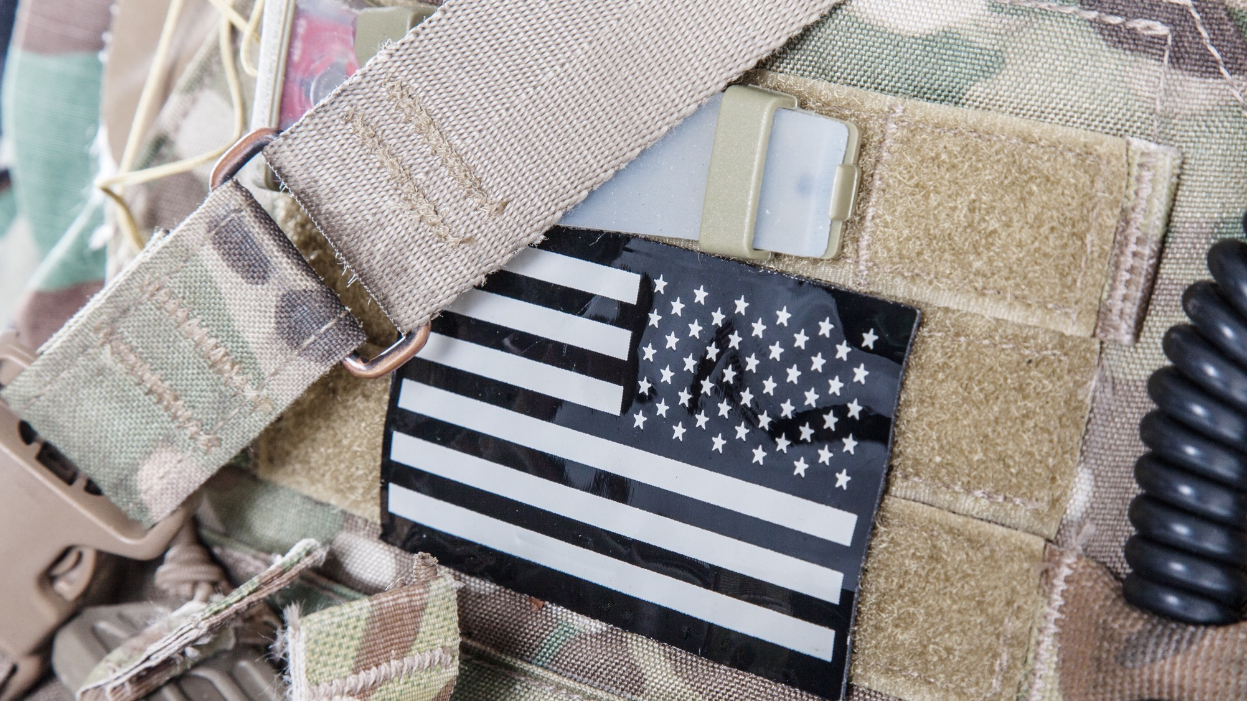
Programs
The Fire Watch
Community Outreach (Connecting Veterans)
Watch Stander Program
Veteran Safe Place Program
Community Coordination (Strengthening Prevention)
Veteran Resource Guide
2020
2021
Other Outreach Programs
Guided by the CDC’s Suicide Prevention Logic Model strategies A.2, I.1, F.1, J.2, D.1.a and D.2.
END VETERAN SUICIDE
SAMHSA Crisis Intercept Mapping
Other Prevention Programs
2020
2021
Governor’s/Mayor’s Challenge
Micro Grants
Data Collection

Slide 8
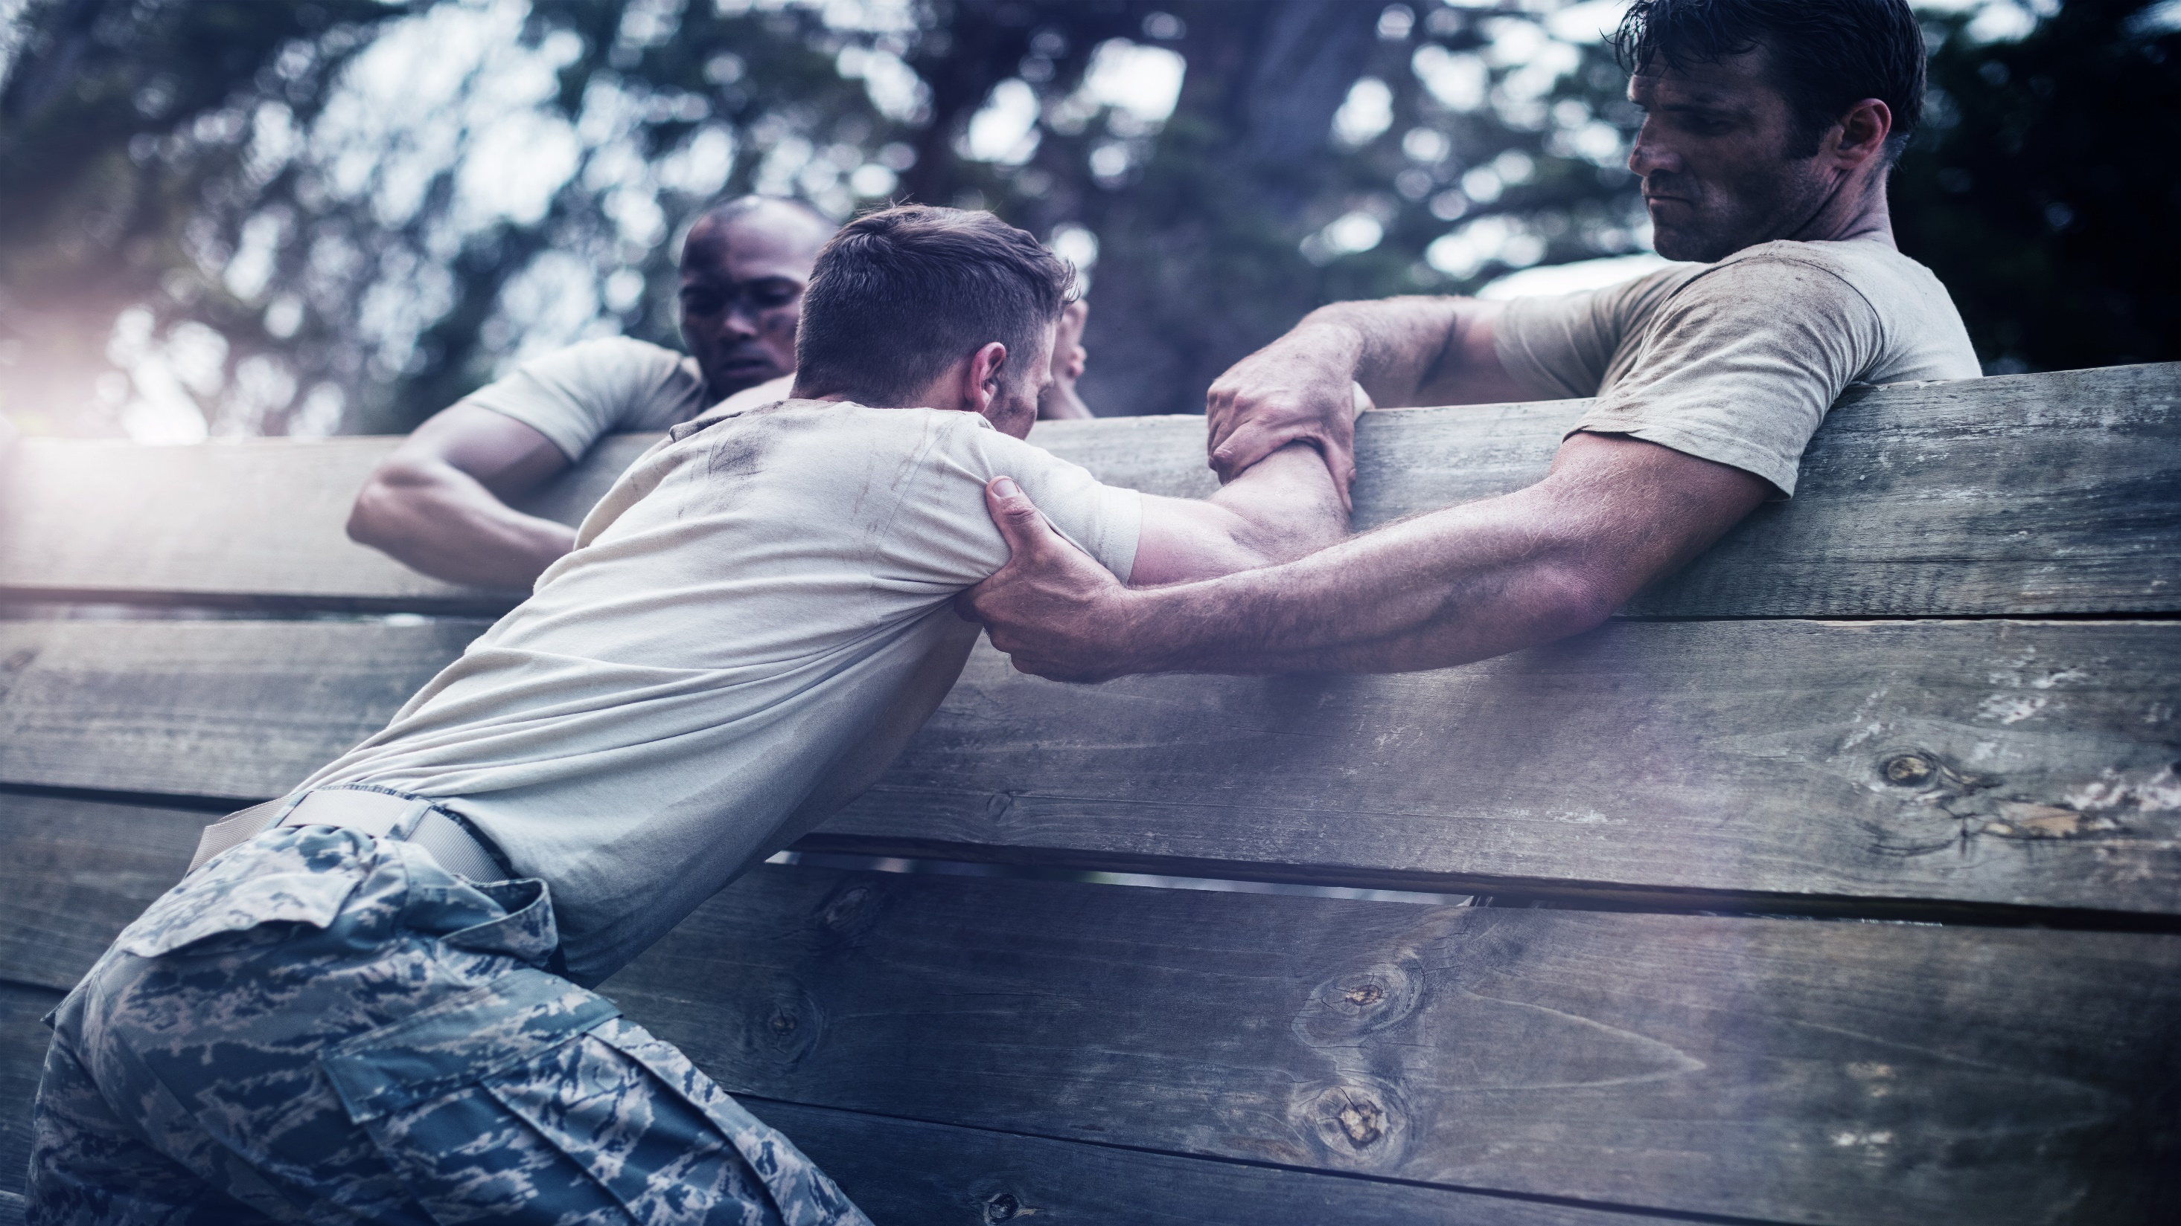
The Watch Stander Program
A community network designed to connect veterans to the resources they need before they slip into crisis
Involves a short on-line learning course to recognize the risk signs of veterans in crisis and how to get them help they need
Other veteran service organizations are our partners; we do not replicate them, but rather direct veterans to them
Anyone can begin the qualification process at www.thefirewatch.org/watch-standers

Slide 9
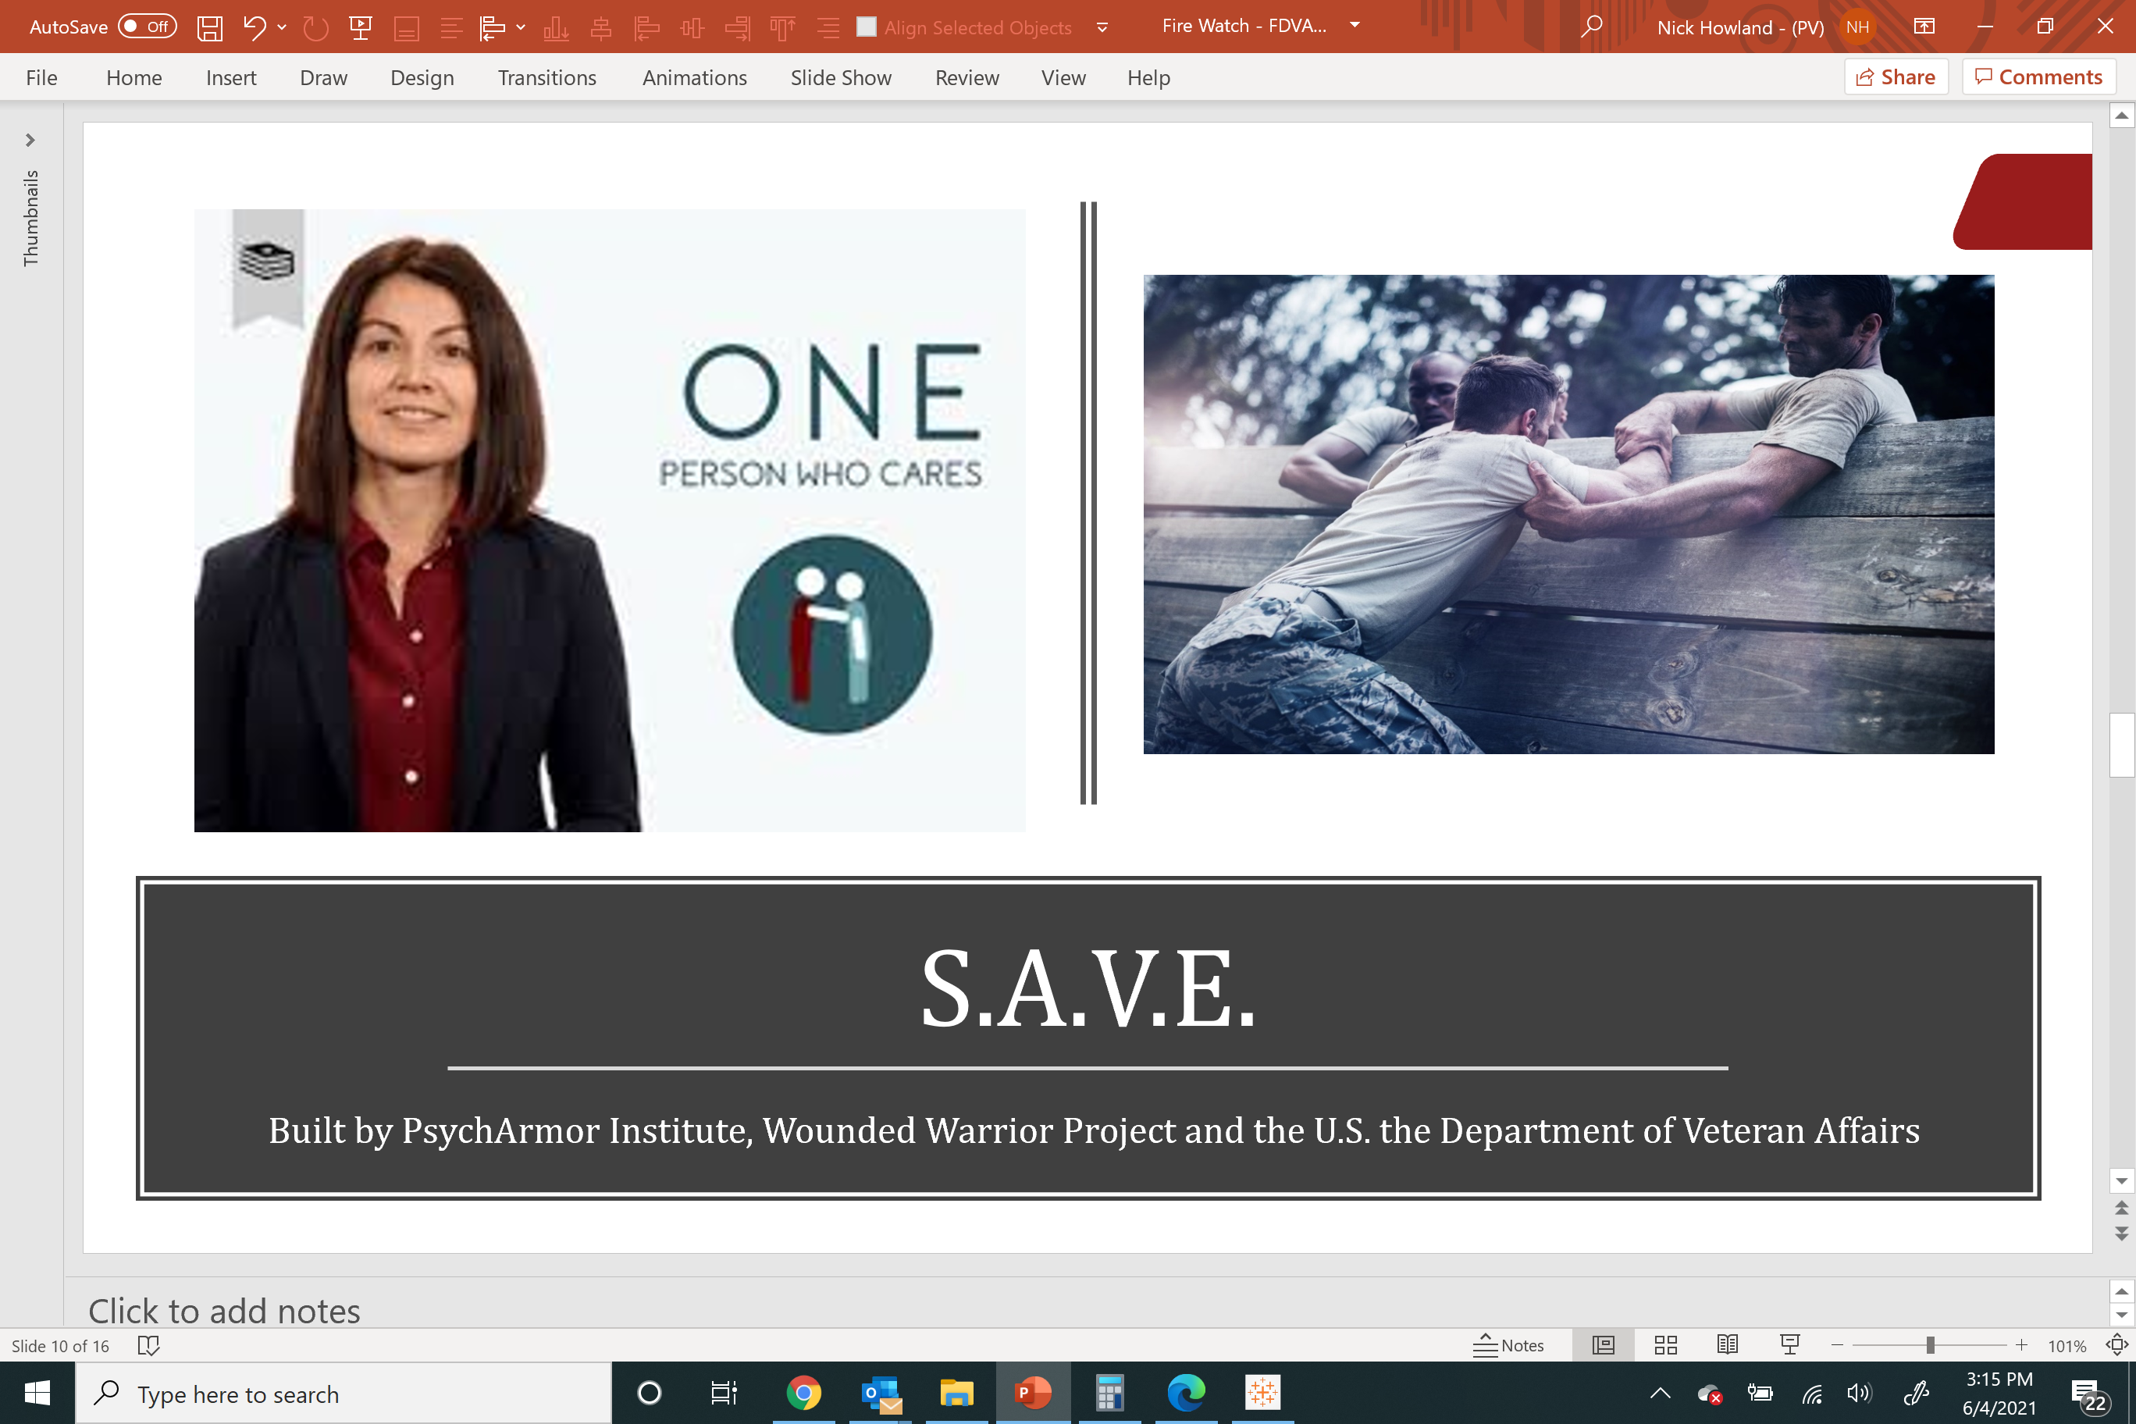
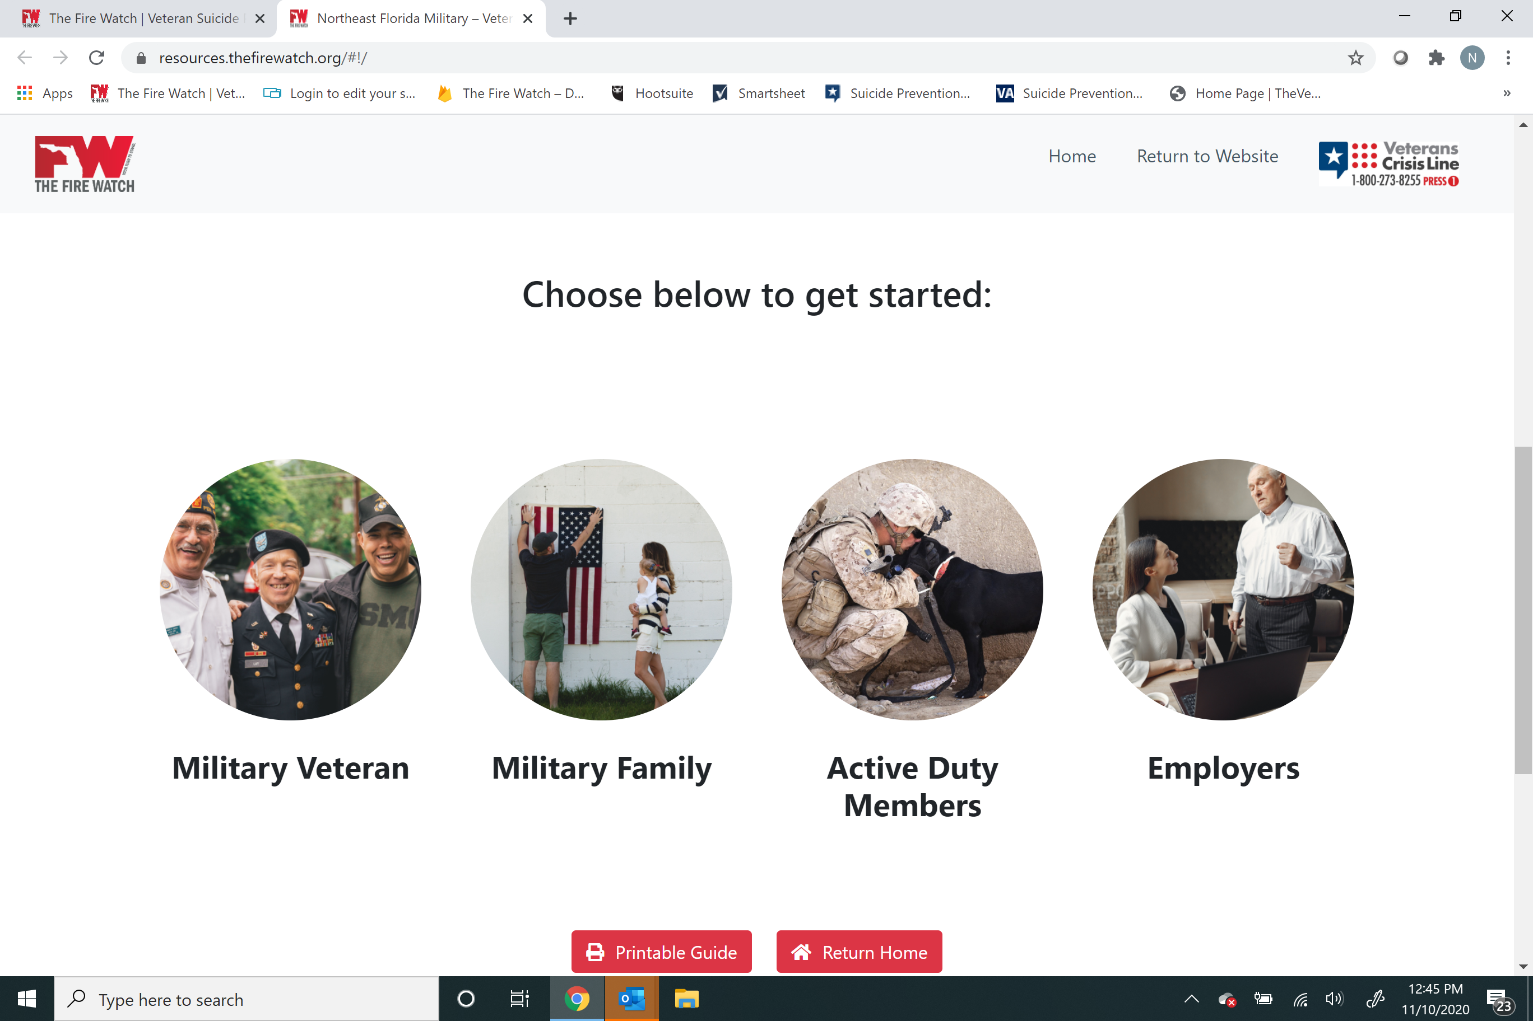
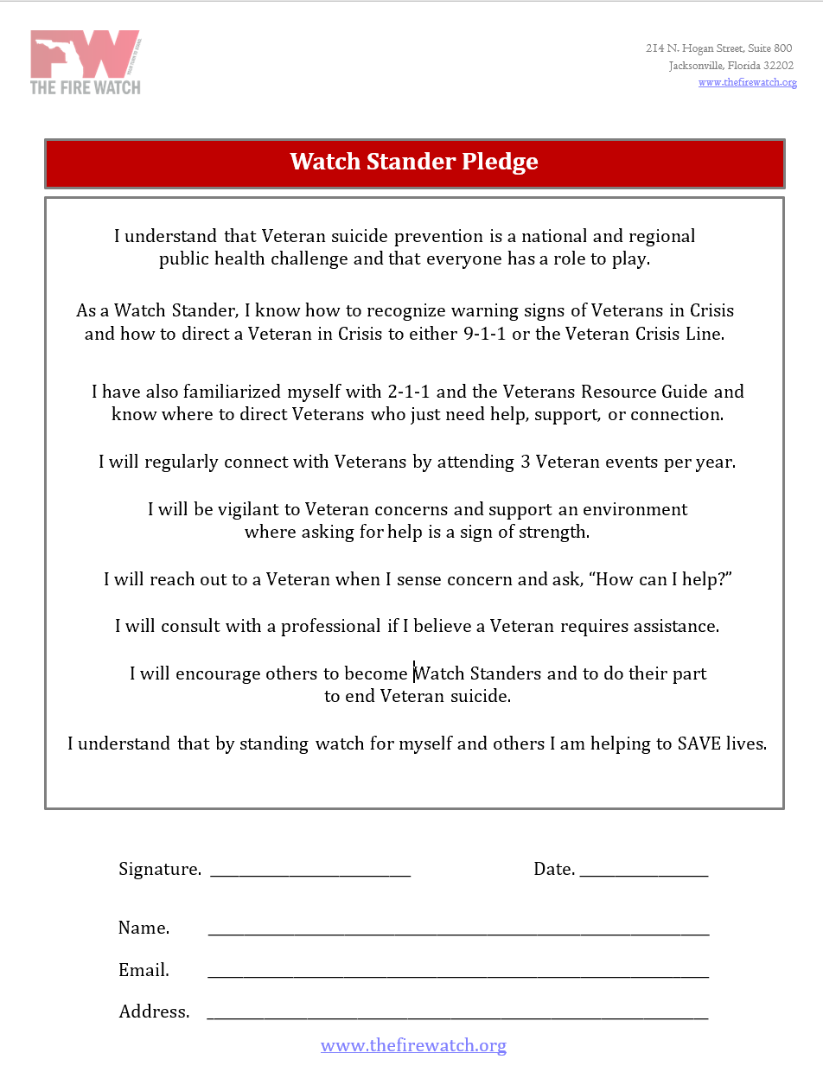
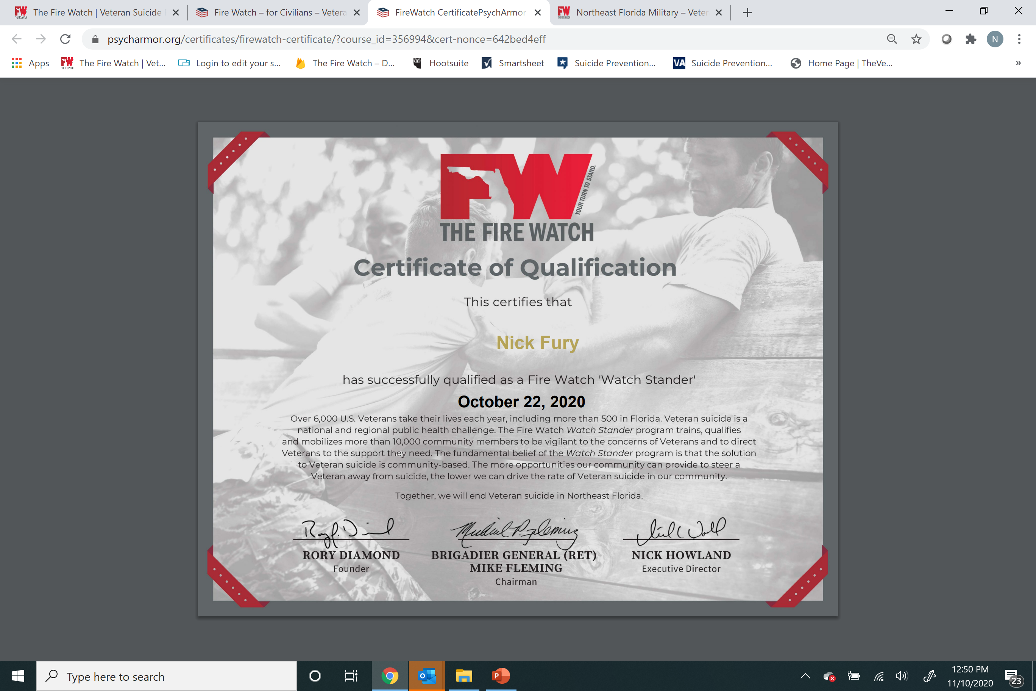
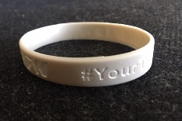
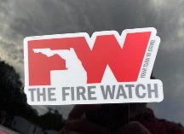
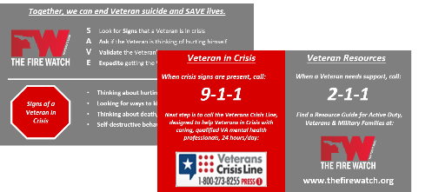
Watch Stander Qualification
Watch S.A.V.E.
Explore the Guide
Sign the Pledge
Stand Watch

Slide 10

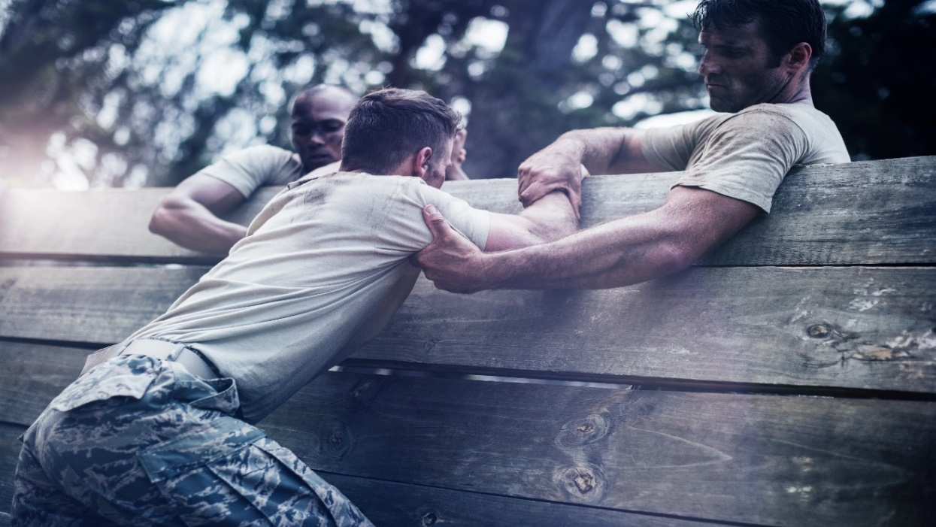
S.A.V.E.
Built by PsychArmor Institute, Wounded Warrior Project and the U.S. the Department of Veteran Affairs

Slide 11
Veteran Resources Guide
Watch Standers can get veterans the help they need before they slip into crisis
Visit the Veterans Resources Guide for a full list of no-cost/low-cost resources for veterans and families
  Northeast Florida Veterans Resources Guide
Developed with multiple community partners and hosted by The Fire Watch
Veterans can also call 2-1-1 to speak with a live counselor with access to the same resources

Slide 12
Standing Watch
Complete the training on the portal
  Print and hang your certificate
  Explore other PsychArmor courses
If you provided us an address, look for your Watch Stander package in the mail
  Display the sticker prominently
  Wear the wrist band proudly
  Keep the wallet card handy
Be vigilant to the concerns of veterans
Attend 2 - 3 veteran events per year
Encourage others to join the Watch

Slide 13
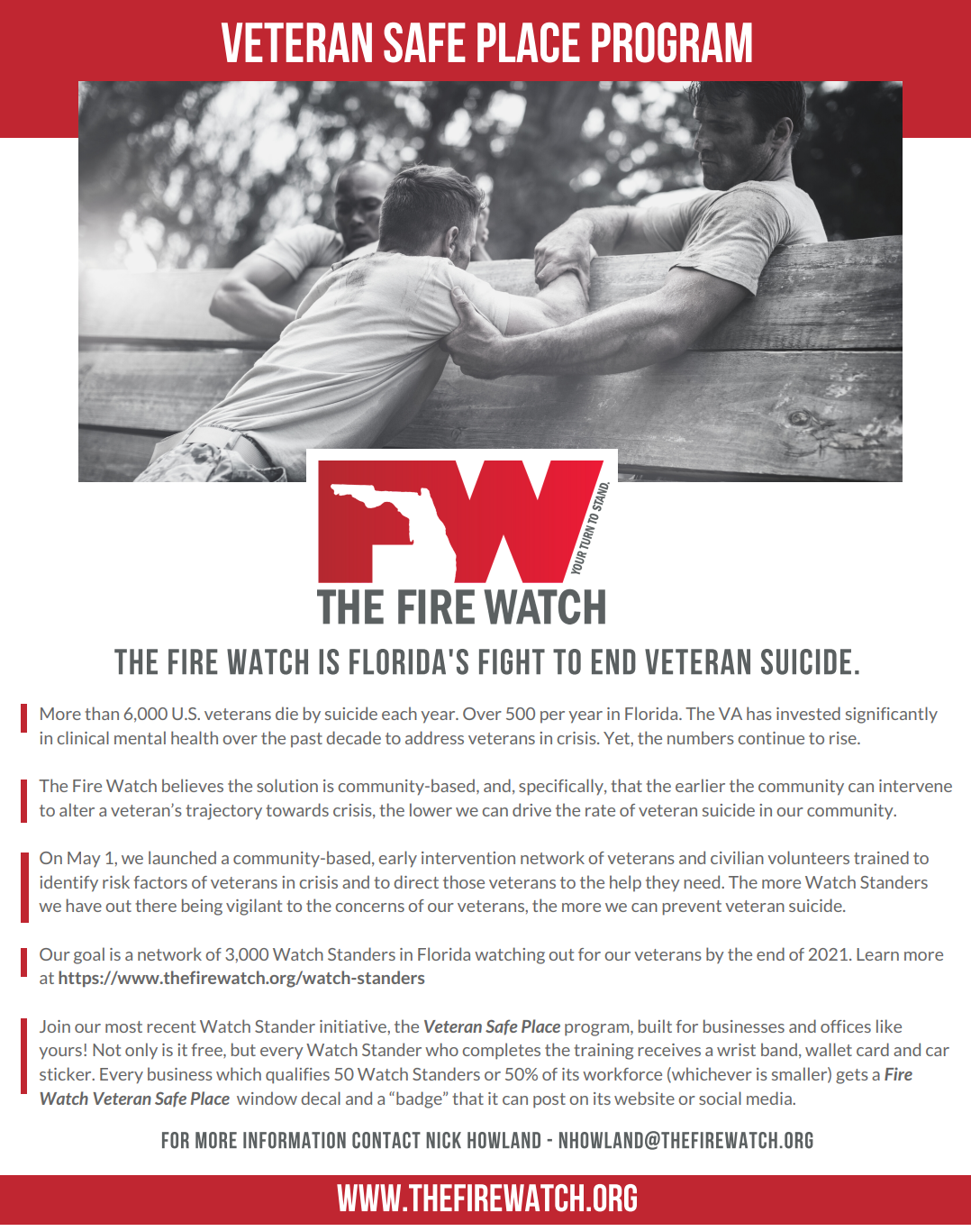


Slide 14
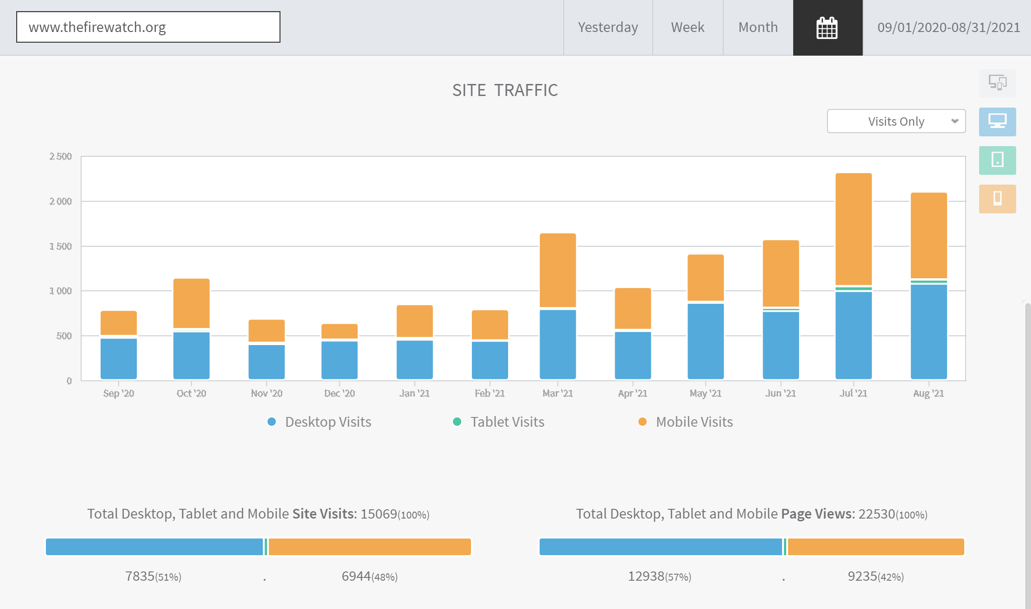
Metrics (as of Sept 1)
The Fire Watch
Page Views (LTM)
22,530
App Users
744
Veteran Resources
401
Watch Standers
1,251

Slide 15
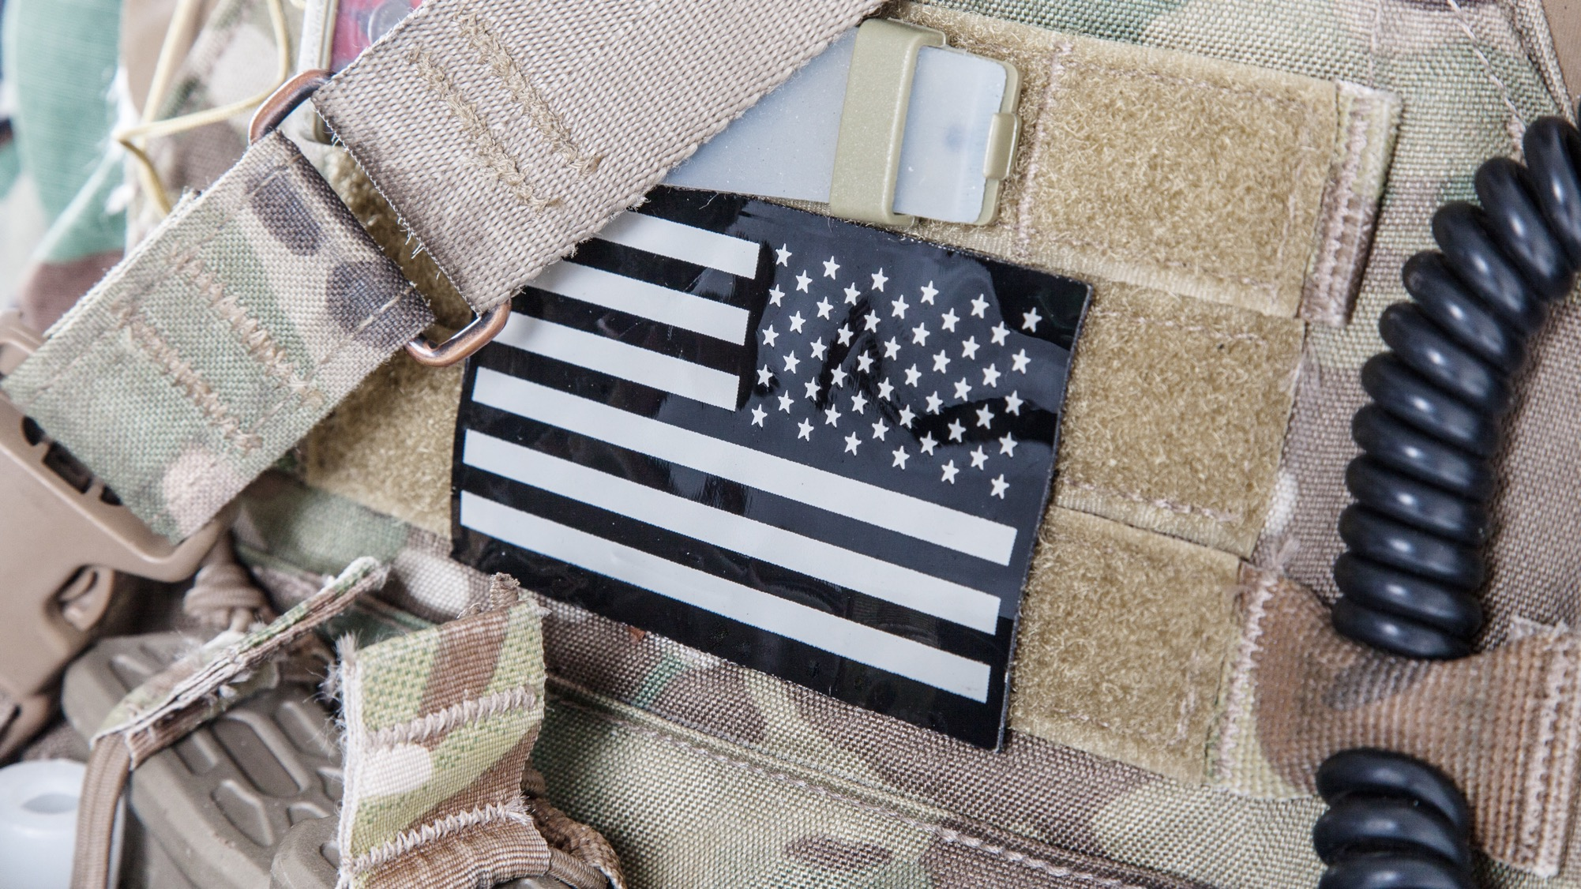

Together, we will end veteran suicide.
info@thefirewatch.org
904.834.9420
#YourTurnToStand

