Slide 2
Who We Are
Established by the Florida Legislature in 2008
Direct Support Organization of Florida Department of Veterans’
Affairs (FDVA)
501(C)(3) Nonprofit - Accountability
Independent Audit ▪ FDVA statutory oversight ▪ 990 forms are on HelpFlVets.org.
FVF is registered with the Florida Department of Agriculture & Consumer Resources.

Slide 3
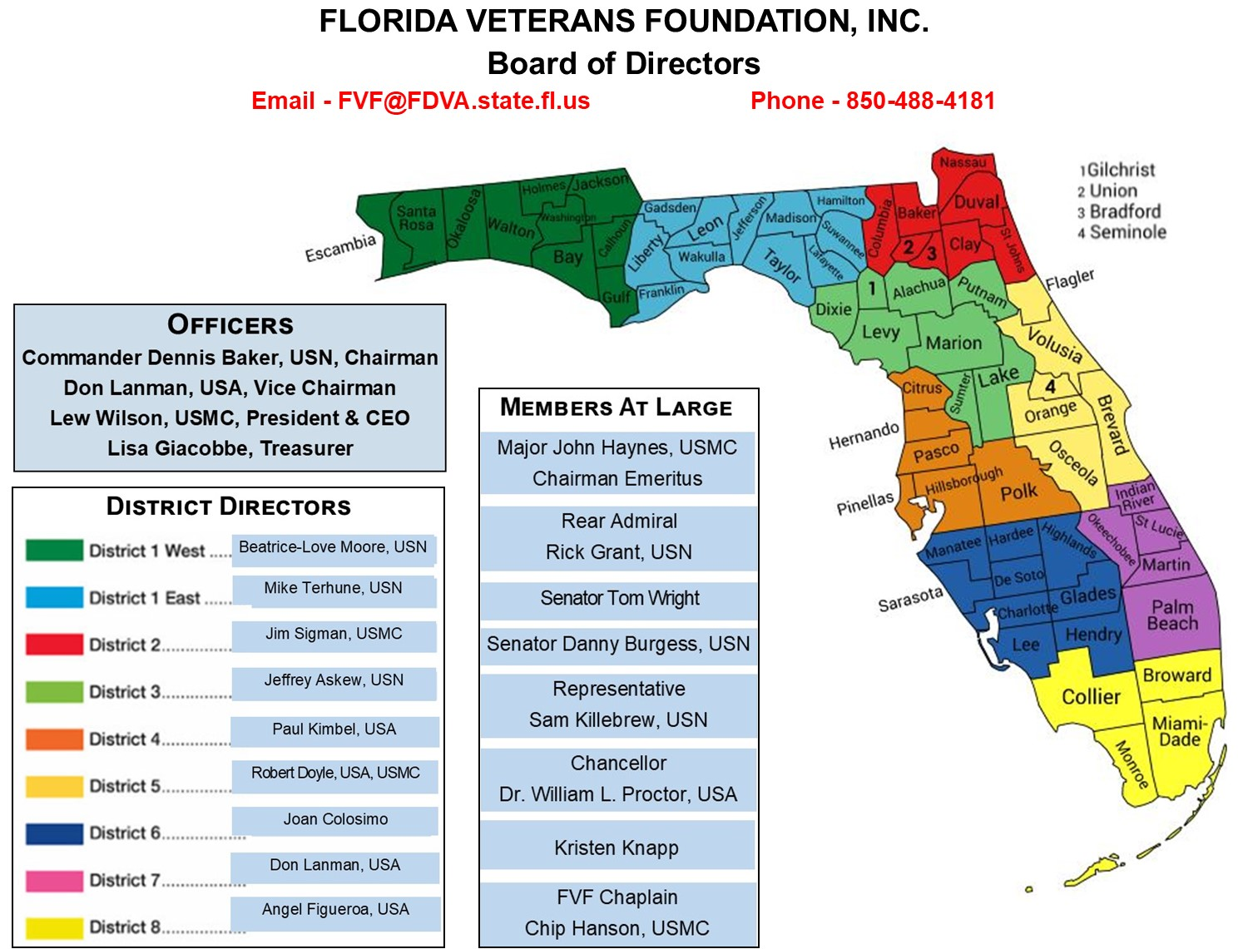
Serving Florida Veterans

Slide 4
Serve All Florida Veterans
Represents Nearly 1.5 million Veterans PLUS their Survivors & Families All Branches of Service and All Service Eras
World War II • Korea • Vietnam • Cold War • Global War on Terror
28,000 Florida Veterans Monthly
Florida Veteran’s Council
375 Florida Veterans Service Organizations (VSO’s)
67 Counties - 135 CVSO’s
Provides Education & Relief Resources to Florida Veterans
Partnerships (DAV, Project Vet Relief, NAVF, BALS, CCTB)

Slide 5
Programs

Slide 6
Finding Unidentified Veterans Enhances Services
Estimated 200,000 to 300,000 Unidentified Veterans in FLA
Veteran Already Receiving Treatment - Shifts to VA Dollars
Enhanced Database Increases Federal Dollars & Services/Med Persons
Improved Database Identifies & Enables Faster Intervention Strategies
Helps Automate Relationships to Veterans & Needed Services
Future Dollars Budgeted & Spent on Positive Outcomes
Presentations to Every possible place to find Veterans

Slide 7
Suicide Prevention, Opioid Addiction & Mental Health Issues

Slide 8
Veterans in Emergency Crisis
Suicide Prevention, Opioid Addiction
& Mental Health Issues
Collaboration of “Emergency Crisis Hotlines” Crisis Centers
Beginning with the CCTB, Heroes Mile, FireWatch, and more
Veterans in Crisis

Slide 9
www.MyFloridaLegal.com
Fraud Prevention & Protection
1(866) 9NO-SCAM
COMMON SCAMS
Identity Theft - Debt and Credit - Housing - Charities -
Automobiles
Other Scams
Florida Toll Free - Fraud Hotline 1-866-966-7226
Florida Veterans Legal Helpline
Applicants receive free legal advice and referrals. Must be a veteran living in Florida.
Housing, Credit, Employment & Family Matters
1-866-486-6161

Slide 10
Fraud Prevention
www.800HelpFla.com or 1-800-Help-Fla (435-7352)
Scams and Fraud

Slide 11
Aging Wartime Veterans & Survivors
Aging Veterans Benefits
Pension Plus Aid & Attendance (A&A)
20,000 Veterans X $50,000 (Average Benefit)
= $1,000,000,000 In Benefits
At NO COST TO THE VETERAN!
Claims Partners Helped Veterans Claim

Slide 12
www.HelpFLVets.org Resources
VA Survivors & Burial Benefits Kit

Slide 13
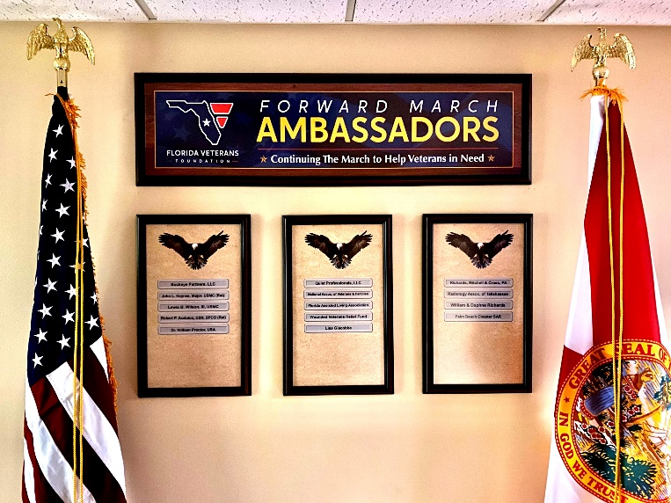
www.HelpFLVets.org
Foundation Support
Donations • Ambassadorships • Grants • Local Fundraisers
Donate to Honor A Veteran
Donate
In Memory Of
Donate Online: www.HelpFLVets.org or
Call Lew Wilson @ 850-590-3830
Email: Lew@HelpFLVets.org

Slide 14
HOW WE CAN TEAM
Collaborate to Help Get Word Out Help to find Aging Veterans/Survivors
Help to find all Veterans for VA Benefits Like us on Facebook & Twitter
Refer us to others

Slide 15
Volunteer
Donate
Support
Lew Wilson
850-488-4181
Extension 1
www.HelpFLVets.org
Email
FVF@FDVA.State.FL.Us

